Slide 1
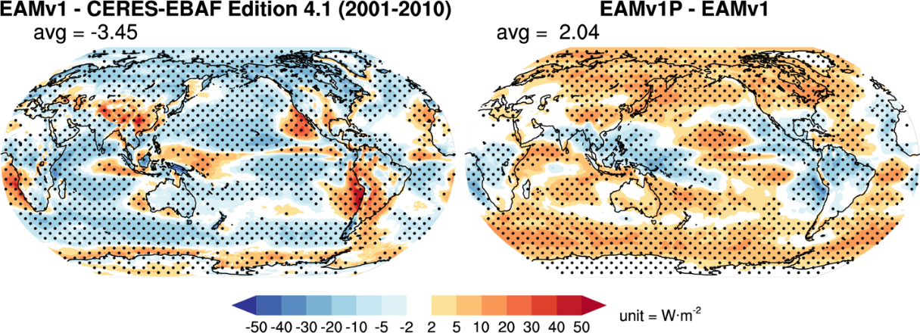
Better Calibration Leads to a Significant Improvement in Model Fidelity
Objective
Improve the fidelity of the Energy Exascale Earth System Model Atmosphere Model version 1 (EAMv1).
Approach
Focus on a subset of skill metrics related to cloud processes rather than the standard dozen metrics.
Compare results from incremental changes to cloud microphysics, turbulent mixing, deep convection, and subgrid effects to understand how assumptions in the representation of these processes affect different aspects of the simulated atmosphere and its response to forcings.
Impact
The recalibration led to significant improvements to the simulated clouds and precipitation.
Improving clouds across meteorological regimes also improves other aspects of the model.
The recalibrated model exhibits lower sensitivity to aerosol perturbation and surface warming for both clouds and precipitation.
This work addresses significant, common, and long-standing cloud biases in Earth system models.
Ma, P.-L., Harrop, B. E., Larson, V. E., Neale, R. B., Gettelman, A., Morrison, H., et al. “Better calibration of cloud parameterizations and subgrid effects increases the fidelity of the E3SM Atmosphere Model version 1.” Geosci. Model Dev., 15(7), 2881-2916, (2022). [DOI: 10.5194/gmd-15-2881-2022]
The difference in cloud radiative effects between the default model EAMv1 and observations (left) and EAMv1 and the recalibrated model EAMv1P (right). This figure shows that recalibration significantly reduces the cloud biases in the original model.
Notes:
http://www.pnnl.gov/science/highlights/highlights.asp?division=749

