Slide 1
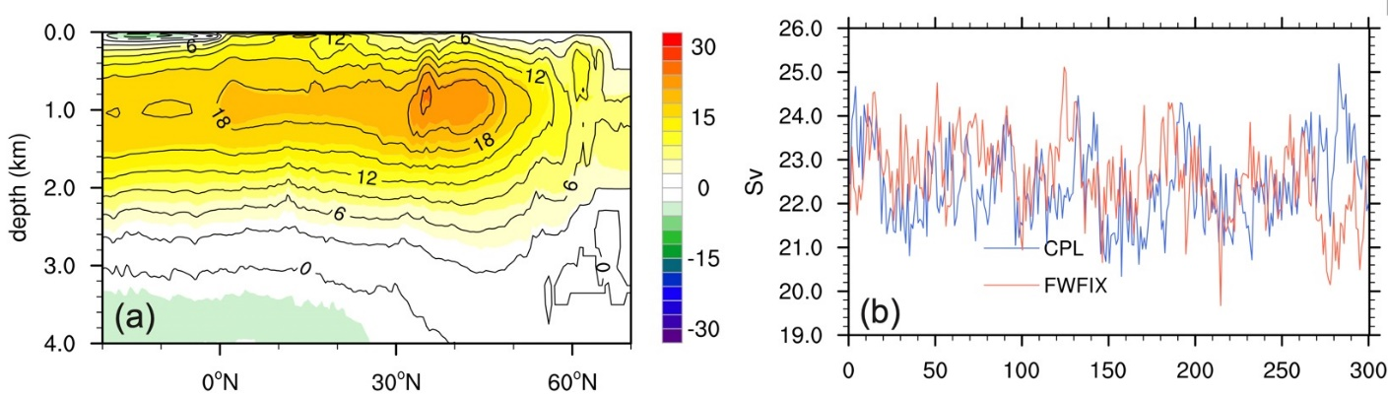
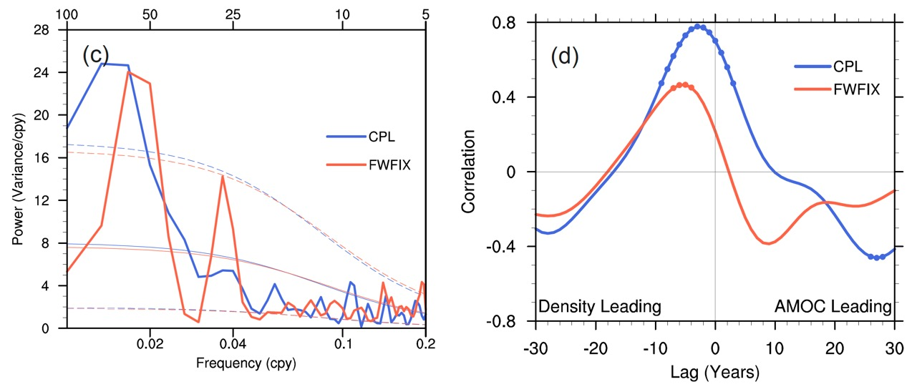
Freshwater Flux Feedback Lengthens Atlantic Meridional Overturning Circulation Variability
Objective
Unravel the effect of freshwater flux variability on the life cycle of the Atlantic meridional overturning circulation (AMOC) low-frequency variability.
Approach
Purposefully design experiments with a fully coupled climate system which can disable the coherence of freshwater flux with the dynamic and thermodynamic ocean processes.
Perform lead-lag regression analysis to unveil the underlying mechanism behind changes in AMOC periodicity.
Use salinity and heat budget analysis to extract the causal factors.
Impact
Changes in surface freshwater flux lengthens the period of AMOC variability.
Salinity anomalies play a more cooperative role with temperature-induced density anomalies when freshwater flux feedback is active. They help extend the duration of deep convection over the Labrador Sea and the period of the low-frequency AMOC variability.
Both local and remote effects of freshwater flux are important in modulating AMOC low-frequency variability.
Frequency (yr⁻¹)
(a) and (b) compare the mean AMOC and its variability between the original coupled run (CPL) and the fixed seasonal freshwater flux run (FWFIX); (c) illustrates the modification of the AMOC spectrum by the interactive freshwater feedback, which tends to boost the energy and extend the AMOC period at low-frequencies; and (d) the correlation between density over Labrador Sea and the AMOC index, showing more persistent density forcing for AMOC variability in the naturally coupled run.
Liu, F., J. Lu, Y.-O. Kwon, C. Frankignoul, and Y. Luo. .“Freshwater flux variability lengthens the period of the low-frequency AMOC variability,” Geophysical Research Letters, 49(20), e2022GL100136 (2022). [DOI: 10.1029/2022GL100136]

