Slide 1
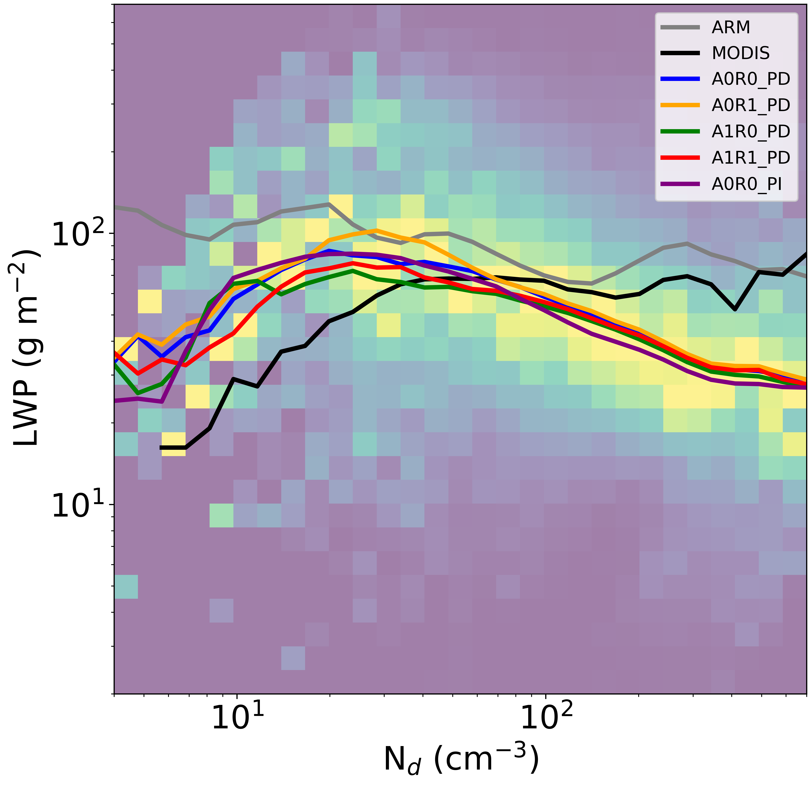
Characterizing Aerosol Effects on Modeled Cloud Lifetimes Using a Novel Framework
Objective
Systematically and objectively evaluate aerosol and cloud properties in the Energy Exascale Earth System Model (E3SM) using a new Lagrangian framework for tracking clouds that can quantify the aerosol-cloud interactions, such as precipitation suppression and other rapid adjustments, that control aerosol cloud lifetime effects.
Approach
Evaluate aerosol-cloud interactions in E3SM from the ground-based Atmospheric Radiation Measurement user facility observations, A-train and geostationary satellite retrievals, from several thousand trajectories that pass through Graciosa Island.
Impact
Unlike most other Earth system models, E3SM can capture the liquid water path–droplet number concentration (LWP-N_{d} ) relationship (showing an increase in LWP at low N_{d} and a decrease in LWP at higher N_{d}). E3SM shows skill in its representation of aerosol-drizzle suppression.
E3SM can also successfully simulate enhanced droplet concentrations from elevated pollution that can last for several days.
Despite these successes, modifying the warm rain process representations do not affect the LWP-N_{d} relationship. In addition, polluted clouds are not thick enough.
These findings provide insights into model strength and weakness, which are useful for model development efforts to improve cloud controlling processes such as cloud top entrainment in order to deliver the correct amount of cooling potential through aerosol-cloud interactions.
clean
polluted
Multiple types of observations are used in a Lagrangian framework to evaluate aerosol-cloud interactions in E3SM simulations. Researchers find little sensitivity to different cloud-to-rain water rate experiments, suggesting that further refinement is needed.
Christensen, M. W., Ma, P.-L., Wu, P., Varble, A. C., Mülmenstädt, J., and Fast, J. D. “Evaluation of aerosol–cloud interactions in E3SM using a Lagrangian framework,” Atmos. Chem. Phys., 23, 2789–2812 (2023). [DOI: 10.5194/acp-23-2789-2023].

