Slide 1
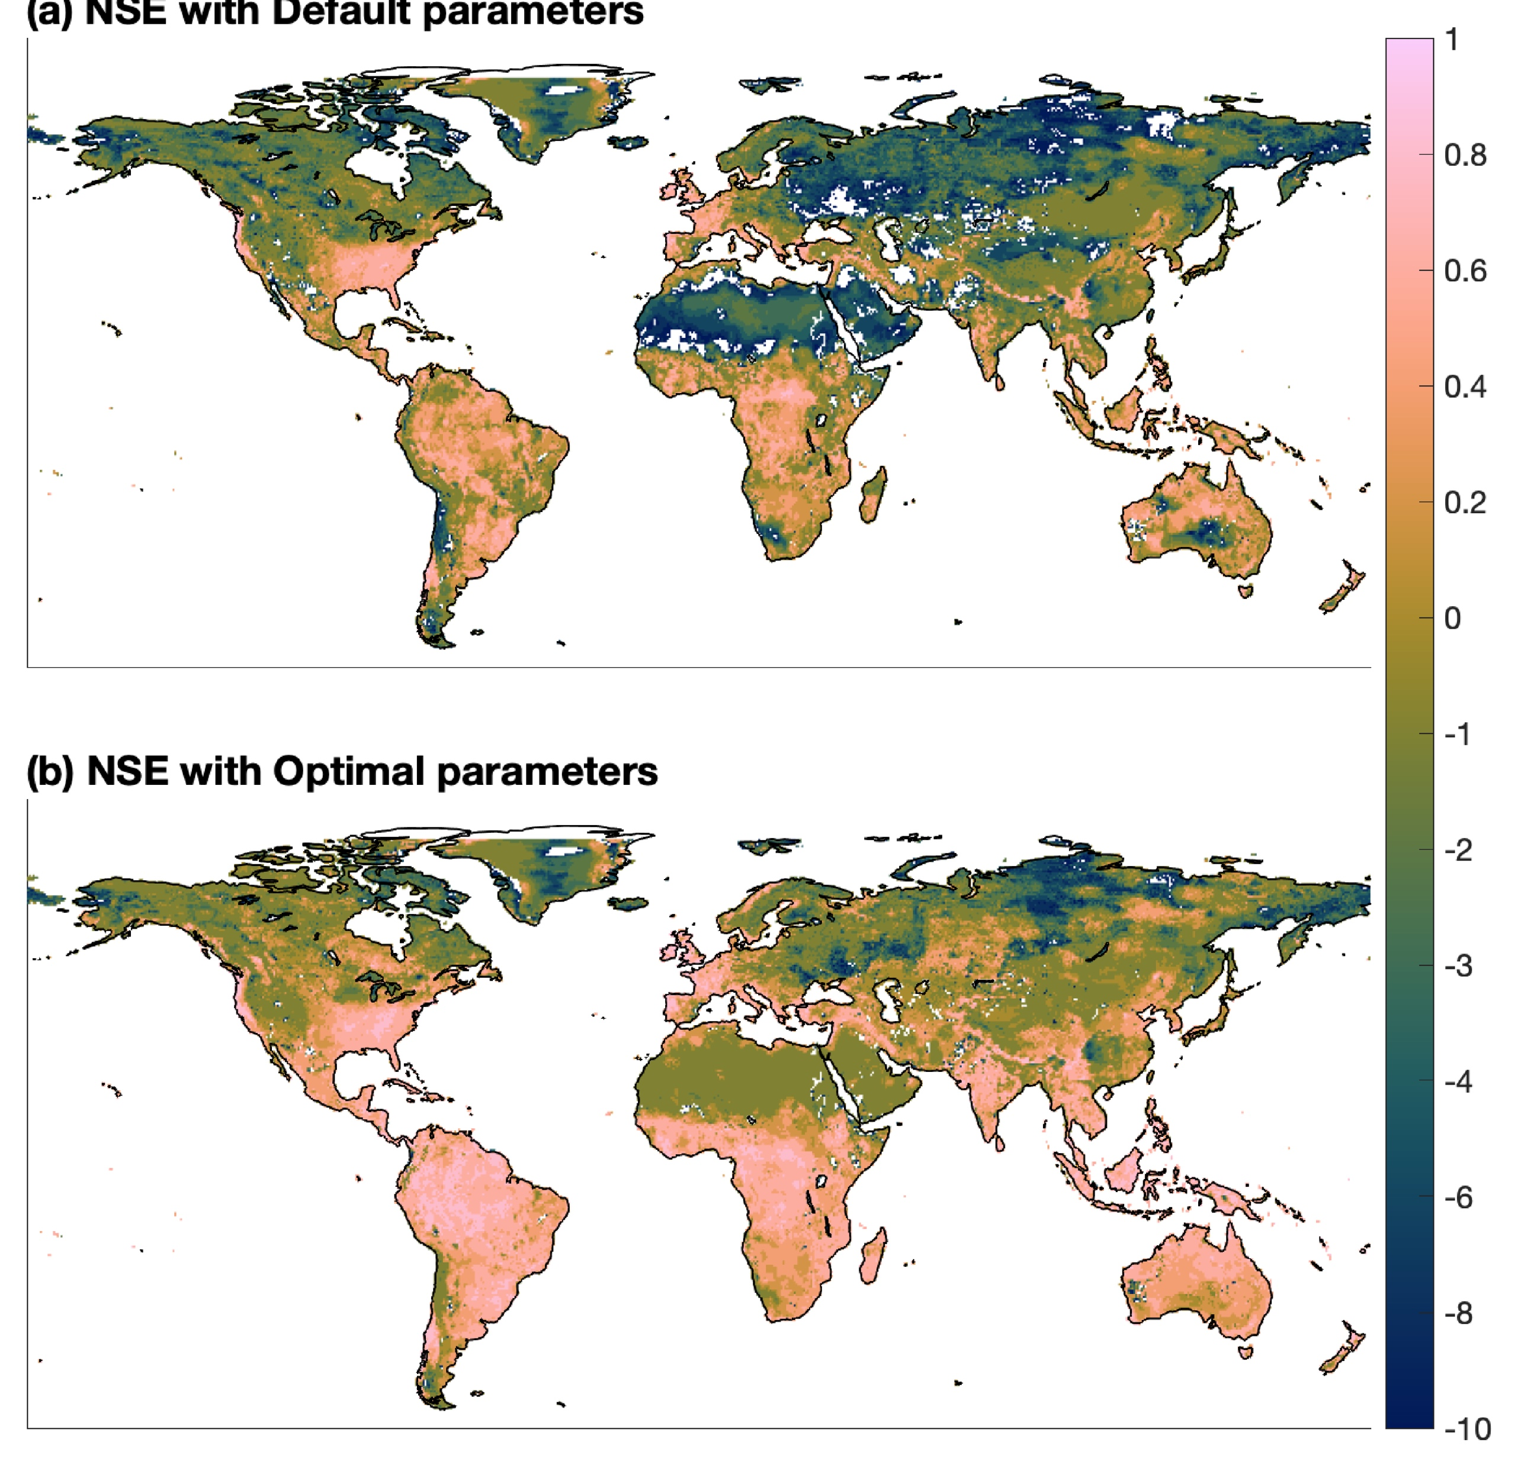
Calibrating a Runoff Generation Scheme at Global Scale
Objective
Calibrate the Energy Exascale Earth System Model (E3SM) runoff generation process at global scale with an efficient uncertainty quantification framework and evaluate the associated parametric uncertainty.
Approach
Construct a computationally efficient polynomial-based surrogate for E3SM-simulated runoff.
Implement sensitivity analysis to identify the most sensitive parameters.
Use a Bayesian method to infer the parameter posteriors.
Impact
A new, computationally efficient calibration framework enables Earth system models to more accurately represent runoff at a global scale.
The parametric uncertainty of the runoff process is significantly reduced after calibration.
This framework can be used for any other large-scale model calibrations.
(a). Evaluation metric with default parameters
High
performance
(b). Evaluation metric with calibrated parameters
Low performance
Evaluation of runoff simulations for 1991 – 2010 at grid level with default and calibrated parameters using the Nash-Sutcliffe mode efficiency metric. The calibrated parameters produce substantially higher performance across the globe, shown by the generally higher numbers.
Xu, D., Bisht, G., Sargsyan, K., Liao, C., and Leung, L. R. “Using a surrogate-assisted Bayesian framework to calibrate the runoff-generation scheme in the Energy Exascale Earth System Model (E3SM) v1.” Geosci. Model Dev., 15, 5021–5043, (2022). [DOI: 10.5194/gmd-15-5021-2022].
Notes:
http://www.pnnl.gov/science/highlights/highlights.asp?division=749

