Slide 1
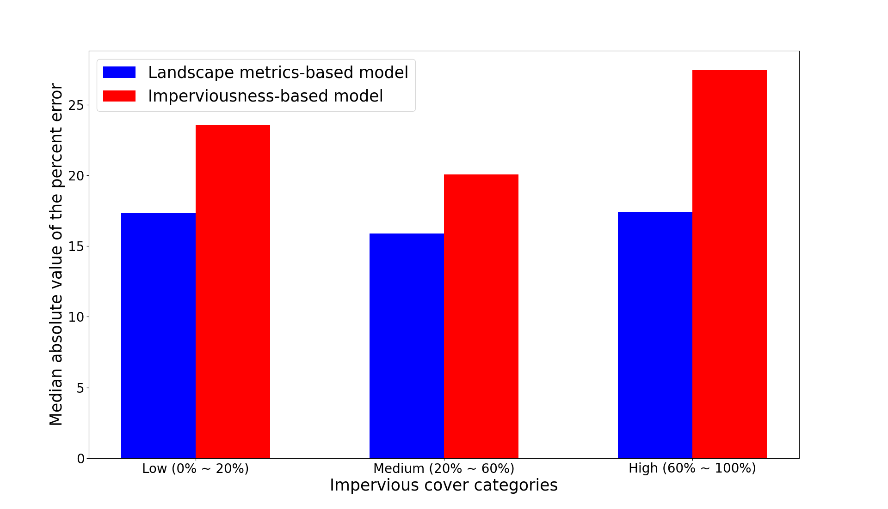
Landscape Metrics Play a Role in Population Downscaling
Objective
Temporally-rich, high-resolution population data is beneficial to many research fields, including demography, urban planning, disaster prevention, and environmental modeling. This study explores the accuracy and feasibility of using landscape metrics to achieve high-resolution population downscaling.
Approach
Implement random forest regression models for population downscaling based on landscape metrics derived from the National Land Cover Database impervious cover percentage map.
Compare the accuracy of population downscaling for the landscape metrics-based models with other traditional methods.
Impact
Certain landscape metrics, including landscape shape index, number of patches, and class area, outperform traditional population downscaling methods.
The improved performance of the landscape metrics-based models can be attributed to their ability to capture pixel-level impervious patterns.
Compared to traditional population downscaling methods, landscape metrics are less susceptible to declining performance when moving from regions with high population to low population.
The median absolute values of percent error for a landscape metrics-based model and a baseline model (imperviousness-based model) for different impervious cover categories. The landscape metrics achieve a lower error rate than the baseline model in all the three categories, regardless of urbanization extent.
Wan, H., Yoon, J., Srikrishnan, V., Daniel, B., Judi, D. “Landscape metrics regularly outperform other traditionally-used ancillary datasets in dasymetric mapping of population.” Computers, Environment and Urban Systems, 99, 101899, (2023). [DOI: 10.1016/j.compenvurbsys.2022.101899]

