Slide 1
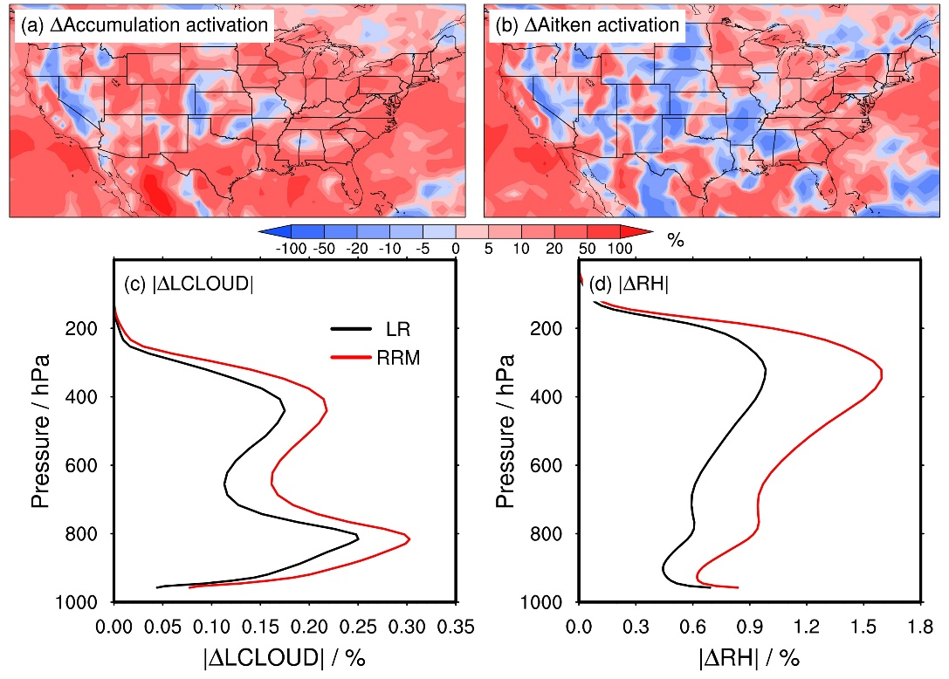
Horizontal Resolution Affects Model Aerosol Properties
Objective
Evaluate the sensitivity of aerosol properties to horizontal grid spacing in the Energy Exascale Earth System Model version 1 (E3SMv1) using the regional refinement approach.
Approach
Run two nudged present-day simulations, one with global unified low-resolution (~100 km) grids (LR) and the other with regional refined high-resolution (~25 km) meshes (RRM) over the contiguous United States.
Compare RRM with LR to examine the resolution sensitivity of various aerosol properties.
Run two corresponding pre-industrial simulations to examine the resolution sensitivity of aerosol-cloud-radiation interactions.
Impact
Provide insights into aerosol parameterization development and its dependence on model horizontal resolution.
Provide a methodology helpful for future studies to investigate the potential impacts of model resolutions on the simulation results.
Spatial distributions of the relative differences in the annual mean vertical-integrated aerosol activation fluxes in large-scale clouds for (a) accumulation and (b) Aitken modes between the RRM and LR simulations. (c) Vertical profiles of the annual regional mean absolute temporal variabilities in the large-scale liquid cloud fractions (|ΔLCLOUD|). (d) The same as panel (c), but for relative humidity (RH). The figure indicates that RRM enhances aerosol activation due to larger |ΔRH| and |ΔLCLOUD|.
Li, J., Zhang, K., Hassan, T., Zhang, S., Ma, P.-L., Singh, B., Yan, Q., and Huang, H.: Assessing the sensitivity of aerosol mass budget and effective radiative forcing to horizontal grid spacing in E3SMv1 using a regional refinement approach, Geosci. Model Dev., 17, 1327–1347, https://doi.org/10.5194/gmd-17-1327-2024, 2024.
Notes:
http://www.pnnl.gov/science/highlights/highlights.asp?division=749

