Slide 1
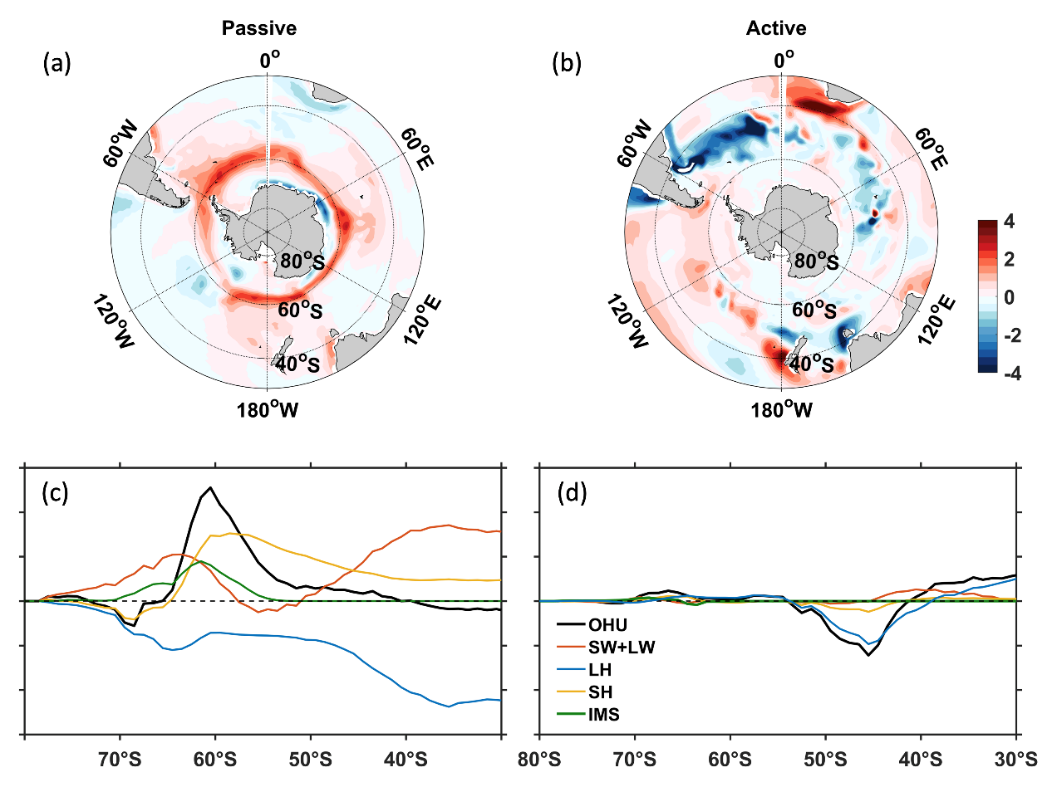
Active Ocean Dynamical Adjustment Plays No Role in Southern Ocean Heat Storage
Objective
Isolate the role of active ocean circulation changes in the Southern Ocean (SO) heat uptake and storage from the role of passive sea surface absorption.
Approach
Take advantage of a set of innovative, partially coupled experiments conducted by Department of Energy scientists to cleanly separate the active ocean effect from the passive ocean effect.
Perform an ocean heat budget analysis and a decomposition of the ocean heat transport into mean and eddy components.
Impact
The active ocean adjustment only “redistributes” heat in the ocean, with little net change in ocean heat storage.
Simulations show that the active ocean heat convergence/divergence achieve an almost perfect heat balance with air–sea fluxes.
The reverse atmospheric heat transport via the Bjerknes compensation mechanism overcompensates for both the active and passive ocean heat transports.
Decomposition of the passive and active ocean heat uptake components. The figures show the dominance of the passive (active) component in the SO heat uptake (shading in a and b, black lines in c and d) over the latitudes poleward (equatorward) of 50°S. In (d), the sum of all the surface flux terms (colored lines) is in good balance with the active ocean heat convergence, leaving little net heat storage in the ocean.
Li, Q, Y. Luo, J. Lu, F. Liu “The Role of Ocean Circulation in Southern Ocean Heat Uptake, Transport, and Storage Response to Quadrupled CO₂,” Journal of Climate, 35, (2022). [DOI: 10.1175/JCLI-D-22-0160.1]
Notes:
http://www.pnnl.gov/science/highlights/highlights.asp?division=749

