Slide 1
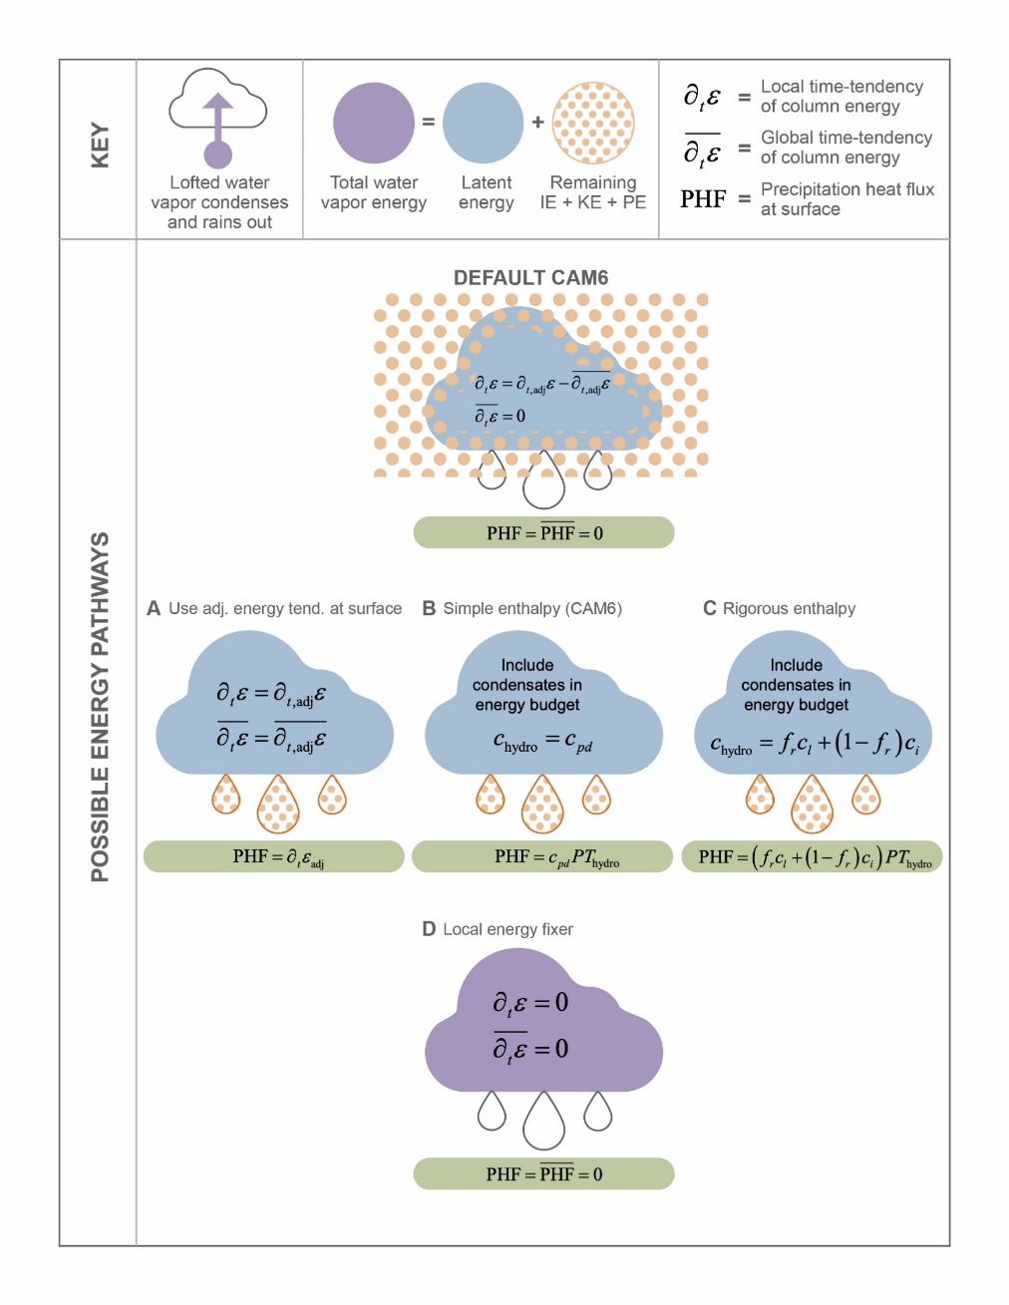
How Model Simplifications Affect the Simulated Water Cycle
Objective
Understand the response of simulated rainfall to assumptions in a model’s energy budget.
Approach
Examine the model’s formulation for energy and describe the regional energy conservation error.
Provide alternative approaches that fix the local energy conservation error.
Test one of these approaches to determine model sensitivity to the moist enthalpy formulation.
Impact
The regional energy budget in Community Atmosphere Model has a large, spurious term related to simplifying assumptions in the energy budget. This is problematic as regional energy budgets are important for understanding water cycle responses to forcing.
Identified and examined proposed pathways that would enable removing the spurious term and provide a more rigorous formulation of moist enthalpy.
B.E. Harrop, M.S. Pritchard, H. Parishani, A. Gettelman, S. Hagos, P.H. Lauritzen, L.R. Leung, J. Lu, K.G. Pressel, and K. Sakaguchi, “Conservation of dry air, water, and energy in CAM and its potential impact on tropical rainfall.” Journal of Climate 35, 9 (2022). [DOI:10.1175/JCLI-D-21-0512.1]
Four potential fixes to the imbalance between atmospheric heating and surface fluxes with varying levels of realism are proposed.
Notes:
http://www.pnnl.gov/science/highlights/highlights.asp?division=749

