Slide 1
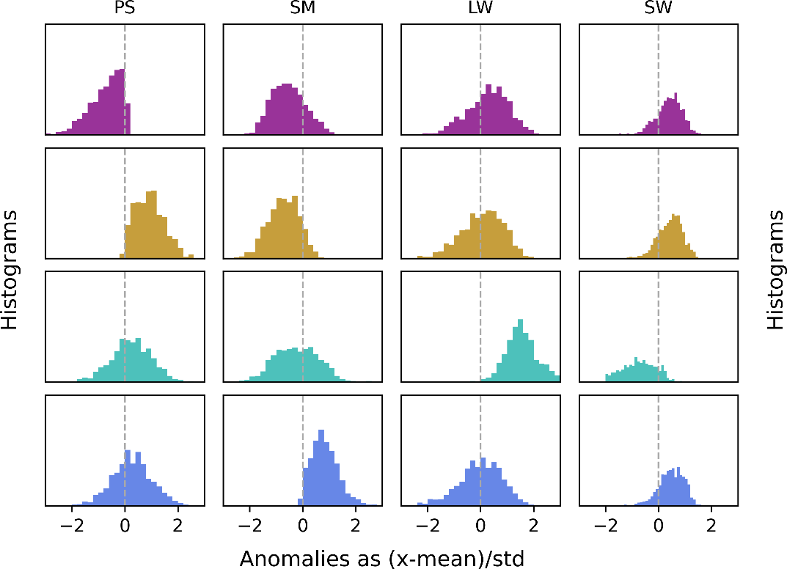
Wildfire Typing Improves Wildfire Predictions in the Western United States
Objective
Understand the antecedent hydro-meteorological conditions (AHCs) before wildfire ignition in the Western U.S. for potential improvement of wildfire prediction.
Approach
Analyzed observed wildfires using hydro-meteorological data from a regional storm-resolving simulation for 1984–2018.
Clustered wildfires based on their AHCs and analyzed their connections to environmental conditions through regression and prediction models.
Impact
Identified four types of wildfires with unique AHCs.
Revealed stronger environmental connections of each wildfire type with wildfire occurrence at seasonal scale compared to treating wildfires as a whole.
Demonstrated better wildfire predictability in two areas: most lightning-ignited wildfires fall into the longwave radiation type and wet soil wildfires often show opposite environmental correlations.
Wildfires in the Western U.S. show four types of distinct hydro-meteorological conditions. From top to bottom: one type features lower surface pressure (PS); one type features higher surface pressure; one type features intense longwave radiation (LW); one type features wetter near-surface soil (SM). These wildfire types also exhibit stronger connections to the regional hydro-meteorological conditions at seasonal scale, providing opportunities for improved regional wildfire predictions.
Chen, X., Leung, L. R. & Dong L., Antecedent hydrometeorological conditions of wildfire occurrence in the western U.S. in a changing climate. J. Geophys. Res.: Atmos. 128, e2023JD039136 (2023). [DOI: 10.1029/2023JD039136]
Notes:
http://www.pnnl.gov/science/highlights/highlights.asp?division=749

