Slide 1
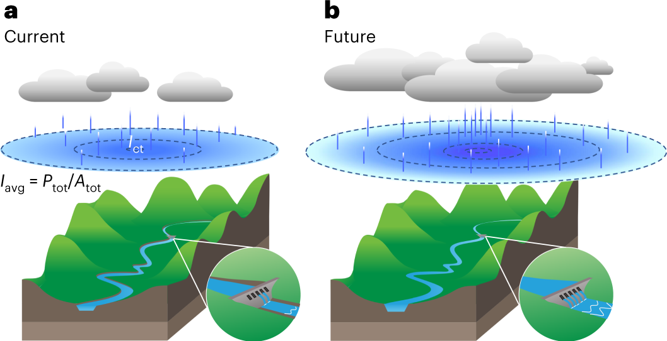
Future Sharpening of Winter Storms in the Western United States
Objective
Understand future changes in Western U.S. storm characteristics and their implications for flood risk and water resources management.
Approach
Conduct regional storm-resolving simulations for two periods, historical and future mid-century, under a high emissions scenario.
Track simulated storm events and evaluate storm spatial structure metrics (precipitation volume, area, and peak intensity).
Analyze how future warming affects the storm structure.
Impact
Identified a robust, ~31% increase in future storm precipitation by mid-century.
Decomposed the precipitation volume increase into contributions from increase in storm size (~22%) and mean intensity (~9%).
Revealed a storm-sharpening effect, with a larger increase in storm center intensity (~19%) compared to the mean intensity increase.
Future changes in storm spatial structure will challenge water infrastructure design and resource management.
Current and future winter storm characteristics in the Western United States. Compared to storms in the current climate (a), future storms (b) exhibit a 22% increase in spatial extent and a 9% increase in average intensity. This results in a 31% increase in total precipitation volume. The intensity near the storm center (+19%) increases faster than the overall average intensity (+9%), causing a spatial concentration of precipitation toward the storm center known as storm sharpening.
Chen, X., Leung, L. R., Gao, Y., Liu, Y. & Wigmosta, M. “Sharpening of cold-season storms over the western United States,” Nature Climate Change 13, 167–173 (2023). [DOI: 10.1038/s41558-022-01578-0]
Notes:
http://www.pnnl.gov/science/highlights/highlights.asp?division=749

