Slide 1
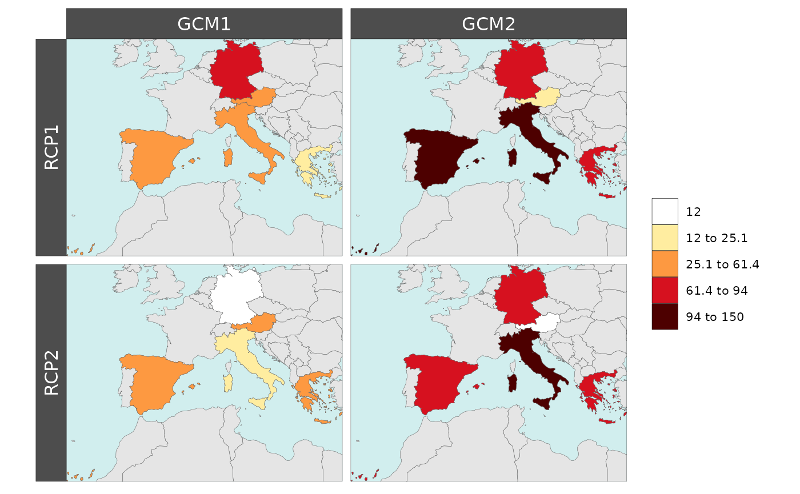
Creating Customizable Maps for Comparisons Across Scenarios, Years, And Data Classes
Objective
Help users with limited to no geographic information system (GIS) knowledge use R to spatially visualize tabular data.
Approach
Automatically plot user-provided simple tables onto relevant maps.
Pre-load rmap with a growing collection of country, state, river basin, and other customized maps that can be added based on user needs.
Automatically recognize regions, data classes, years, scenarios to create relevant difference maps that show changes across time, regions, and scenarios.
Impact
Most multi-sector dynamics research involves the evolution of spatio-temporal parameters. rmap allows users to visualize changes across time, space, and scenarios without GIS knowledge, saving time and effort across projects while visually highlighting key messages.
rmap has already been used in several publications to highlight key messages through maps showing spatio-temporal changes in various socio-economic and climate variables such as runoff, electricity demand, land use change, agricultural yields and investments over time.
rmap provides the global modeling community with a new tool to easily create highly customizable maps based on simple tabular data without prior GIS knowledge. This figure shows an example of plotting hypothetical data for several countries in the European Union compared across four different hypothetical climate scenarios. This can be achieved with only a few lines of code in rmap .
Khan, Z., Zhao, M., Vernon, C.R., Wild, T. and Yarlagadda, B. “rmap: An R package to plot and compare tabular data on customizable maps across scenarios and time.” Journal of Open Source Software, 7(77), 4015 (2022). [DOI: 10.21105/joss.04015]

