Slide 1
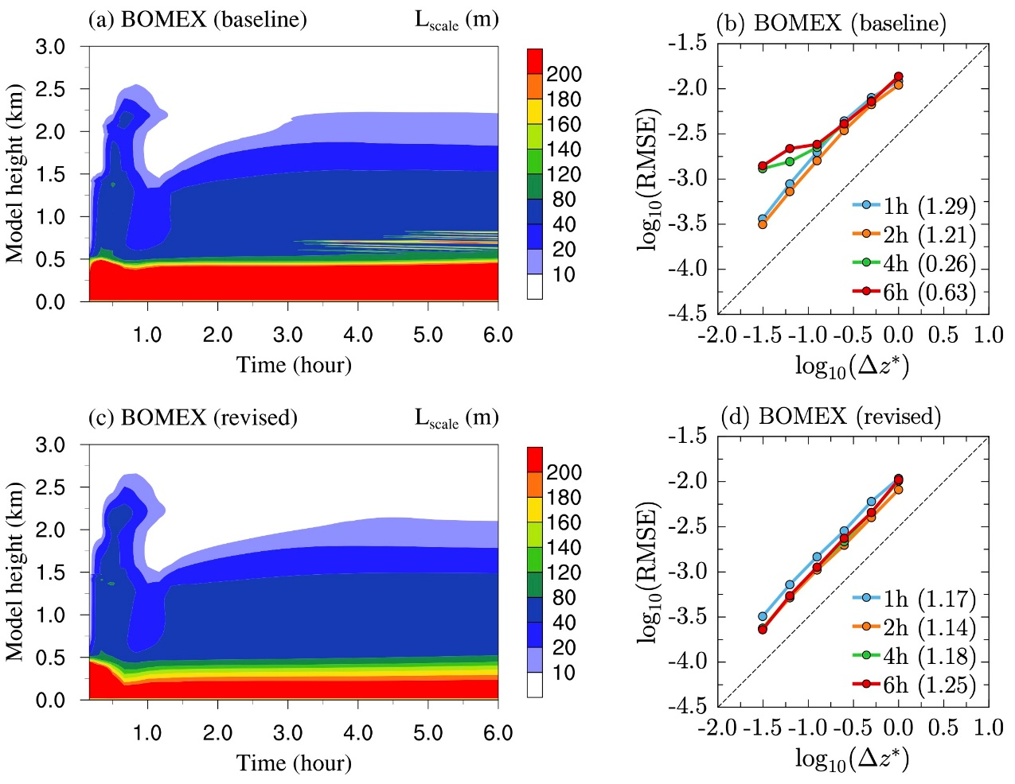
Applying a Mathematical Diagnostic Tool to Detect Numerical Pathologies in Atmospheric Physics Parameterizations
Objective
Detect and address pathologies in the numerical algorithms used in a sophisticated parameterization of turbulence and clouds.
Approach
Apply convergence testing to single-column simulations of four representative test cases covering a diverse range of weather and cloud regimes.
Use resolution convergence to guide the reformulation of numerical algorithms.
Impact
Proper behavior of numerical models in convergence tests is a necessary foundation for further work to increase numerical accuracy and improve computational efficiency.
Both the method of testing and specific pathologies detected are expected to be relevant to other atmospheric models across the climate research community.
Upper row: pathologies in model equations and discretization lead to unphysical oscillations (a) and degraded convergence (b) in simulations of cumulus clouds (Barbados Oceanographic and Meteorological Experiment, or BOMEX, test case). Removing the pathologies leads to more physical solutions (c) with the expected first-order convergence (d).
Zhang, S., Vogl, C. J., Larson, V. E., Bui, Q. M., Wan, H., Rasch, P. J., and Woodward, C. S. ”Removing numerical pathologies in a turbulence parameterization through convergence testing.” Journal of Advances in Modeling Earth Systems, 15, e2023MS003633 (2023). [DOI: 10.1029/2023MS003633]

