Slide 1
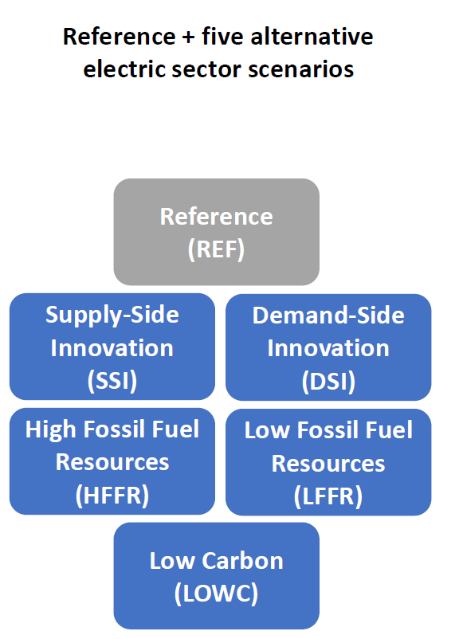
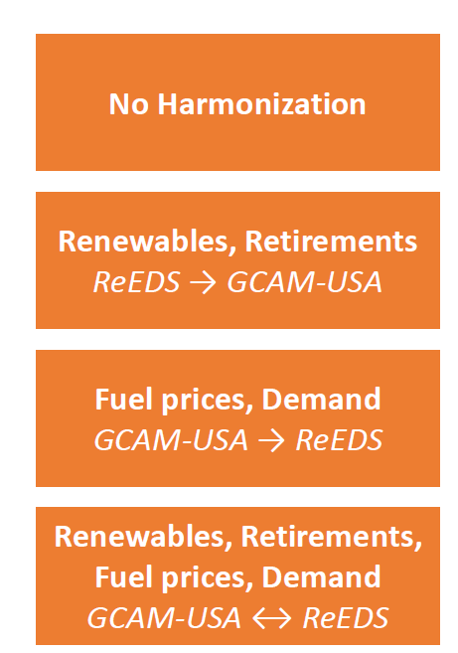
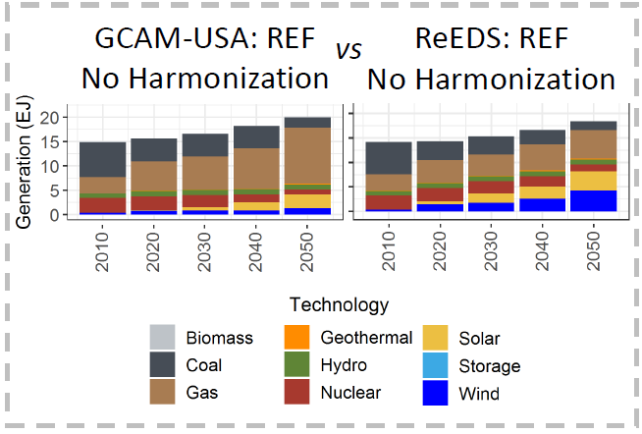
Why Do Models Disagree? An Example from the Electric Sector
Reference + five alternative electric sector scenarios
Four harmonization configurations varying the degree of input harmonization between GCAM-USA and ReEDS
Objective
Explore and generalize the relationships between harmonization and consistency using structurally different models and multiple electric sector futures.
Approach
Define six electric sector scenarios and four harmonization configurations for the ReEDS electric sector capacity expansion model and the GCAM-USA human-Earth system model.
Quantified the cross-model solution consistency for all 24 scenario combinations by comparing electricity generation for each technology, region, and year.
Impact
Consistency can vary across scenarios for a given set of harmonized inputs, with irreconcilable structural differences leading to persistent inconsistencies.
Thorough harmonization efforts can improve the decision-making implications of multi-model activities.
Experimental design structure to measure overall solution consistency between ReEDS and GCAM-USA for each combination of electric sector future and harmonization scenario.
Cohen S. M., G. C. Iyer, M. Brown, J. Macknick, M. Wise, M. Binsted, N. Voisin, J. Rice, and M. Hejazi. “How structural differences influence cross-model consistency: An electric sector case study,” Renewable and Sustainable Energy Reviews, 144, 111009, (2021). [DOI:10.1016/j.rser.2021.111009]
Notes:
http://www.pnnl.gov/science/highlights/highlights.asp?division=749

