Slide 1
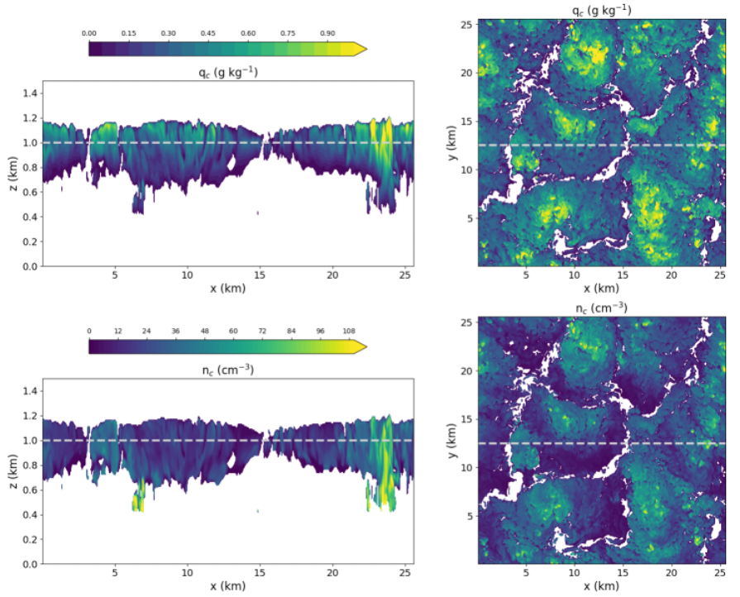
Spatial Heterogeneity of Clouds Impacts Rain Initiation in Global Models
Objective
Evaluate the representation of rain initiation, a process affecting aerosol’s cloud lifetime effects, in version two of the Energy Exascale Earth System Model (E3SMv2) using high-resolution modeling that explicitly resolves spatial variability in cloud properties and droplet collisional growth.
Approach
Generate an ensemble of high-resolution simulations covering various cloud regimes encountered in global climate models.
Compare the rate of new rain droplet formation, called an autoconversion rate, used in E3SM to that computed explicitly from the predicted cloud droplet size distributions.
Quantify the effects of spatial cloud variability on a horizontally averaged autoconversion rate.
Impact
Evaluation of the autoconversion representation is performed over a significantly broader range of conditions than has been done previously.
E3SM reasonably represents the overall rain droplet formation rate.
The model contains compensating errors in underestimated local rate and overestimated enhancement factor, which is aimed at accounting for unresolved, or subgrid, cloud variability.
Enhancement factor in E3SM is overestimated due to neglecting horizontal variability in cloud droplet number concentration that is affected by aerosols.
Simulated clouds over the Eastern North Atlantic observational site
cloud water content
droplet concentration
A strong spatial correlation between cloud water content (upper panels) and droplet number concentration (lower panels) has important consequences for rain initiation and must be accounted for in global models.
Ovchinnikov, M., et al. 2024. “Evaluation of autoconversion representation in E3SMv2 using an ensemble of large-eddy simulations of low-level warm clouds.” JAMES. doi: 10.1029/2024MS004280.

