Slide 1
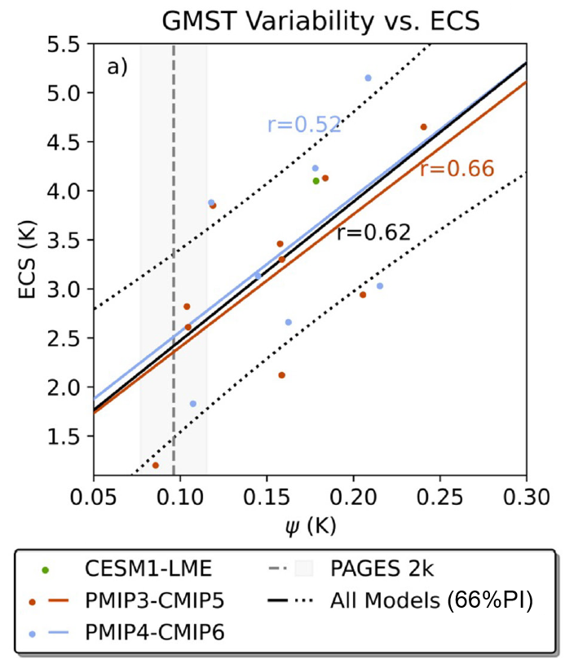
Revisiting a Constraint on Equilibrium Climate Sensitivity From a Last Millennium Perspective
Scientific Achievement Scientists at UCLA and USC have evaluated whether a previously proposed emergent constraint between global interannual temperature variability and equilibrium climate sensitivity (ECS) holds up when the former is derived over the past millennium rather than the past century. They find that the relationship between interannual temperature variability and ECS is stronger when the temperature variability is computed over a longer time frame. Paleoclimate reconstructions of temperature are then used in conjunction with this relationship to reduce uncertainty in model estimates of ECS. Notably, this constraint suggests an ECS value of 2.6 ± 0.7K. Significance & Impact
Substantial doubt had previously been cast on the use of global temperature variability metrics to constrain intermodel spread in ECS. This study shows that when temperature variability metrics are computed over much longer time periods (1150 years instead of 100), a meaningful relationship with ECS does exist. Our estimates of ECS are slightly weaker than the best estimate of 3K from the Intergovernmental Panel on Climate Change.
Emergent relationship between interannual temperature variability, computed over 850-1999, and ECS derived from a collection of PMIP models. Regression lines are shown for both the PMIP3 ensemble (orange), the PMIP4 ensemble (blue), and the joint ensemble (black). The vertical dashed gray line and shading is derived from the PAGES 2k dataset.
Research Details The team compared two metrics of global temperature variability derived from past millennium climate simulations with ECS from an ensemble of climate models. A reasonably strong across-model correlation was found between the variability metrics and ECS, supporting the previously proposed physical reasoning behind this emergent constraint.
Cropper, S., C. W. Thackeray, and J. Emile-Geay, 2023: Revisiting a Constraint on Equilibrium Climate Sensitivity From a Last Millennium Perspective, Geophysical Research Letters, doi:10.1029/2023GL104126.
Notes:
The Science
Scientists at University of California Los Angeles and University of Southern California have evaluated whether a previously proposed emergent constraint between global interannual temperature variability and equilibrium climate sensitivity (ECS) holds up when the former is derived over the past millennium rather than the past century. They find that the relationship between interannual temperature variability and ECS is stronger when the temperature variability is computed over a longer time frame. Paleoclimate reconstructions of temperature are then used in conjunction with this relationship to reduce uncertainty in model estimates of ECS. Notably, this constraint suggests an ECS value of 2.6 ± 0.7K.
The Impact Substantial doubt had previously been cast on the use of global temperature variability metrics to constrain intermodel spread in ECS. This study shows that when temperature variability metrics are computed over much longer time periods (1150 years instead of 100), a meaningful relationship with ECS does exist. This relationship can then be used to make informed predictions about likely values of ECS. Our estimates of ECS are slightly weaker than the best estimate of 3K from the Intergovernmental Panel on Climate Change.
Summary Despite decades of effort to constrain equilibrium climate sensitivity (ECS), the latest generation of climate models still exhibit a large spread. Past studies have sought to reduce ECS uncertainty through a variety of methods including emergent constraints, a model evaluation technique that offers the potential to reduce inter-model spread in projections of climate change. One example uses global temperature variability over the past century to constrain ECS. While this method shows promise, it has been criticized for its susceptibility to the influence of anthropogenic forcing and the limited length of the instrumental record used to compute temperature variability. Here, we investigate the emergent relationship between ECS and two metrics of global temperature variability using model simulations and paleoclimate reconstructions over the last millennium (850–1999). We find empirical evidence in support of these emergent relationships. Observational constraints suggest a central ECS estimate of 2.6–2.8 K, consistent with the Intergovernmental Panel on Climate Change's consensus estimate of 3K. Moreover, they suggest ECS “likely” ranges of 1.8–3.3 K and 2.0–3.6 K.

