Slide 1
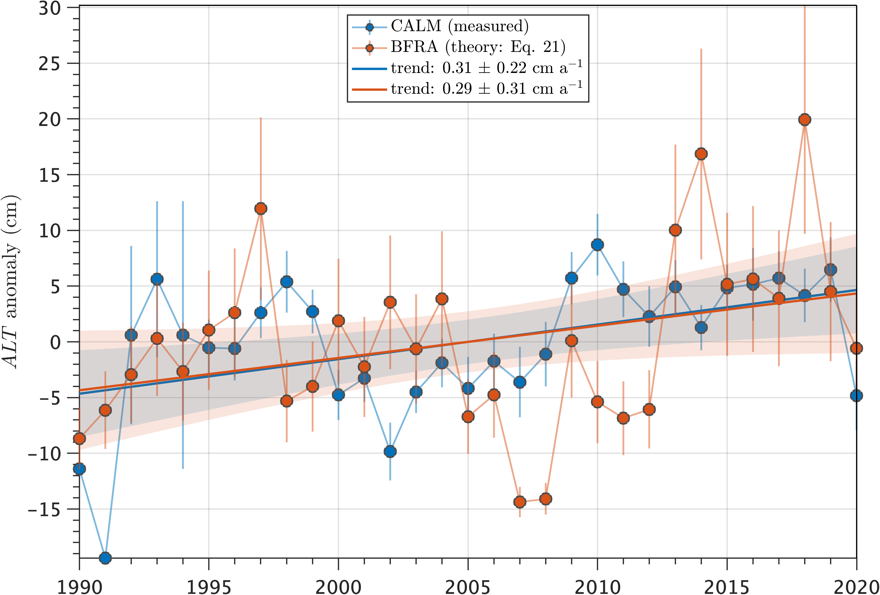
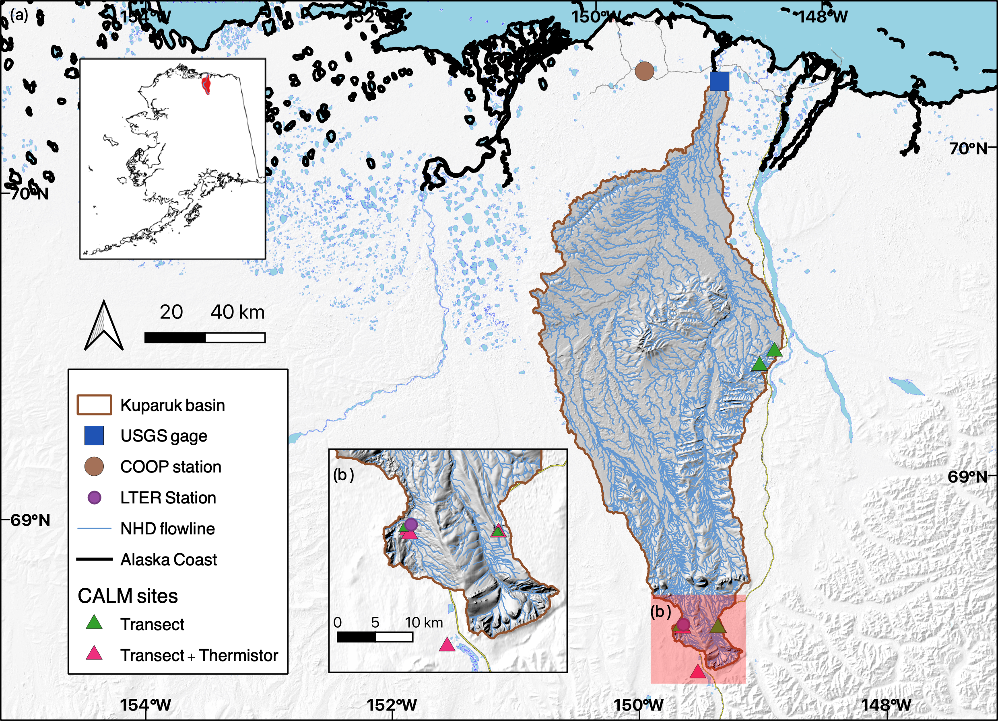
Measuring Permafrost Thaw with Streamflow
Objective
Develop a new method that uses streamflow measurements to estimate trends in permafrost active layer thickness (ALT) at the river basin scale.
Approach
Derived new theoretical relationships between streamflow and ALT trends.
Tested the newly described theoretical relationships using streamflow, ALT, and surface meteorology measurements from the Kuparuk River basin on the North Slope of Arctic Alaska.
Compared modeled results against independent estimates of active layer water storage from satellite gravimetry and climate reanalysis.
Impact
ALT trends indicate how permafrost is responding to warming air temperatures, but ALT measurements typically exist at point-scales. This work provides a new way to estimate ALT change at the river basin scale.
Because this new method leverages long-term streamflow measurements, it can be applied to areas with short, sporadic, or even non-existent point-scale ALT measurements to generate a better picture of permafrost changes at broad scales.
This work shows how streamflow trends encode information about changes in the thickness of water-storing thawed ground overlying permafrost (ALT). A first application to the Kuparuk River basin indicates that the active layer is thickening by about 1 cm every three years, with close agreement between Circumpolar Active Layer Monitoring (CALM) program measurements and the new theoretical baseflow recession analysis (BFRA) method.
Cooper M. G., T. Zhou, K. E. Bennett, W. R. Bolton, E. T. Coon, S. W. Fleming, J. C. Rowland, and J. Schwenk. “Detecting Permafrost Active Layer Thickness Change from Nonlinear Baseflow Recession,” Water Resources Research, 59, e2022WR033154 (2023). [DOI: 10.1029/2022WR033154]
Notes:
http://www.pnnl.gov/science/highlights/highlights.asp?division=749

