Slide 1
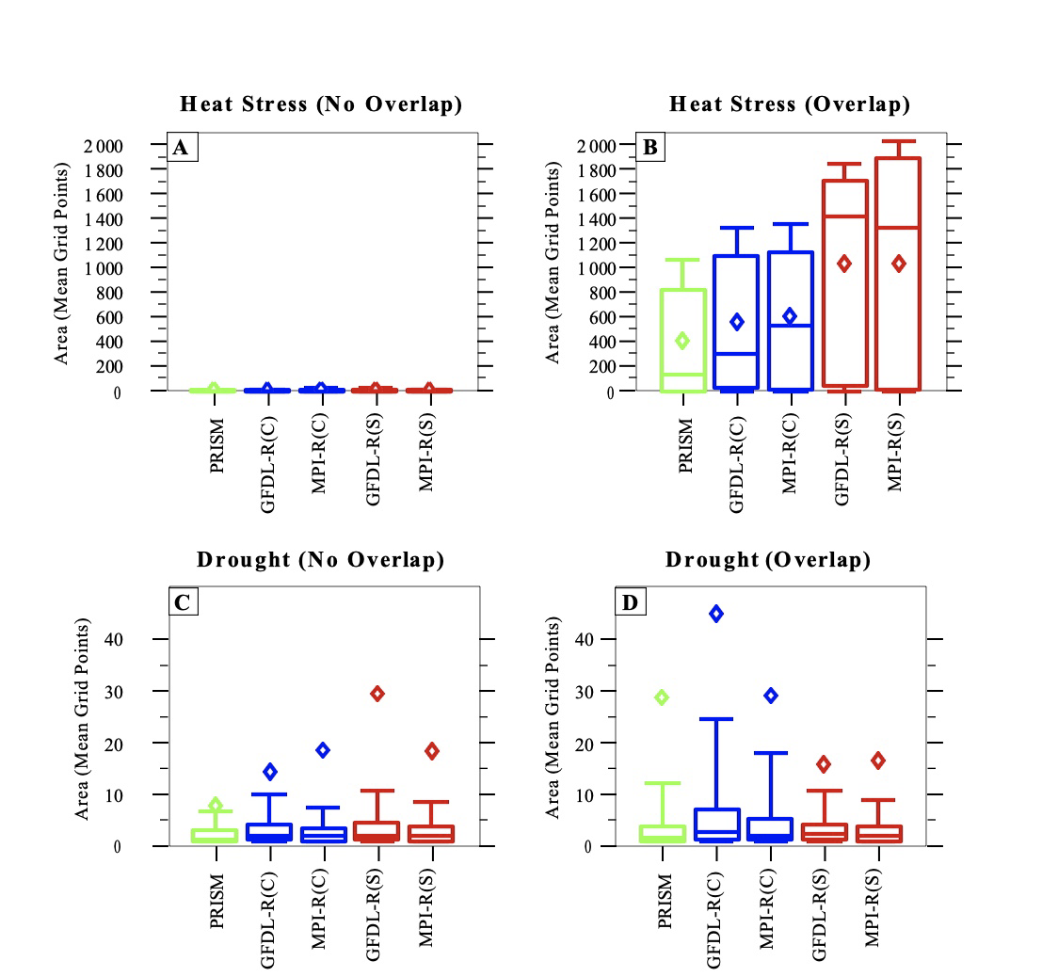


Object-Oriented Analysis Yields Compounding Short-term Drought and Crop Heat-stress Events
The Science: We analyzed for a north-central U.S. region, short-term drought and agricultural heat stress during April-May-June-July. We used the 4-km Parameter Elevation Regression on Independent Slopes Model (PRISM) for observations, aggregated to a 25-km grid, and two 25-km Regional Climate Model version 4 (RegCM4) simulations that used either GFDL- or MPI-GCM boundary conditions. We chose 1981-2000 as our contemporary time period, and 2041-2060 as our scenario time period, which used the Representative Concentration Pathway 8.5 emissions scenario. We used object-oriented analysis to identify events of interest in observations and simulations by identifying objects in aspace-time domain that met specified criteria, such as exceeding a heat-stress temperature threshold. The event diagnosis allowed analysis of compound events, occurring when temperature and drought objects overlap.
Impact: Identified objects yielded events that can undermine agricultural productivity and which are thus relevant to decision makers, making them building blocks for possible climate storylines. The information yielded projected changes in these agriculturally motivated events. One prominent conditional behavior emerging from the work was that a heat-stress event should be a warning to watch for potential drought, as both could compound each other to more intense levels.
Figure
Summary: The observations and simulations showed similar spatial distributions of event frequencies across the analysis region. However, the simulations attained this distribution by having fewer events that tend to cover larger areas compared to observed events, suggesting that the effective resolution of the simulations was coarser than their 25-km grids. Short-term drought frequency increased and heat-stress frequency decreased in transitioning to the scenario climate. When compounding occurred heat-stress events generally preceded the short-term drought events. The overlapping, compound events tended to be more extreme compared to non-overlapping events of either type.
Box-and-whiskers plots of areas of events that are non-compound (no overlap of their object) or compound (object overlap) events, for (A) non-compound heat-stress events, (B) compound heat-stress events, (C) non-compound short-term drought events, and (D) compound drought events. [Boxes: 25%, 50%, 75%. Whiskers: 10%, 90% ; Diamonds = means ; C=Contemporary, S=Scenario]
Fisel, B. J., S. Garbers, D. Haar, M. Zoerner, and W. J. Gutowski, Jr., 2024: Object-oriented analysis as a foundation for building climate storylines of compounding short-term drought and crop heat stress. Frontiers in Climate, https://doi.org/ 10.3389/fclim.2024.1357391.
Biological and Environmental Research
Notes:
Word highlight text here.

