Slide 1
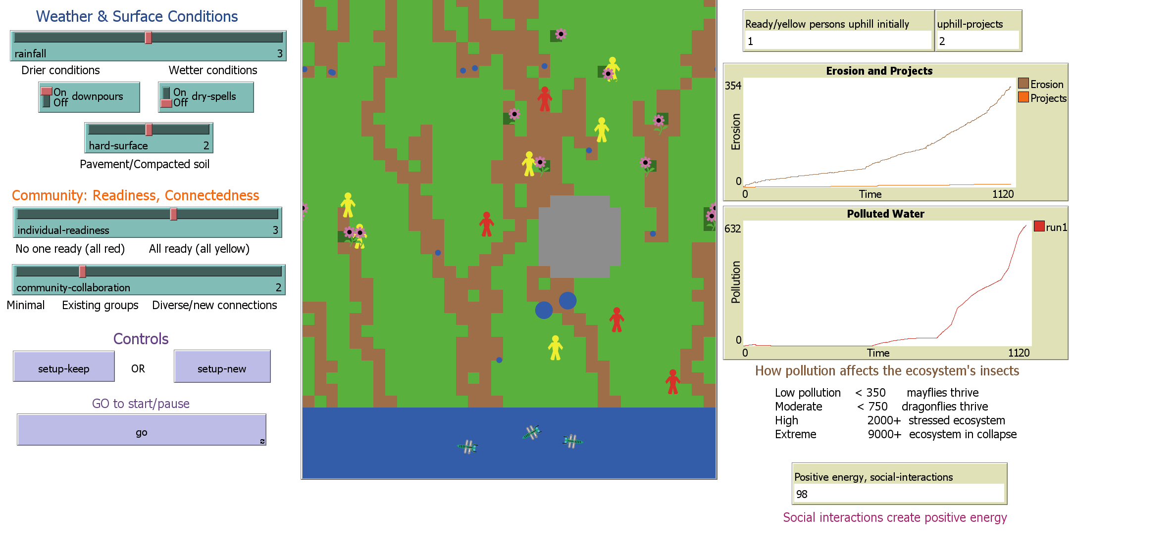
How Humanists, Climate Scientists, and Communities Can Co-Produce Narratives for Action
The Science: Fostering scientifically-based climate action requires more than just the description of human-natural connections: it requires direct relationship building that combines climate science with needs, concerns and values of our community partners. For this we incorporate social capital building, with its emphasis on collaborative ties for resilience across diversity—a focus that we strengthen through community-empowerment work from performance studies. Also, and most profoundly, the environmental humanities expand the human ties of social capital to kinships across the human and more-than-human realms (including Indigenous cosmologies) and elevate narratives of the silenced and the marginalized)
Impact: Successful outcomes in our community engagement occurs through three types of narrative gaps purposely included in our engagement tools: gaps of non-specificity, multiplicity, and revision. Such gaps build agency through diversity and foster collaborative storytelling across different backgrounds and experiences. The gaps of revision evoke and invite counter-stories that draw attention to the blind spots in the original climate-research narratives and then use these places of brittleness as opportunities to envision new possibilities that communities and researchers create together as fully collaborating experts.
Figure
Summary: Minding the gaps in climate-science information offers a way to acknowledge vulnerability and uncertainty as the dynamic places for collaboration and interdependence. As such these sites become loci for responsibility that require turning—continuously—outward from the solidity of one’s own perspectives to engage in the larger knowledge ecosystems that surround us, including those of the more-than-human. It is about humility and kinship. It is about allowing what we do not know to be a strength that urges us to collaborate. Kinship and responsibility through uncertainties is precisely what climate collaboration needs to embrace.
This seemingly cartoonish computer model of a river section with human agents is a compelling, accessible tool that evokes stories of climate change impacts from collaborating community members. Users can explore weather and climate variations through settings on the left, observe the environment’s evolution through the central graphical display and follow quantitative impacts of the evolving climate.
Shenk, L., K. Franz and W. J. Gutowski, 2023: Minding the Gaps to S(t)imulate Collaborative Storytelling: How Humanists, Climate Scientists, and Communities Can Co-Produce Narratives for Action. Environmental Humanities [DOI: 10.1215/22011919-10746001].
Biological and Environmental Research
Notes:
Word highlight text here.

