Slide 1
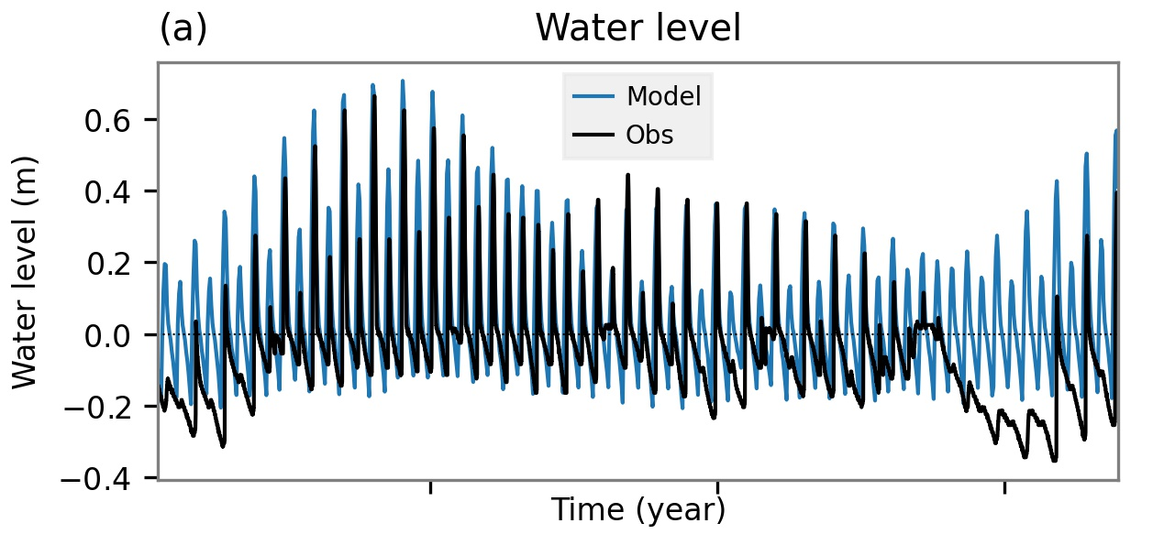
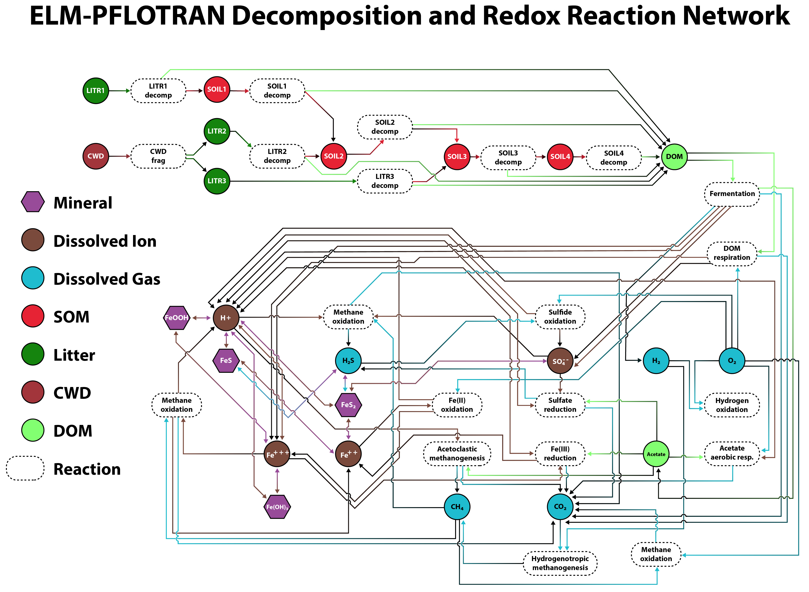
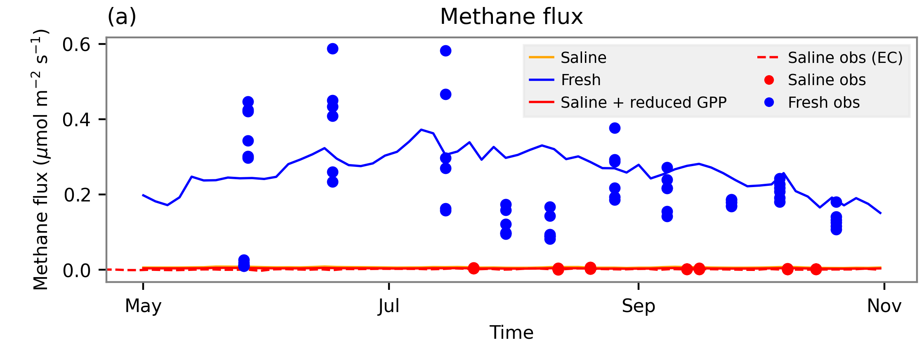
Simulating coastal wetland chemistry to improve methane modeling
Scientific Challenge
Current land models do not incorporate tides or saltwater influences on terrestrial carbon cycling or greenhouse gas balance
Our goal was to improve representation of coastal wetland biogeochemistry and hydrology in the E3SM Land Model (ELM)
Approach and Findings
Coupled a reaction network simulator to ELM
Incorporated tidal hydrology and salinity boundary conditions
Evaluated using porewater and flux measurements from Massachusetts salt marshes and freshwater wetlands
Sulfur redox cycling reduces methane emissions in saline coastal marshes
Figure
ELM soil column
Alquimia interface
Significance and Impact
Integrating a reaction network simulator into the E3SM Land Model opens broad possibilities for more detailed biogeochemical representation
Coupling tidal hydrology, saltwater influence, and redox biogeochemistry directly into a land model improves accuracy of simulated methane fluxes
(Top) Simulated tidal water levels in ELM (Middle) Biogeochemical reaction network integrated into the ELM subsurface (Bottom) Reduced methane emissions from saline tidal influence (red) compared to freshwater (blue)
Sulman, B. N., Wang, J., LaFond-Hudson, S., O’Meara, T. A., Yuan, F., Molins, S., et al. (2024). Integrating tide‐driven wetland soil redox and biogeochemical interactions into a land surface model. Journal of Advances in Modeling Earth Systems, 16(4). https://doi.org/10.1029/2023ms004002
Department of Energy • Office of Science • Biological and Environmental Research
Notes:
Word highlight text here.

