Slide 1
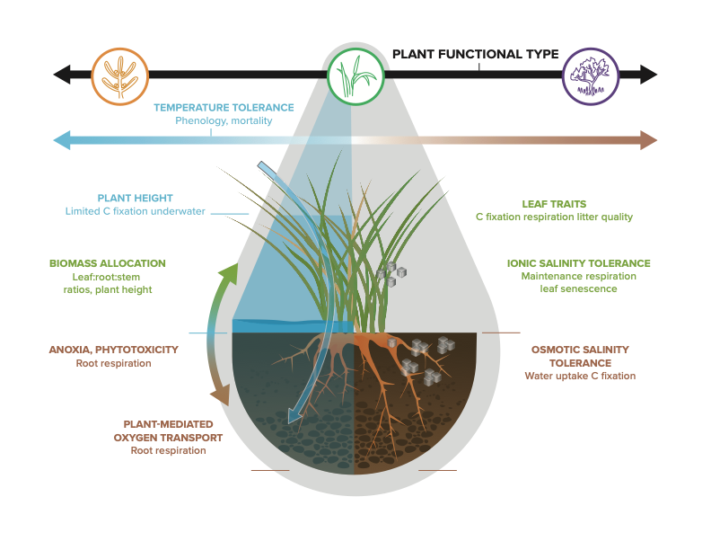
A roadmap for improving models of coastal wetland vegetation
Incorporating key coastal vegetation types and their salinity and flood tolerances can improve land models
Approach | Synthesized current knowledge of coastal wetland vegetation Identified simulation strategies and data needs for improving land model representation of coastal vegetation
Results | Models should use separate mangrove, graminoid salt marsh, and succulent plant functional types Key vegetation traits include biomass partitioning, salinity tolerance, and flood responses
Significance | Coastal wetlands can sequester carbon at high rates but are poorly represented in land surface models Better coastal wetland vegetation representation in land models can improve simulations of carbon cycling in coastal regions This study provides a concrete road map and data needs for model improvements
LaFond-Hudson, S. and Sulman, B. N. (2023). Modeling strategies and data needs for representing coastal wetland vegetation in land surface models. New Phytologist. doi:10.1111/nph.18760
Key plant traits to implement in land surface models for better representation of coastal wetland vegetation processes

