Slide 1
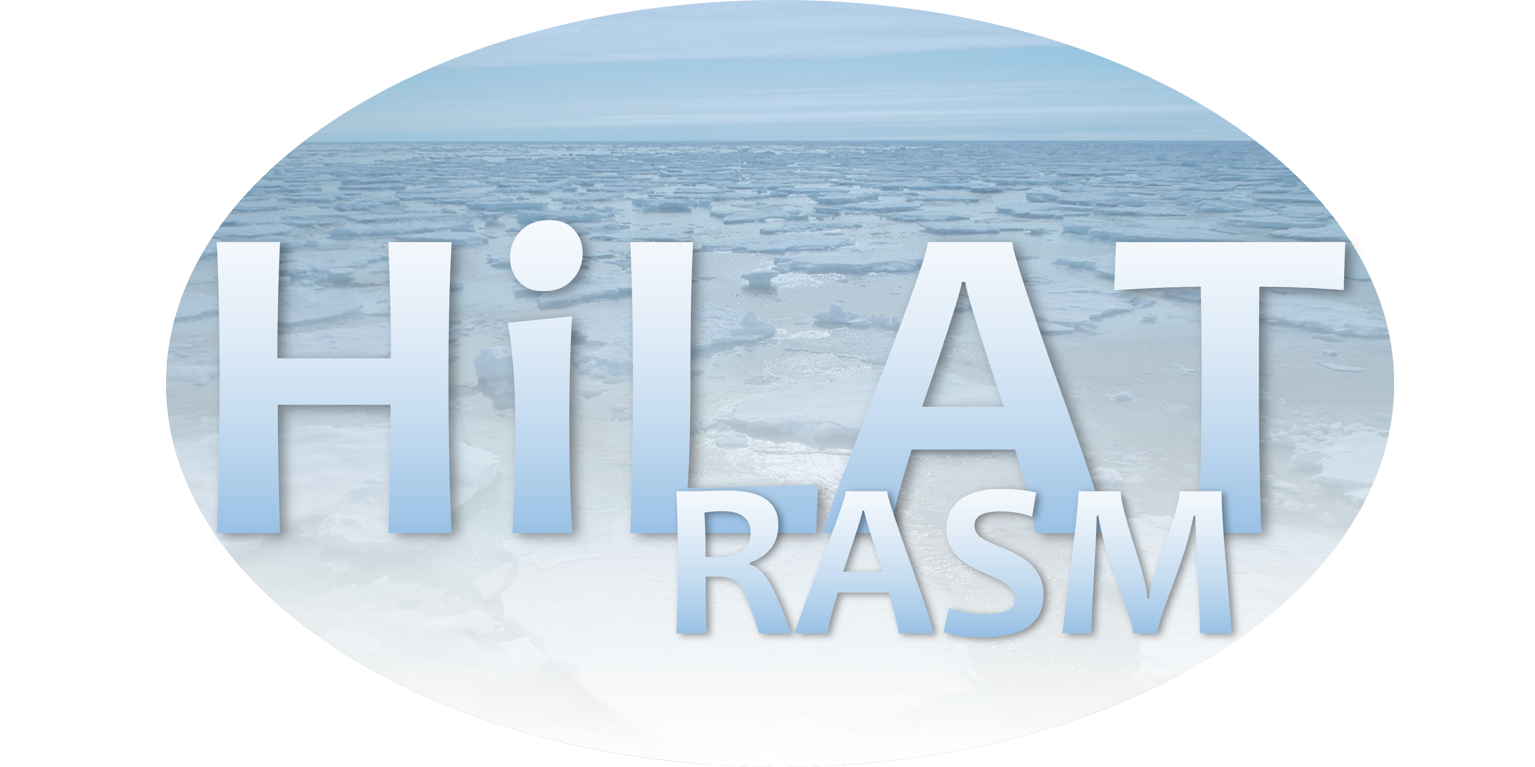
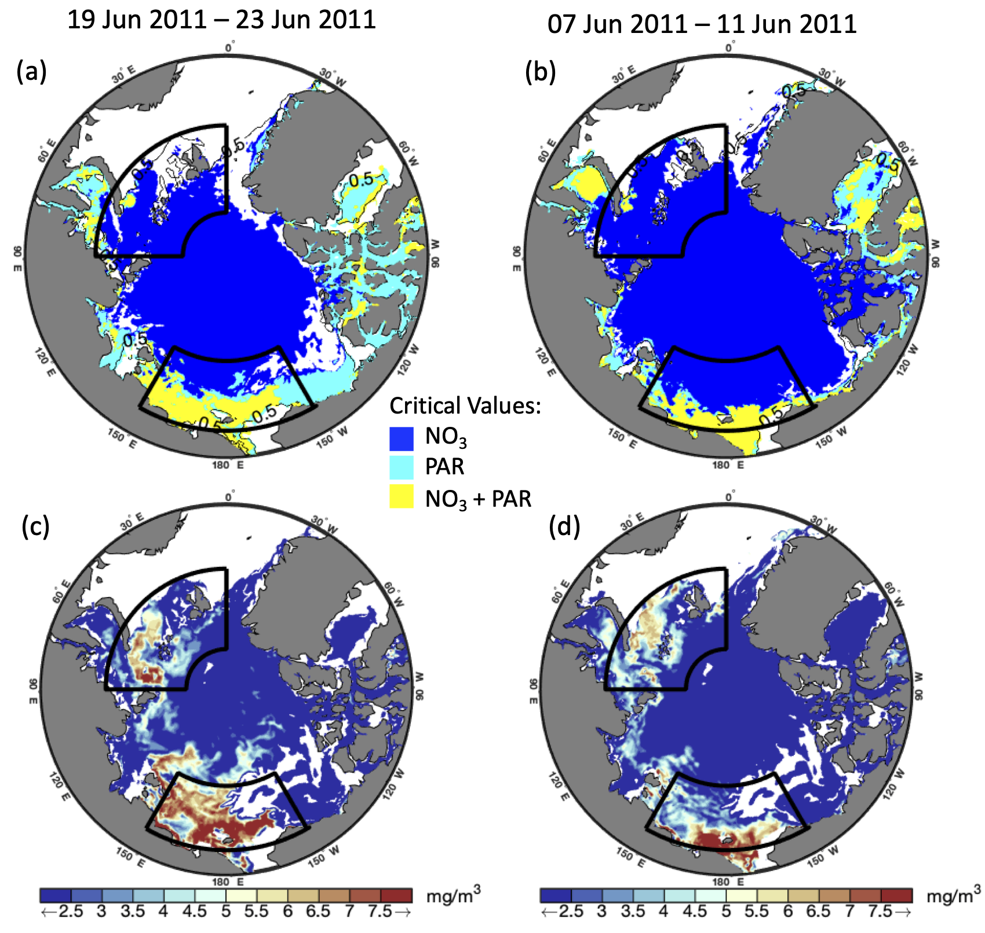
Investigation of Under-Ice Phytoplankton Growth in the Fully-Coupled,
High-Resolution Regional Arctic System Model
Objective
We used the Regional Arctic System Model to investigate the phytoplankton that live beneath Arctic sea ice. We compared our numerical model results to recent observations and then used the model to provide a pan-Arctic view of these under-sea ice phytoplankton blooms. We also determined the extent to which light and nutrients limit growth in different regions of the Arctic.
Western Arctic peak Eastern Arctic peak
Research
Our results demonstrate the presence of extensive under-ice phytoplankton growth in the western Arctic in summer, with similar (but lower magnitude) values in the eastern Arctic.
We investigate the critical levels of nitrate (NO₃) concentration and photosynthetically available radiation (PAR) that are necessary for under-ice phytoplankton growth to occur.
Our results show that while the majority of ice-covered Arctic waters have sufficient surface nitrate levels to sustain growth, PAR reaching the ocean surface through the sea ice in early summer only exceeds critical levels in the western Arctic.
→ Top row: critical light and nutrient conditions during the peak under-ice growth periods in the western Arctic (a) and eastern Arctic (b) regions. Only the model grid cells where ice fraction is greater than 50% are shaded. Lower rows: surface chl-a for the same time periods. Region contours are shown in black..
Impact
Phytoplankton blooms occur annually in the Arctic and are light-limited at the beginning of the growing season and nutrient-limited at the end of the growing season.
Western Arctic under-sea ice blooms are truly formed under sea ice, while the eastern Arctic blooms appear to be more influenced by advection.
Clement Kinney, J., Frants, M., Maslowski, W., Osinski, R., Jeffery, N., Jin, M., & Lee, Y. J. (2023). Investigation of under-ice phytoplankton growth in the fully-coupled, high-resolution Regional Arctic System Model. Journal of Geophysical Research: Oceans, 128, e2022JC019000. https://doi. org/10.1029/2022JC019000

