Slide 1
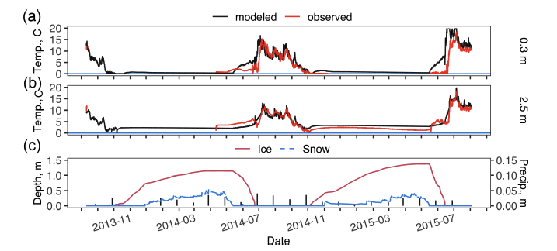
Title
Scientific Challenge
Lakes in the Arctic are important reservoirs of heat with much lower albedo in summer and greater absorption of solar radiation than surrounding tundra vegetationUnder climate warming scenarios, we expect Arctic lakes to accelerate thawing of underlying permafrost due to warming water temperatures in the summer and winter.
Approach and Findings
Here we validated the Lake 2.0 model using water temperature data from lakes in northern Alaska. Snow depth and lake ice strongly affect water temperatures during the frozen season, which dominates the annual thermal regime of Arctic lakes.
Modeled and observed lake water temperature at 0.3m (a) and 2.5m (b) and modeled lake ice depth, lake snow depth, and measured monthly precipitation (vertical black bars) (c). Gray shading indicates periods of uncertainty in temperature sensor depth when ice-rafting may have moved the sensor to shallower water. The y axis of panel (a) is limited to water temperatures>0C as the LAKE model water temperature is limited to >0C.
Significance and Impact
These findings suggest that reductions in lake ice thickness and duration could lead to more heat storage by lakes and enhanced permafrost degradation.
Clark, J. A., Jafarov, E. E., Tape, K. D., Jones, B. M., and Stepanenko, V.: Thermal modeling of three lakes within the continuous permafrost zone in Alaska using the LAKE 2.0 model, Geosci. Model Dev., 15, 7421–7448, https://doi.org/10.5194/gmd-15-7421-2022, 2022.
Department of Energy • Office of Science • Biological and Environmental Research
Notes:
Word highlight text here.

