Slide 1
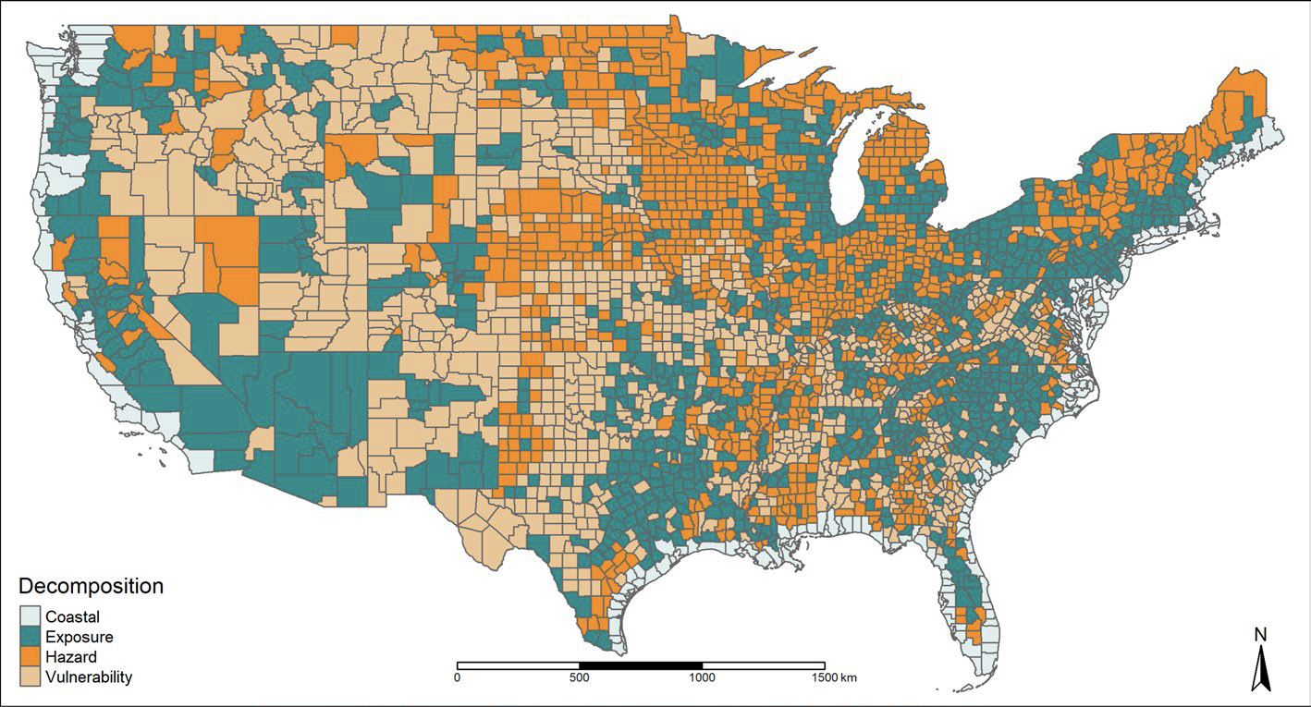
Linkages between riverine flooding risk and economic damage over the continental United States
Objective
To prepare for future flood disasters, it is important to be able to decompose the sources of flooding damage—such as the hazard itself, how exposed people and properties are, and how vulnerable they are. We suggest a new approach to attributing flooding damages to hazard, exposure, and vulnerability at the county level across contiguous U.S.
Approach
We analyzed flooding risk factors in non-coastal U.S. counties between 1999 and 2018 using data on property damages, river discharge, housing units, and flooding events, employing trimmed least absolute deviated and least square estimators for censored flooding damages in panel data.
Figure: Decomposition of hazard, exposure, and vulnerability of expected flooding damage. The map indicates which counties have the largest hazard, exposure, or vulnerability damage proportion from the expected value of flooding property damage for the 2001–2018 period. The dark shade of cyan represent counties where the damage associated only to exposure dominates over hazard and vulnerability; the medium shade of orange and light shade of burly wood represent counties where hazard and vulnerability dominates, respectively. The dimly light shade of azure represents coastal counties that are not considered in the analysis.
Impact
Exposure is the key contributor to flooding risk in most US counties, emphasizing the need for community efforts and funding for mitigation strategies, especially in densely populated areas, while counties near the Mississippi River system may face heightened consequences from climate change.
Cisneros-Pineda A., Liu J., Grogan D. & Hertel T. (2024). Linkages between riverine flooding risk and economic damage over the continental United States. Natural Hazards, 120, 5941–5952. https://doi.org/10.1007/s11069-024-06445-z

