Slide 1
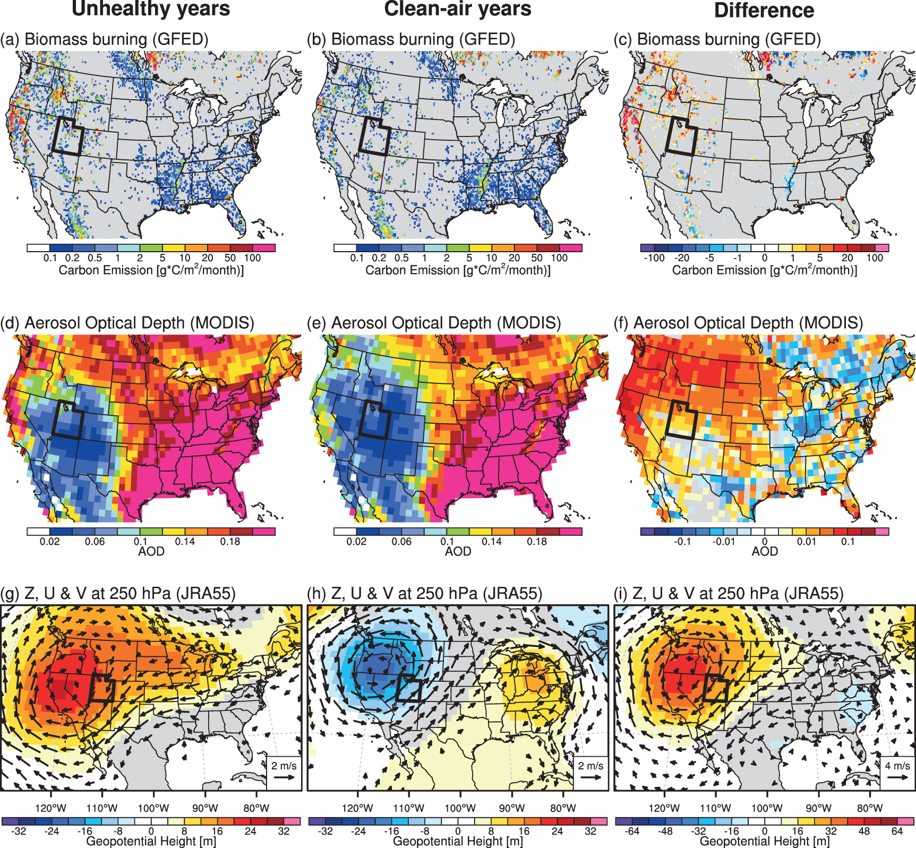
Interannual variability and trends of summertime PM2.5-based air quality in the Intermountain West
Scientific Challenge
Summertime air quality is a growing public health concern in the populated region of Northern Utah, yet the relationship between climate factors and the frequency of poor air quality during summer is still unknown.
Approach and Findings
Analyzing the last 20 years of observed and model-simulated datasets, we demonstrated that summertime unhealthy days in Northern Utah highly correlate with the number of dry-hot days, wildfire size, and an upper atmospheric ridge over the Northwestern United States.
Figure
Significance and Impact
Climate metrics developed in this study could be used to establish longer-term monitoring and seasonal forecasting for degraded air quality and its compounding factors, which is currently limited to forecasting products for only several days.
Figure: Composite maps of (a)–(c) carbon emissions from biomass burning in GFED, (d)–(f) aerosol optical depth in MODIS, and (g)–(i) geopotential height (shading) and horizontal wind anomalies (vector) at 250 hPa in JRA55 for the unhealthy years (left), the clean-air years (center), and their difference (right panels) during the months of MJJAS.
citation: Chikamoto et al (2023): Interannual variability and trends of summertime PM2.5-based air quality in the Intermountain West.
Environ. Res. Lett., 18, 044032, doi:10.1088/1748-9326/acc6e0.
Department of Energy • Office of Science • Biological and Environmental Research
Notes:
Word highlight text here.

