Slide 1
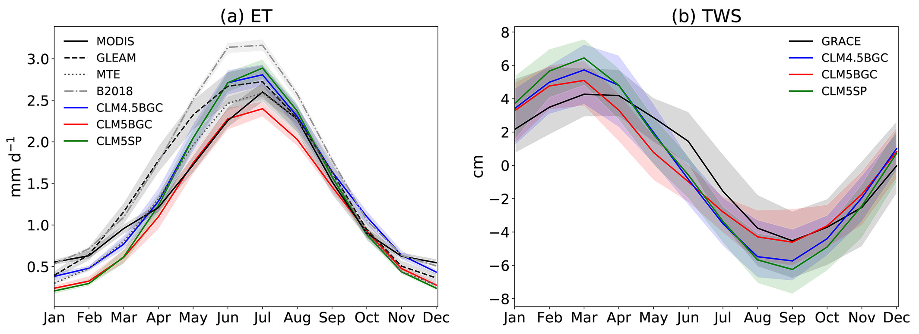
Benchmarking the Community Terrestrial System Model Over the Contiguous United States
Objective
Evaluate versions 4.5 and 5 of the Community Land Model, now referred to as the Community Terrestrial System Model (CTSM), at a scale where land surface heterogeneity and key physical processes can be appropriately represented over the Contiguous United States (CONUS).
Approach
Compare and contrast simulations of energy, water, and carbon cycles using three different configurations of CTSM over the CONUS at 0.125° during 1979 – 2018.
Evaluate model performance against various ground-based and remote-sensed datasets.
Impact
The results show that recent model enhancements improve CTSM land surface process simulations.
Evaluation against observations at small catchments suggests that hydrologic parameters need to be calibrated to improve simulations of runoff, especially subsurface runoff.
Demonstrates the need to incorporate spatially distributed plant phenology and physiology parameters, as well as regionally specific agricultural management practices.
Comparison of mean monthly remote‐sensed and simulated variables from the three CTSM simulations that are averaged over the entire CONUS for (a) evapotranspiration (ET) and (b) total water storage anomaly (TWSA). The shaded areas represent the 5% and 95% percentiles of the reference data and model predictions to indicate interannual variability for each month.
Cheng, Y., Huang, M., Zhu, B., Bisht, G., Zhou, T., Liu, Y., Song, F., He, X., 2021, Validation of the Community Land Model Version 5 Over the Contiguous United States (CONUS) Using In Situ and Remote Sensing Data Sets. Journal of Geophysical Research: Atmospheres, 2, 1–27. [DOI: 10.1029/2020JD033539]

