Slide 1
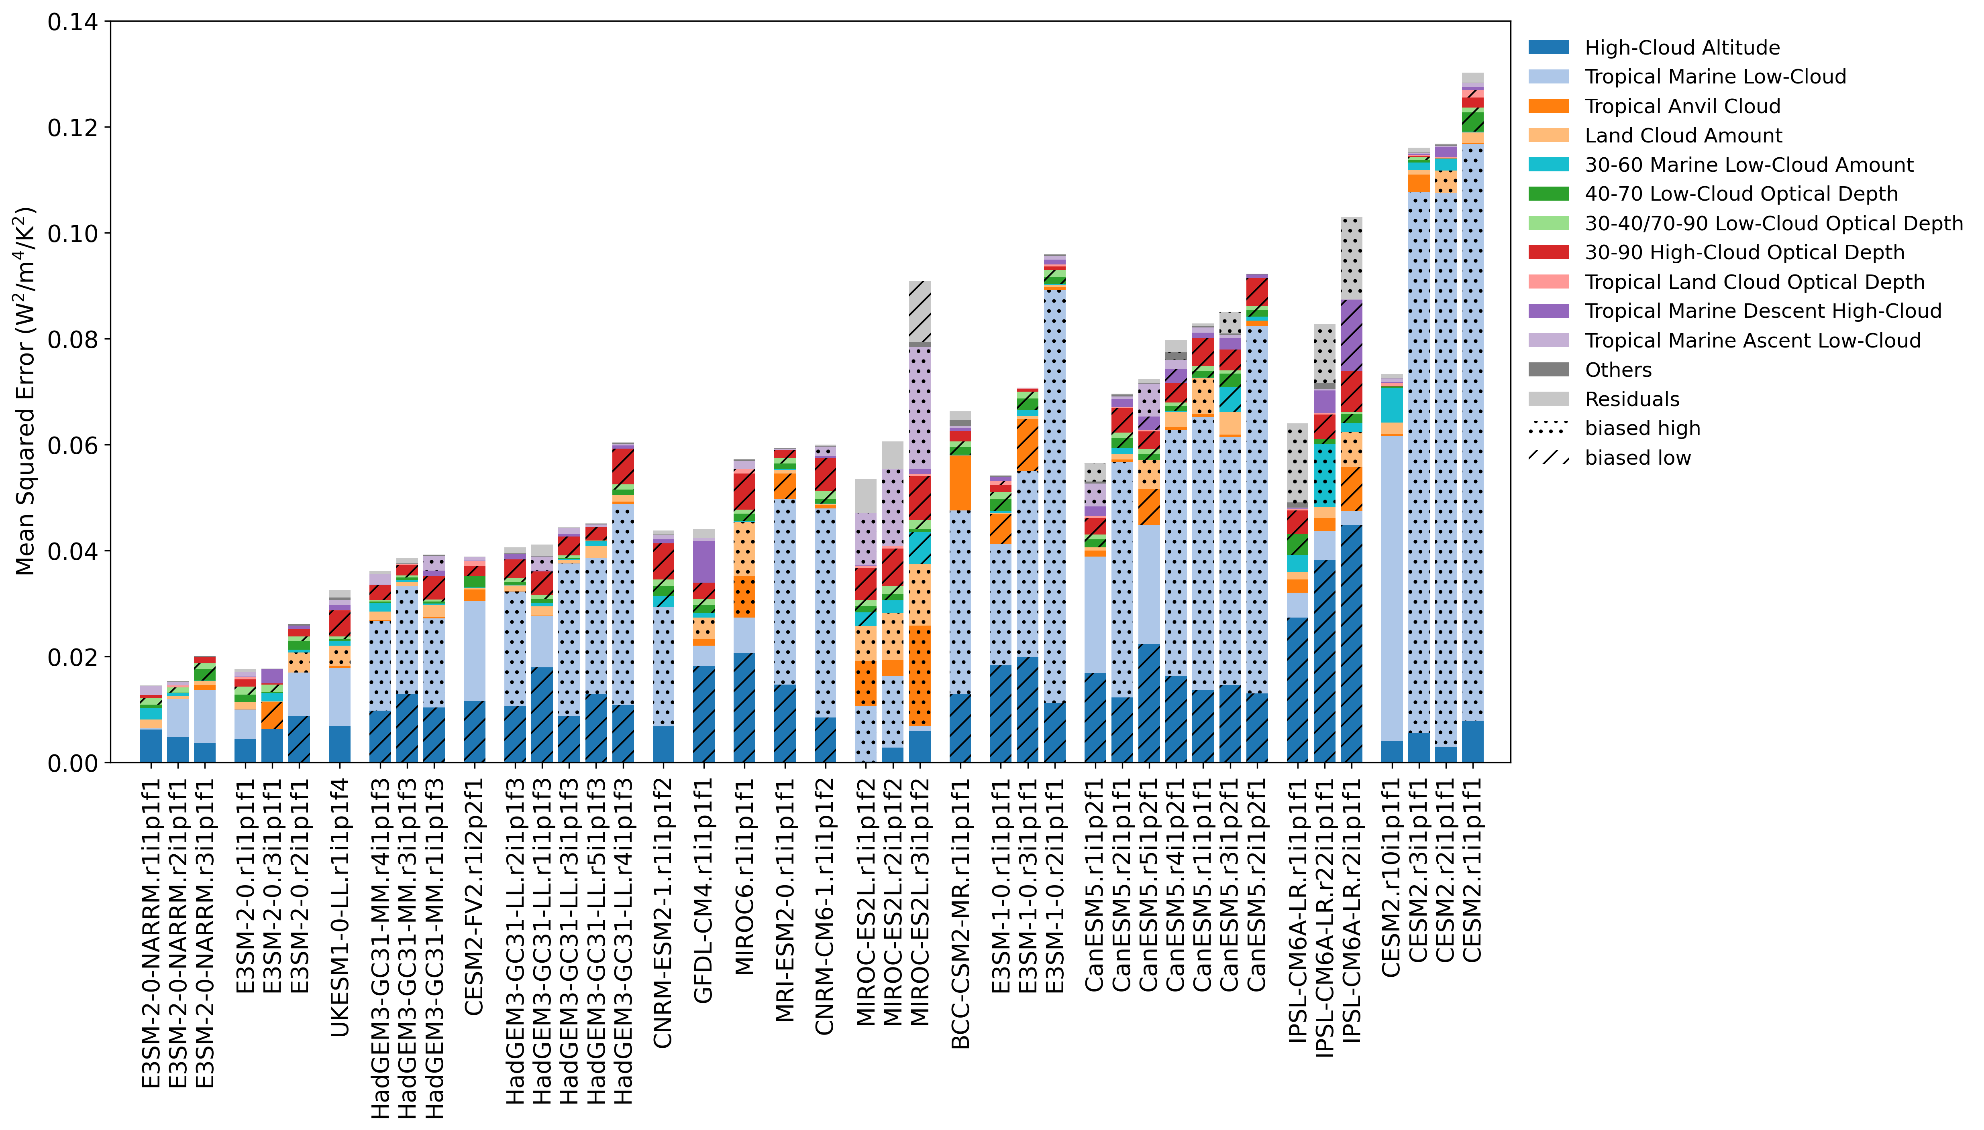
Evaluating Cloud Feedback Components in Observations and
Their Representation in Climate Models
Science Question
How well do climate models reproduce individual short-term cloud feedback components diagnosed from satellite observations?
How do cloud feedbacks in response to short-term variations relate to those in response to long-term warming?
Key Accomplishments
The team found that climate models simulate a positive total cloud feedback that agrees with the observations in general
The models consistently overestimate tropical marine low cloud feedback and underestimate the high-cloud altitude and extratropical high-cloud optical depth feedbacks (see figure)
Models that better simulate short-term cloud feedbacks generally do not better simulate long-term cloud feedbacks
Impact
An apples-to-apples comparison of climate models against observations helps reveal errors in simulated cloud feedbacks.
The systematic model biases highlight the need for improving the simulation of high clouds and tropical marine low clouds.
The mean squared error of modeled cloud feedback against observations calculated from 13 components. The components that are significantly biased high and low at 90% confidence are indicated by stippling and hatching, respectively.
Chao, L.-W., Zelinka, M. D., & Dessler, A. E. (2024). Evaluating cloud feedback components in observations and their representation in climate models. Journal of Geophysical Research: Atmospheres, 129, e2023JD039427. doi: 10.1029/2023JD039427
Notes:
The Science
Scientists at PCMDI and Texas A&M University assessed individual cloud feedback components in response to interannual variations in climate models by comparing against satellite observations. They found that climate models simulate a positive total cloud feedback that agrees with the observations in general. However, models consistently overestimate the decrease of the cloud cover over tropical ocean subsidence regions and underestimate the increase in the altitude of high clouds and the decrease in the reflectivity of high clouds over extratropical regions.
The Impact
Cloud feedback is highly uncertain since it is determined by various cloud types that are often challenging to represent in global climate models. Evaluating the performance of models in accurately reproducing individual observed cloud feedback components is therefore crucial. The systematic model biases identified in this study highlight the need for improving the representation of high clouds and tropical marine low clouds and the processes governing those changes in climate models.
Summary
This study quantifies the contribution of individual cloud feedbacks to the total short-term cloud feedback in satellite observations over the period 2002-2014 and evaluates how they are represented in climate models. The observed positive total cloud feedback is primarily due to positive high-cloud altitude, extratropical high- and low-cloud optical depth, and land cloud amount feedbacks partially offset by negative tropical marine low-cloud feedback. Seventeen models from the Atmosphere Model Intercomparison Project (AMIP) of the 6th Coupled Model Intercomparison Project (CMIP6) are analyzed. The models generally reproduce the observed moderate positive short-term cloud feedback. However, compared to satellite estimates, the models are systematically high-biased in tropical marine low-cloud and land cloud amount feedbacks and systematically low-biased in high-cloud altitude and extratropical high- and low-cloud optical depth feedbacks. Errors in modeled short-term cloud feedback components identified in this analysis highlight the need for improvements in model simulations of the response of high clouds and tropical marine low clouds. Our results suggest that skill in simulating interannual cloud feedback components may not indicate skill in simulating long-term cloud feedback components.

