Slide 1
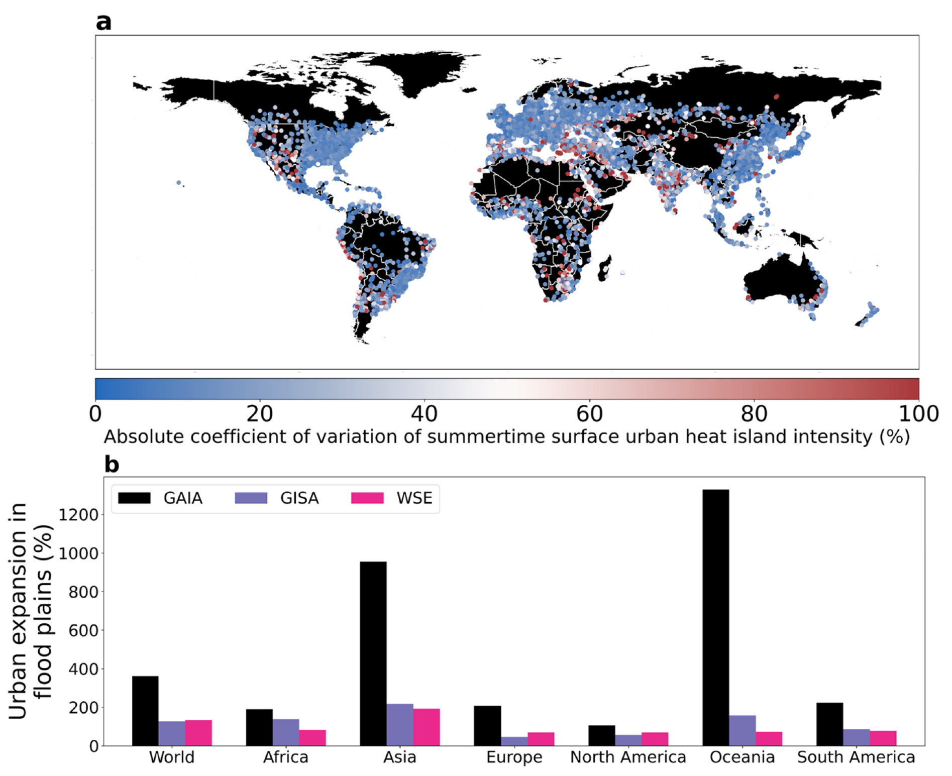
Discrepancies in Urban Land Estimates Leads to Difficulties in Quantifying Climate Risks
Objective
Quantify discrepancies in estimates of urban land cover from various datasets and their implications for monitoring urban climate hazards and for urban weather/climate modeling.
Approach
Analyzed spatiotemporal patterns of urban land using multiple global datasets, including thirteen historical urban land cover products, two datasets specifically used in process-based models, and four future projections of urbanization.
These differences have implications for monitoring urban climate hazards, simulating regional weather, and urban climate modeling.
Illustrated the impact of the choice of urban dataset on a few use cases, including estimating urban heat and flood hazards.
Impact
Results emphasize the need for choosing fit-for-purpose datasets for specific urbanization studies.
The study calls for a sustained effort within the urban scientific community to evaluate and adopt suitable datasets for different research and policy applications.
The impact of the choice of urban land estimate on various use cases was considered. a Coefficient of variation in estimates of summertime surface urban heat island intensity derived from different land cover datasets for over 10,000 global clusters across eight current-generation datasets; b Impact of choice of land cover dataset for quantifying change in urban flood hazard between 1985 and 2015.
Chakraborty, T., Venter, Z.S., Demuzere, M. et al. Large disagreements in estimates of urban land across scales and their implications. Nat Commun 15, 9165 (2024). https://doi.org/10.1038/s41467-024-52241-5
Notes:
http://www.pnnl.gov/science/highlights/highlights.asp?division=749

