Slide 1
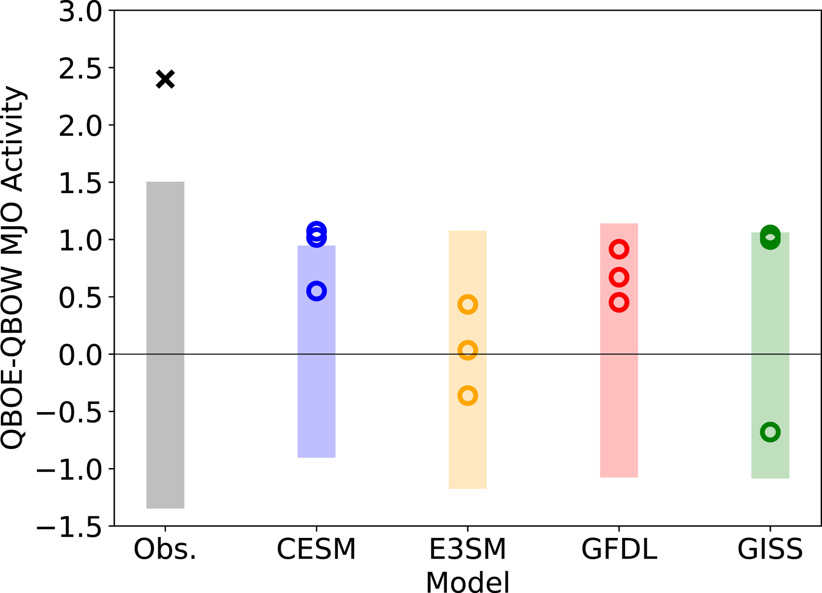
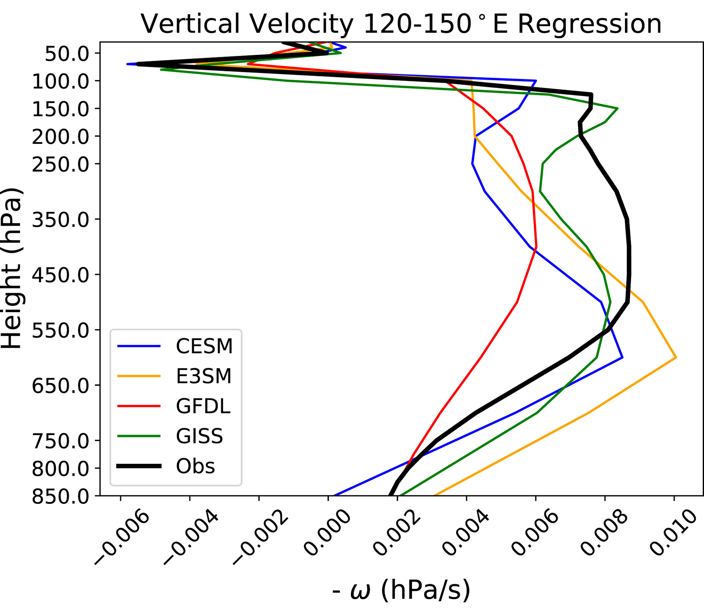
The Lack of QBO-MJO Connection in Models with Nudged Stratosphere
Zane K. Martin, Isla R. Simpson, Pu Lin, Clara Orbe, Qi Tang, Julie M. Caron, Chih-Chieh Chen, Hyemi Kim, L. Ruby Leung, Jadwiga H. Richter, and Shaocheng Xie, JGR: Atmospheres, (128), 17, doi:10.1029/2023JD038722
OBJECTIVE
Observations have shown a strong link between the Quasi-biennial Oscillation (QBO) and the Madden-Julian Oscillation (MJO), with increased MJO activity during the QBO easterly phase over the maritime continent (Yoo and Son 2016). Model do not consistently capture this relationship. We assess the impact of a nudged stratosphere on four models to see if they are able to capture the QBO-MJO connection.
Fig. 1: The change in December-February Madden-Julian oscillation (MJO) activity (measured by the standard deviation (in W/m²) of 20–100 days filtered, eastward wavenumber 1–5 OLR over the warm pool (50°−170°E, 20°S–5°N), as in Kim et al. (2020)) between QBOE and QBOW. The shaded bar is the 2.5–97.5 percentile range of changes in MJO activity taken across bootstrapped periods in each model or in observations when the QBO was neutral. The observed change is denoted in the left-most column with a black “x.”
APPROACH
Using 3-member ensembles of CESM2, E3SM1, NASA-GISS, and GFDL-CM4 models, we nudge the stratospheric winds to time varying reanalyses. E3SM1 was nudged to ERA-I, and the other 3 models were nudged to MERRA. The nudging relaxation time period is 12 hours, and there is a smooth transition from full nudging at 100mb to no nudging below 150mb. This leads to an accurate representation of the QBO across all 4 models.
IMPACT
Our results show that while QBO signals across the models are well-represented with nudging, and no clear systematic bias is found in their simulated MJOs, none of them shows a clear QBO-MJO connection in any ensemble member, or in the ensemble mean. Additionally, we assessed hypotheses of model deficiencies that could contribute to the lack of QBO-MJO link. We found a common deficiency across models in the MJO vertical structure of vertical velocity which are either too bottom-heavy (CESM, E3SM, GISS) or too weak (GFDL). This points to opportunities for future research focused on the impact of the vertical structure of MJO on the QBO-MJO connection deficiencies in models.
Regression plots of December-February (DJF) vertical velocity, for Madden-Julian oscillation (MJO) Phase 4/5 (e.g., regression onto RMM 1) averaged over 120°−150°E (e.g., capturing active MJO conditions over the Maritime Continent, and averaging over the region of deep convection and ascent).

