Slide 1
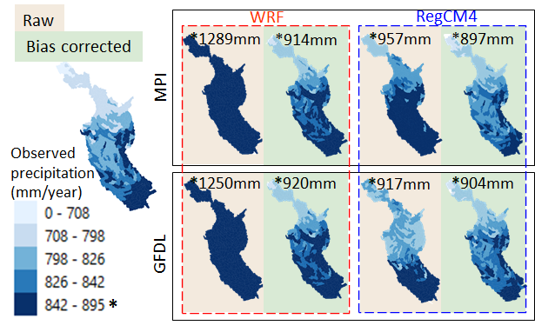
Assessing the Influence of a Bias Correction Method on Future Climate Scenarios Using SWAT as an Impact Model Indicator
Scientific Challenges:
GCM and RCM precipitation output can be biased due to several factors. Bias correction methods exist to correct biased climate model output. However, questions exist as to when bias correction should be used and what methods are most reliable. There are also implications of large bias corrections relative to smaller projected future climate changes. These issues also affect other models interfaced with climate model projections.
Impact:
Precipitation output from four GCM-RCM combinations were input into the SWAT ecohydrological model for historical simulations (1981–2005) and future projections (2030–2050) for the Des Moines River Basin in the north central U.S. Raw climate model outputs resulted in overpredicted historical precipitation levels but bias corrected precipitation amounts were more accurate (Fig. 1). Bias-corrected precipitation also resulted in more accurate streamflow estimates (e.g., Fig. 2). However, the SWAT future hydrological results also revealed that the bias correction was often larger than the projected change in precipitation.
Summary:
Bias correction resulted in improved historical precipitation and SWAT-predicted monthly streamflow. However, the bias-corrected precipitation data led to changes in future prediction signals. This occurred because the bias correction was often larger than the climate-change signal, indicating that the procedure was not a small correction but a major factor.
Figure 1 - Spatial representation of observed annual precipitation (1981–2005), raw climate data, and bias-corrected climate data. The * refers to the replacement of the maximum rainfall value (in the legend) for each model.
Figure 2 - Monthly surface runoff and water yield outputs for observed data, raw climate data, and bias-corrected climate data for the 1981 to 2005 time period.
Citation: Brighenti, T.M.; Gassman, P.W.; Gutowski, W.J., Jr.; Thompson, J.R. Assessing the Influence of a Bias Correction Method on Future Climate Scenarios Using SWAT as an Impact Model Indicator. Water 2023, 15, 750. https://doi.org/10.3390/w15040750.

