Slide 1
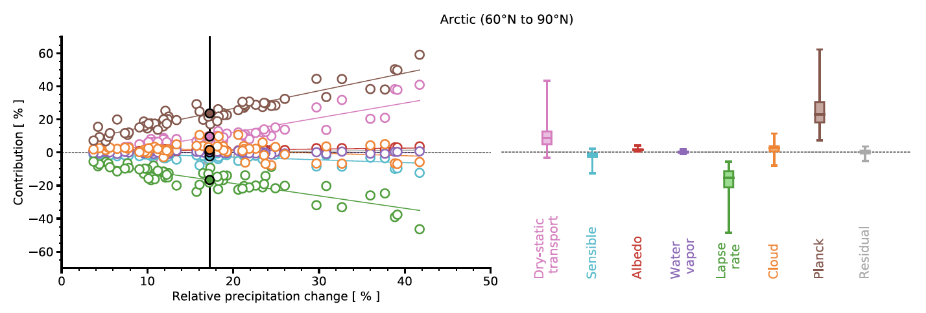
Contributions to regional precipitation change and its polar-amplified pattern under warming
Science Question
Why do climate models predict that the largest relative change in precipitation in response to greenhouse warming will occur at the poles?
Why does it vary so much across models?
Key Accomplishments
The team decomposed regional precipitation change in response to greenhouse warming across a suite of climate models into all of the terms that affect the atmospheric energy budget: contributions from atmospheric radiative feedbacks, dry-static energy flux divergence changes, and surface sensible heat flux changes.
Impact
The team found that polar precipitation amplification and its inter-model spread are primarily tied to the Planck feedback.
The inter-model spread is also strongly affected by co-variations among radiative feedbacks and changes in the dry-static energy flux divergence.
Constraining regional precipitation change requires constraining not only individual feedbacks but also how they co-vary with each other and with atmospheric heat fluxes.
Contributions to the intermodel spread in relative Arctic precipitation change for each CMIP6 GCM. The right panel shows the spread of individual contributions across 61 GCMs. Boxes show the median, 25th and 75th percentiles, and whiskers show the full model spread.
Bonan, D. B., N. Feldl, M. D. Zelinka, and L. C. Hahn, 2023: Contributions to regional precipitation change and its polar-amplified pattern under warming, Environ. Res.: Climate, 2, 035010, doi:10.1088/2752-5295/ace27a
Notes:
The Science
PCMDI scientists and colleagues at California Institute of Technology, UC Santa Cruz, and University of Washington have diagnosed the reasons why the polar regions experience the largest relative change in precipitation in response to increased greenhouse-gas concentrations, and why this varies substantially across models. The team decomposed regional precipitation change in response to greenhouse warming across a suite of climate models into all of the terms that affect the atmospheric energy budget: contributions from atmospheric radiative feedbacks, dry-static energy flux divergence changes, and surface sensible heat flux changes.
The Impact
Although a robust prediction of climate models is that the largest relative change in precipitation in response to greenhouse warming occurs in the polar regions, it remains unclear why this is the case. The team found that this polar amplification – and its inter-model spread – is primarily tied to the Planck feedback in which substantial atmospheric radiative cooling must balance increases in latent heat release from precipitation. However, the inter-model spread is also strongly affected by co-variations among radiative feedbacks and changes in the dry-static energy flux divergence. This implies that constraining regional precipitation change requires constraining not only individual feedbacks but also how they co-vary with each other and with atmospheric heat fluxes.
Summary
The polar regions are predicted to experience the largest relative change in precipitation in response to increased greenhouse-gas concentrations, where a substantial absolute increase in precipitation coincides with small precipitation rates in the present-day climate. The reasons for this amplification, however, are still debated. Here, we use an atmospheric energy budget to decompose regional precipitation change from climate models under greenhouse-gas forcing into contributions from atmospheric radiative feedbacks, dry-static energy flux divergence changes, and surface sensible heat flux changes. The polar-amplified relative precipitation change is shown to be a consequence of the Planck feedback, which, when combined with larger polar warming, favors substantial atmospheric radiative cooling that balances increases in latent heat release from precipitation. Changes in the dry-static energy flux divergence contribute modestly to the polar-amplified pattern. Additional contributions to the polar-amplified response come, in the Arctic, from the cloud feedback and, in the Antarctic, from both the cloud and water vapor feedbacks. The primary contributor to the intermodal spread in the relative precipitation change in the polar region is also the Planck feedback, with the lapse rate feedback and dry-static energy flux divergence changes playing secondary roles. For all regions, there are strong covariances between radiative feedbacks and changes in the dry-static energy flux divergence that impact the intermodal spread. These results imply that constraining regional precipitation change, particularly in the polar regions, will require constraining not only individual feedbacks but also the covariances between radiative feedbacks and atmospheric energy transport.

