Slide 1
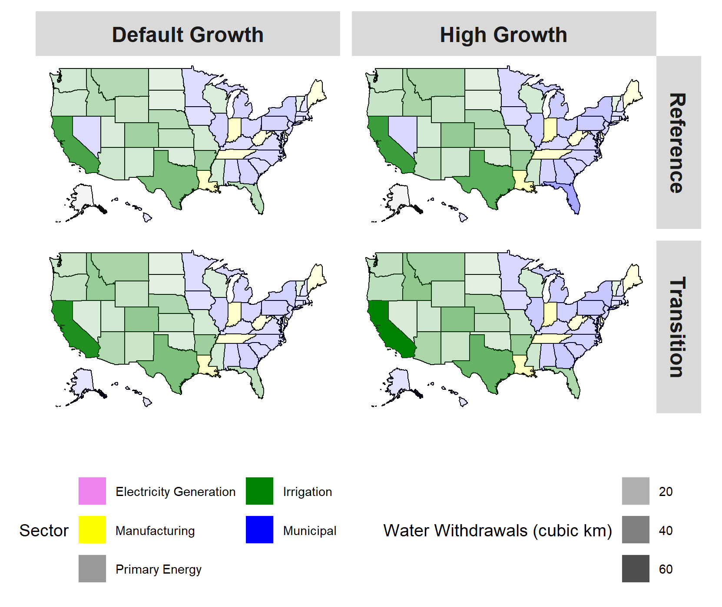
A Tool for Exploring State-Level Changes Across Multiple Systems
Objective
Document key improvements to the detailed U.S. version of the multi-sector Global Change Analysis Model (GCAM), GCAM-USA, including water supply, water demand, and improved representation of electric power plant operations.
Approach
GCAM-USA represents economic and energy systems for all 50 U.S. states and D.C.
Represent water demand (multiple scales), water supply (river basin level), and agriculture and land-use decisions (river basin level) with sub-national detail.
Employ a new electric power module that separates new power plant investment decisions from decisions about how to operate these plants to meet electricity demands during the day and night for every month.
Impact
GCAM-USA can be used to explore how changes in population, economic growth, technology, or policy impact the demand for and production of energy, water, and crop at the state level in the U.S., while maintaining consistency with broader national and international conditions.
GCAM-USA based simulations of water withdrawals by state to 2100. The colors correspond to the sector accounting for the most water withdrawals per state while shading depicts the magnitude of total withdrawals across all sectors (in 2100).
M.T. Binsted, et al. "GCAM-USA v5.3_water_dispatch: Integrated modeling of subnational US energy, water, and land systems within a global framework." Geoscientific Model Development, 15 (6), 2533–2559, (2022). [DOI: 10.5194/gmd-15-2533-2022]

