Slide 1
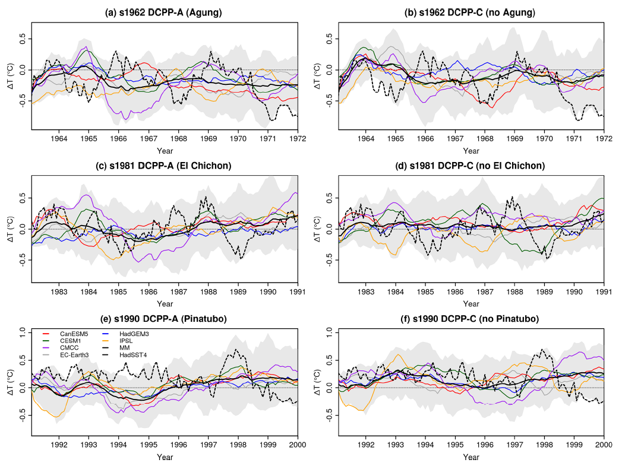
Impact of volcanic eruptions on CMIP6 decadal predictions: a multi-model analysis
R. Bilbao, P. Ortega, D. Swingedouw, L. Hermanson, P. Athanasiadis, R. Eade, M. Devilliers, F. Doblas-Reyes, N. Dunstone, A.-C. Ho, W. Merryfield, J. Mignot, D. Nicoli, M. Samso, R. Sospreda-Alfonso, X. Wu, and S. Yeager, 2024: Earth Syst Dynam, https://doi.org/10.5194/esd-15-501-2024
OBJECTIVE
Investigate the role of volcanic forcing in decadal predictions by analyzing the multi-model response to volcanic aerosol loadings from Agung, El Chichón, and Pinatubo in the initialized prediction framework.
APPROACH
Six Coupled Model Intercomparison Project Phase 6 (CMIP6) systems that contributed to the component C volcano experiment protocol of the Decadal Climate Prediction Project (DCPP) are compared. The DCPP-C experiment allows for high signal-to-noise attribution of the climate impacts of large volcanic eruptions by contrasting initialized ensemble hindcasts with and without volcanic forcing.
IMPACT
This multi-system analysis highlights several robust responses to volcanic forcing including: global surface and upper ocean cooling that lasts up to a decade, increased meridional temperature gradient in the stratosphere with associated enhancement of NH polar vortex, and increased subpolar Atlantic deep mixing followed by a decadal AMOC strengthening. While inclusion of volcanic forcing generally reduces forecast error relative to observations, this is not the case in the tropical Pacific where all systems show an increase in error following Pinatubo.
Tropical Pacific (20° S–20° N, 160° E–80° W) SST anomalies in DCPP hindcasts with (left column) and without (right column) volcanic forcing associated with Agung (top), El Chichón (middle), and Pinatubo (bottom). Bottom row highlights common skill degradation associated with Pinatubo.

