Slide 1
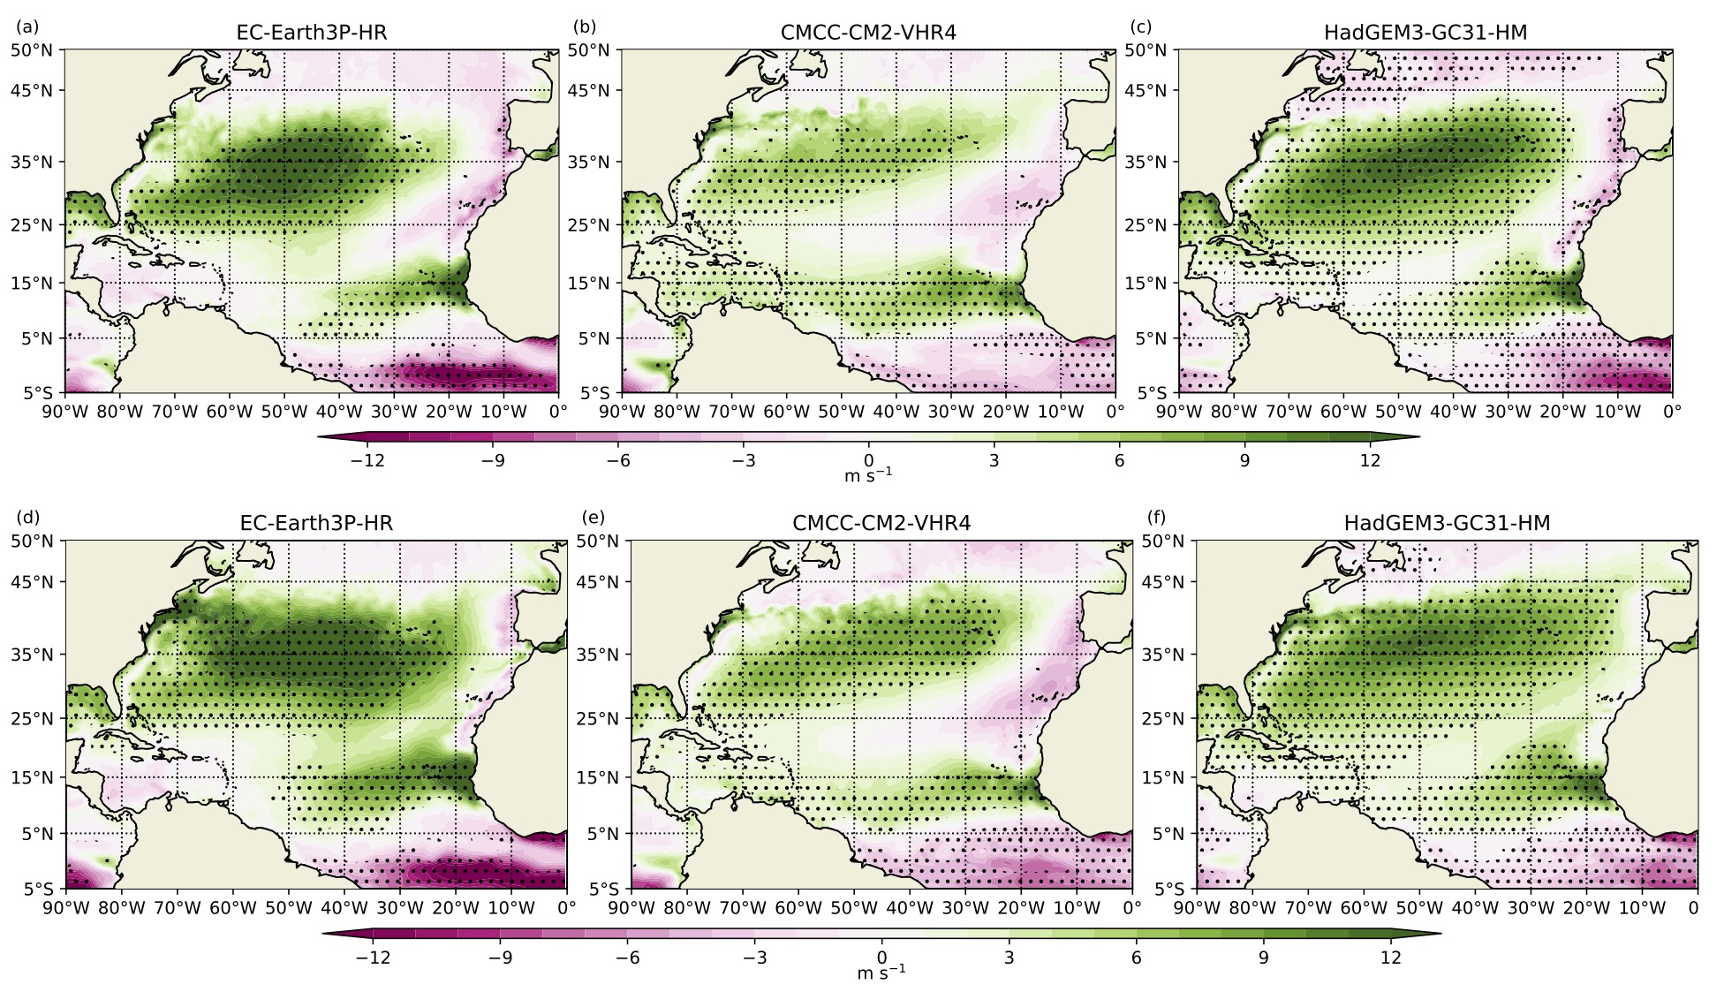

The relationship between African easterly waves and tropical cyclones in historical and future climates in the HighResMIP-PRIMAVERA simulations
Scientific Challenges
African easterly waves (AEWs) can serve as precursors to tropical cyclones (TCs) that develop in the Atlantic Ocean. It is therefore crucial to understand the relationship between AEWs and TCs and how this relationship maybe be affected by future climate change.
Approach and Results
We used three models from the HighResMIP PRIMAVERA simulations to examine AEWs and TCs in historical and future climates. Our results show that AEWs are not a limiting factor for future TC development, but AEW strength and environmental conditions are good indicators of TC genesis.
Significance
Potential intensity (m s⁻¹) of TCs that developed minus TCs that did not develop from AEWs, from the average (a)-(c) historical and (d)-(f) future simulations for the three HighResMIP models. Stippling refers to a significant difference in potential intensity between TCs that developed and TCs that did not develop from AEWs.
Future changes in the frequency of AEWs are not a good indicator of future TC activity.
AEWs that develop into TCs are stronger than non-developing AEWs in historical and future climates.
AEW strength combined with environmental conditions are good indicators of tropical cyclogenesis from waves.
Bercos-Hickey, E., Patricola, C. M., Loring, B., and W. D. Collins (2023). The relationship between African easterly waves and tropical cyclones in historical and future climates in the HighResMIP-PRIMAVERA simulations. Journal of Geophysical Research: Atmospheres, 128, e2022JD037471. https://doi.org/10.1029/2022JD037471

