Slide 1
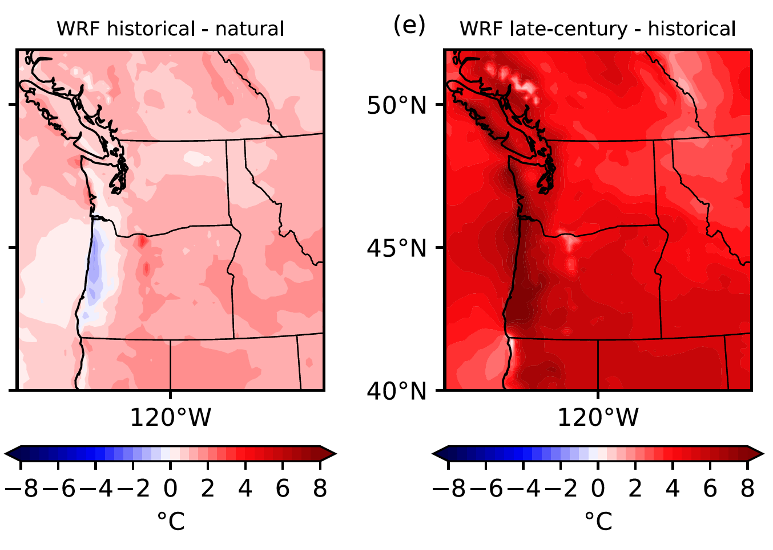

Anthropogenic contributions to the 2021 Pacific Northwest heatwave
While it is clear that global warming causes heatwaves to be warmer, the unique meteorological conditions behind the 2021 Pacific Northwest heatwave tax our ability to make quantitative estimates of the human contribution. Hence, there is low confidence in traditional estimates of the human contribution to this heatwave's temperatures and present an alternative, albeit more highly constrained estimate that human activities caused a ~0.8-1ºC increase in the observed daily maximum temperatures. Additional future warming could lead to a ~5ºC increase in the heatwave by the end of the 21st century.
We demonstrate that the observed 2021 daily maximum temperatures are far above the bounds of Generalized Extreme Value distributions fitted from historical data. Hence, confidence in tradition causal inference statements about the human influence on this heatwave is low.
Ensemble-averaged human caused changes in daily maximum 2m air temperature (ºC) on June 28, 2021 now and at the end of the 21st century.
We demonstrate that out of sample fitted non-stationary Generalized Extreme Value (GEV) distributions fail to contain many of the observed 2021 observations within the uncertainty estimates of their upper bounds. We conclude that estimates of the PNW heatwave return times are not accurate and that confidence in GEV-based estimates of the human influence on the change in the probability of the observed extreme temperatures should be low. We further that quantitative changes in event magnitude and frequency from CMIP-class models are made with low confidence We present an alternative but more limited attribution of the anthropogenic changes to the PNW heatwave using ensembles of simulations from regional climate models, where the hindcast attribution method was used to examine the effects of anthropogenic global warming.
Emily Bercos-Hickey, Travis A. O'Brien, Michael F. Wehner, Likun Zhang, Christina M. Patricola, Huanping Huang, Mark D. Risser (2022) Anthropogenic contributions to the 2021 Pacific Northwest heatwave. Geophysical Research Letters 49, e2022GL099396. https://doi.org/10.1029/2022GL099396

