Slide 1
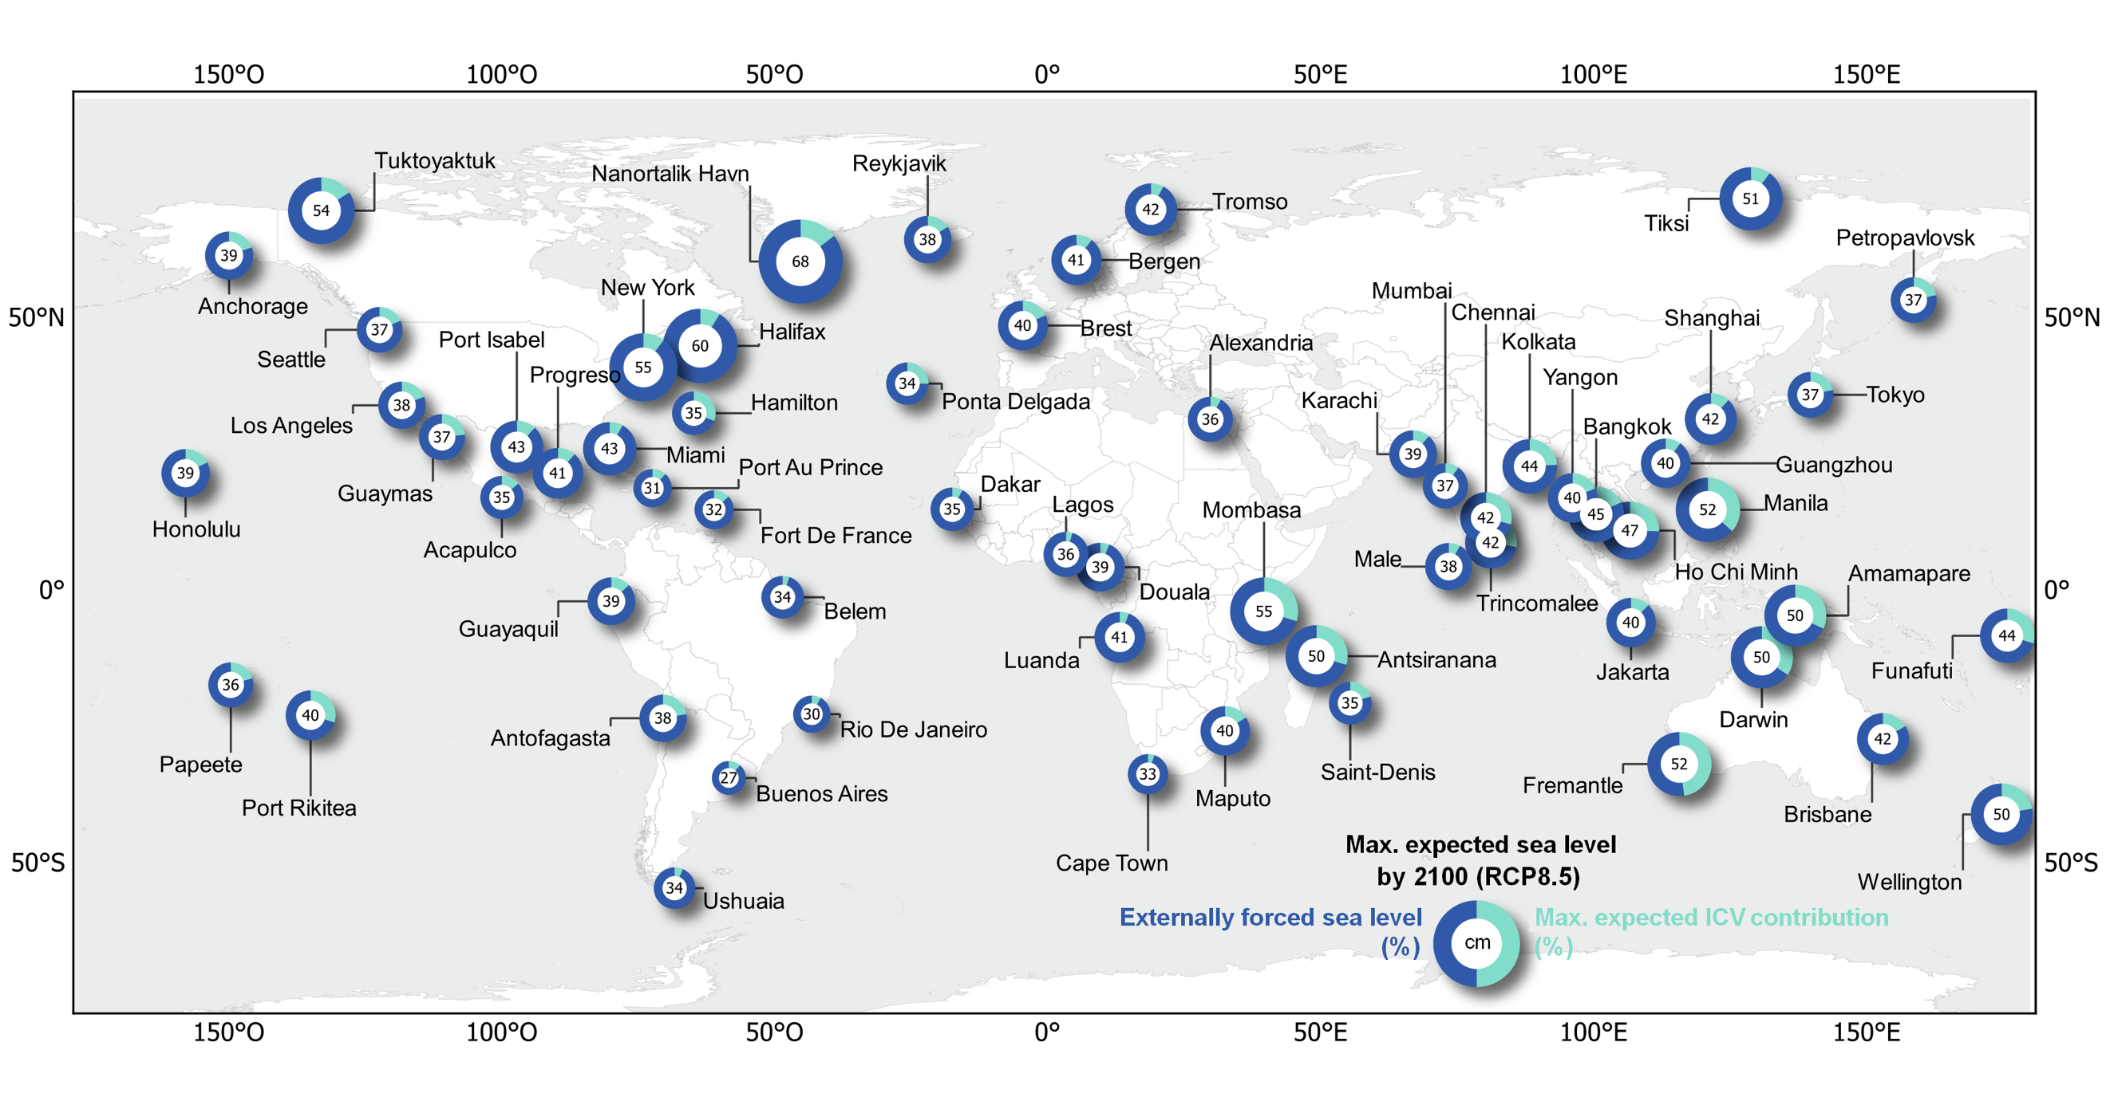
Increased exposure of coastal cities to sea level rise due to internal climate variability
Objective: Adaptation to future sea-level rise is based on projections of continuously improving climate models. These projections are accompanied by inherent uncertainties, including those due to internal climate variability (ICV). The ICV arises from complex and unpredictable interactions within and between climate-system components, rendering its impact irreducible. Although neglecting this uncertainty can lead to an underestimation of future sea-level rise, its estimation and impacts have not been fully explored.
Approach: Analyzing the CESM1 large ensemble simulation and applied the power-law statistics
Results/Impacts: The sea-level projections are accompanied by inherent uncertainties of which a significant part arises from complex and unpredictable interactions within and between climate-system components, rendering them irreducible. Neglecting the uncertainty induced by the ICV inevitably results in underestimation of future SLR and the associated flooding risks. Along with the spread in the sea-level changes derived from CESM1-LE, we used a realistic statistical model of large deviations in sea-level fluctuations based on previous analyses of the observed sea-level records. The power-law model provides a simple and efficient framework for estimating ICV uncertainty in sea-level projections. The power-law statistics seem to indicate a wider range of probable sea-level changes generated by the ICV than the spread among CESM1-LE members. This effect is pronounced by 2100 and under RCP8.5 along the coasts of East Africa, west Australia, insular Southeast Asia and west United States. If the ICV uncertainty upper limit is reached, some SLR hotspots would be created in Southeast Asian megacities, making a part of at least ~20% in the expected SLR at Chennai, Kolkata, Yangon, Bangkok, Ho Chi Minh City and Manila and reaching ~30% in the western tropical Pacific Islands and in Western Indian Ocean.
Becker, M., M. Karpytchev and A. Hu, 2023, Increased exposure of coastal cities to sea level rise due to internal climate variability, Nature Climate Change, published online March 2, 2023.
Figure 1. Upper-bound scenario of the expected sterodynamic SLR by 2100 under RCP 8.5 (relative to 2006). The sizes of the circles and the numbers attached to them represent the maximum expected SLR, defined as the sum of externally forced sea level obtained from the ensemble mean of SLR from CESM1-LE (blue) and the maximum expected ICV contribution obtained from power-law statistics (turquoise) corresponding to the two-sided 95% confidence interval upper bound. Probability of a larger ICV contribution than that shown by the turquoise part of circles is 2.5%. The selected cities are major ports worldwide. Population previsions for the megacities by 2100 are given in millions under the Shared Socioeconomic Pathway 2 (Middle of the Road)

