Slide 1
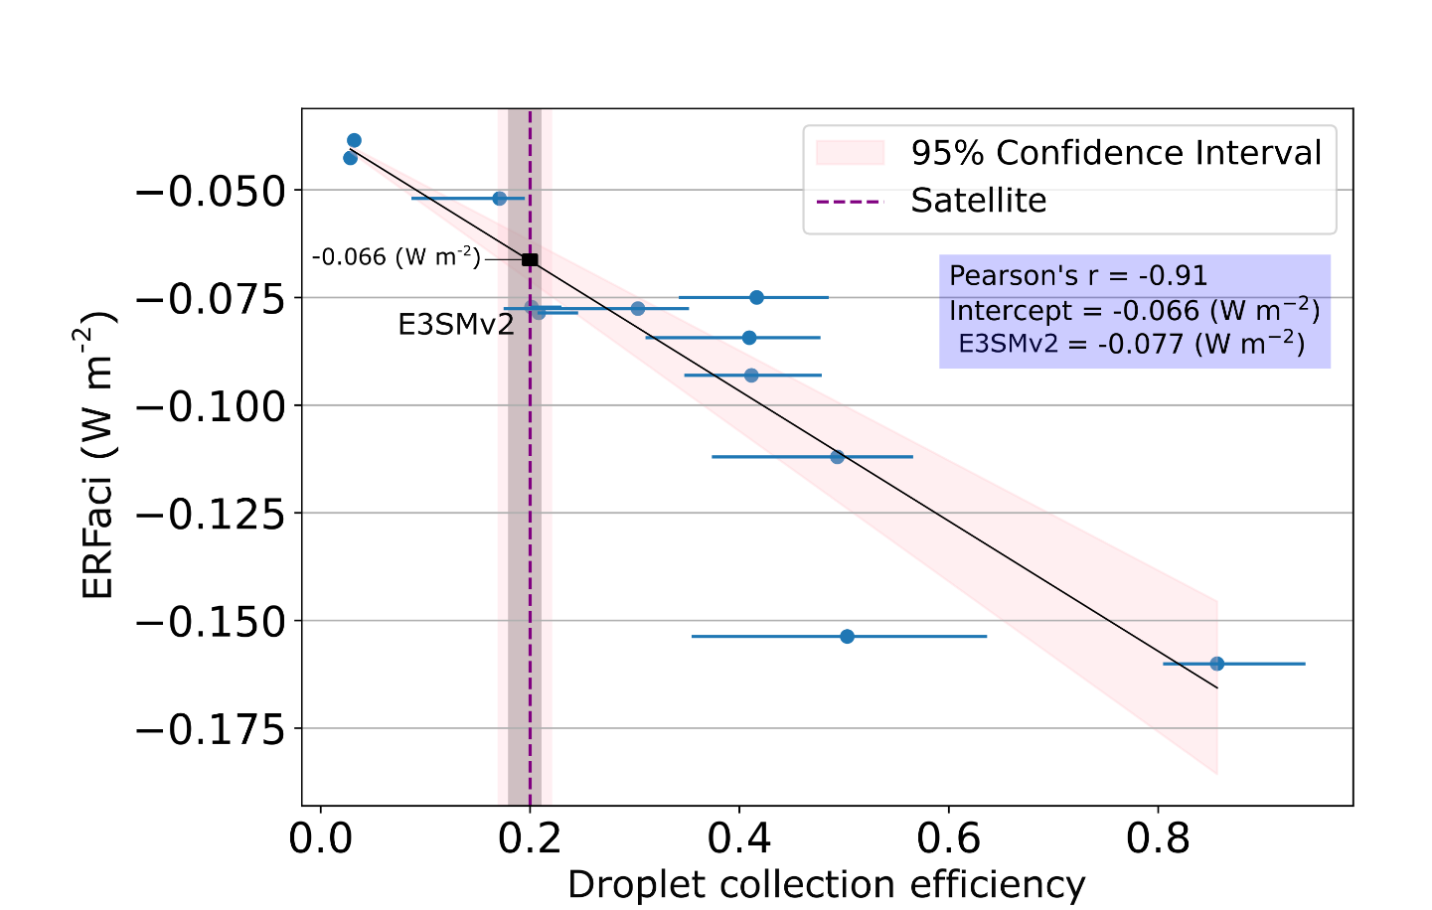
Satellite observations constrain model aerosol forcing uncertainty due to raindrop formation
Objectives
Develop a process-oriented constraint on the component of effective radiative forcing associated with aerosol–cloud interactions (ERFaci) linked to raindrop formation in the Energy Exascale Earth System Model version 2 (E3SMv2) using an updated, MODerate Resolution Imaging Spectroradiometer (MODIS)–CloudSat based contoured frequency by optical depth diagram (CFODD) analysis of single-layer warm liquid clouds.
Approach
Update the CFODD analysis using new MODIS and CloudSat data.
Derive the relationship between droplet collection efficiency (computed from CFODD) and ERFaci using a set of E3SM simulations with varying rain formation process representations.
Use a linear regression model to constrain model ERFaci through observationally derived droplet collection efficiency.
The robust linear relationship between the ERFaci in E3SMv2 and droplet collection efficiency (derived from CFODD) indicates that CFODD can be used to constrain ERFaci. E3SMv2 and observational estimates are in good agreement, suggesting that droplet collection efficiency is not the primary contributor to the ERFaci uncertainty.
Impacts
E3SMv2-simulated droplet collection efficiency is highly sensitive to warm rain process representations, affecting droplet collection efficiency.
E3SMv2’s ERFaci agrees with the MODIS-CloudSat constrained value, indicating that the rain formation process does not contribute significantly to overall ERFaci uncertainty.
The overrepresentation of small droplet clouds suggests a compensating bias, without which the total aerosol forcing could be stronger.
Beall, C. M., Ma, P.-L., Christensen, M. W., Mülmenstädt, J., Varble, A., Suzuki, K., and Michibata, T.: Droplet collection efficiencies inferred from satellite retrievals constrain effective radiative forcing of aerosol–cloud interactions, Atmos. Chem. Phys., 24, 5287–5302, https://doi.org/10.5194/acp-24-5287-2024, 2024.

