Slide 1
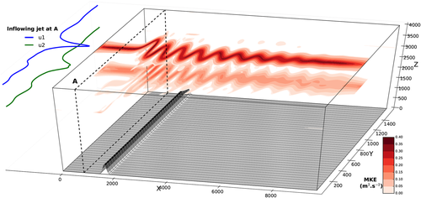
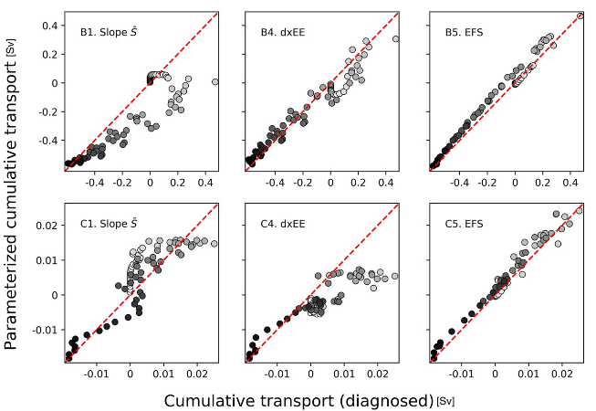
Baroclinic Control of Southern Ocean Eddy Upwelling Near Topography
Objective
Using a simplified ocean jet model, we examine how much and why topography impacts cross-jet transport, and how to improve our representation of these processes.
Research
We use an idealized model of an ocean jet to examine how bottom topography along the Antarctic Circumpolar Current can enhance and localize eddy-induced upwelling.
We find that the upwelling systematically occurs in regions where eddies grow through baroclinic instability, rather than in regions where eddy energy is large.
We propose a simple parameterization of eddy-induced upwelling based on the zonal evolution of eddy energy, which provides a better representation of the zonal variability of upwelling around topography compared with existing parameterizations.
Model domain. A prescribed 2-layer jet flows eastward over topography, leading to stationary meanders downstream of topography.
Impact
The upwelling that occurs in the Southern Ocean is an essential part of the global heat and carbon cycle, and ocean models rely on eddy parameterizations to represent these. Future ocean eddy parameterizations should consider metrics specific to the growth of baroclinic instability to accurately model eddy upwelling near topography.
Parameterized cumulative southward transport across the jet axis plotted against the resolved cumulative transport, for (upper row) 150 m ridge, and (lower row) 300 m seamount. Note that the parameterization in the right-most column –based on eddy growth rate— is the best match to the resolved transport.
Barthel, A., Hogg, A. M., Waterman, S., & Keating, S. (2022). Baroclinic control of Southern Ocean eddy upwelling near topography. Geophysical Research Letters, 49, e2021GL097491. https://doi.org/10.1029/2021GL097491

