Slide 1
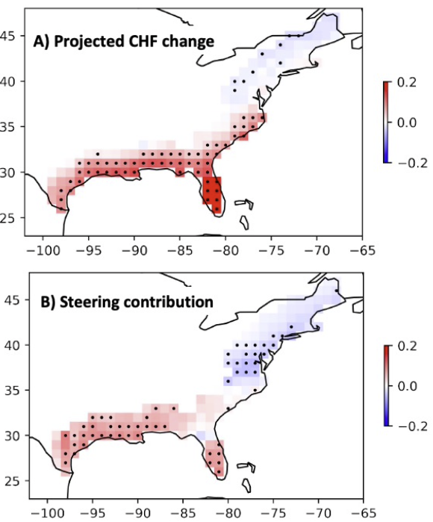
Heightened U.S. Coastal Hurricane Risk Under Global Warming
Objective
Use a hierarchical modeling framework to project U.S. coastal hurricane risk into the future and understand the physical mechanisms responsible for any changes.
Approach
Combine the Risk Analysis Framework for Tropical Cyclones (RAFT) with Coupled Model Intercomparison Project Phase 6 (CMIP6) climate models to project changes in U.S. coastal hurricane frequency (CHF).
Analyze the ambient storm environment projected by the CMIP6 climate models to understand its role in the evolving CHF.
Use a non-linear stationary wave model to delve into the detailed dynamical processes.
Impact
An increase in CHF is projected for the Gulf and lower East coasts, but CHF changes for the upper East Coast are mostly insignificant.
Examining various factors suggests that changes in steering flow play the dominant role in future CHF changes.
Experiments with the stationary wave model suggest that enhanced warming in the eastern tropical Pacific, which triggers a baroclinic stationary Rossby wave in the atmosphere, leads to circulation and steering flow changes.
Besides altering steering flow, wind changes also reduce wind shear near the coast and further enhance hurricane risk.
CHF is projected to increase along the Gulf and lower eastern U.S. coasts under global warming, primarily due to steering wind changes. A) Projected changes in CHF based on RAFT combined with 8 CMIP6 models. B) The contribution of changes in steering flow to the total change in CHF shown in (A). Change is defined as the mean over 2066-2100 minus the mean over 1980-2014. The future climate corresponds to a high-end (SSP585) emissions scenario.
Balaguru, K., Xu, W., Chang, C.-C., Leung, L. R., Judi, D. R., Hagos, S. M., Wehner, M. F., Kossin, J. P., Ting, M. “Increased US coastal hurricane risk under climate change,” Science Advances, 9 (14) (2023). DOI: 10.1126/sciadv.adf0259.

