Slide 1
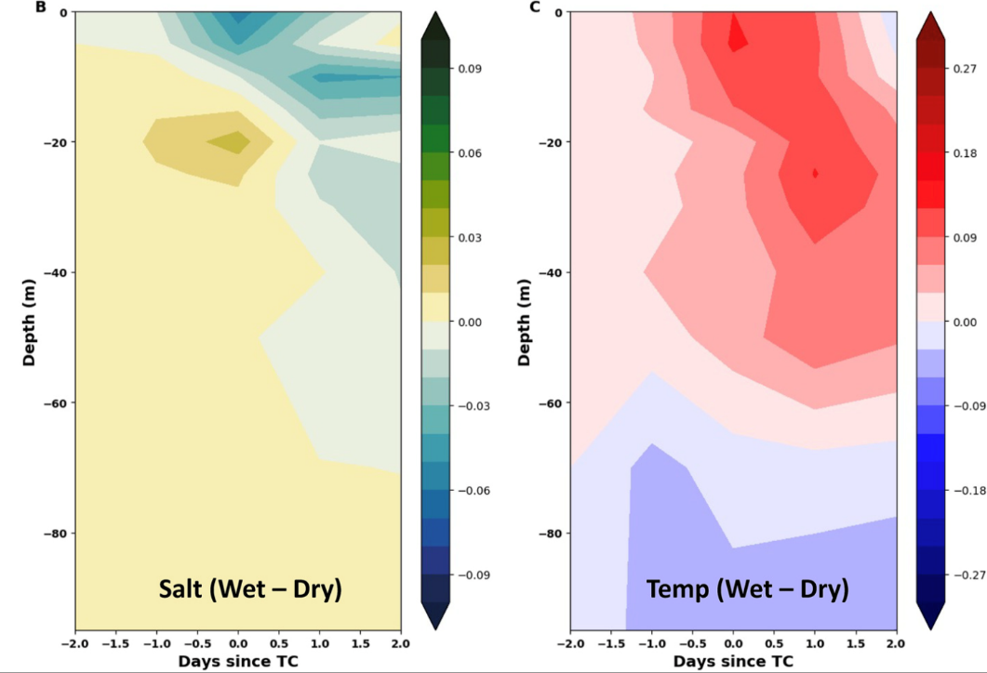
Rainfall Decreases Tropical Cyclone-Induced Sea Surface Cooling
Objective
Determine if rainfall from tropical cyclones (TCs) affects TC-induced sea surface cooling through changes in salinity stratification.
Approach
Using observations to compute pre-storm upper-ocean state, initial storm state, and change in sea surface temperature (SST) and salinity along TC tracks.
Compute differences in both upper-ocean salinity and induced temperature change between TCs that rain more (‘Wet’ TCs) and TCs that rain less (‘Dry’ TCs).
Perform a similar analysis using high-resolution E3SM simulations that explicitly resolve TCs.
Use idealized numerical sensitivity experiments to further understand the role of rainfall in TC-induced SST cooling.
Impact
High rain rates can reduce sea surface cooling induced by weak TCs.
Changes in upper-ocean stratification and mixing are primarily responsible for the identified rainfall effect.
Decreased SST cooling produces a rainfall-induced positive feedback mechanism for TC intensification, which may become more important in the future as TC rainfall is projected to increase in a warmer climate.
A
B
Difference in the composite mean anomalous upper-ocean
A) salinity (psu) and B) temperature (º C) response between ‘Wet’ and ‘Dry’ TCs based on 20 years of high-resolution E3SM simulations. Relative to ‘Dry’ TCs, the upper-ocean freshens considerably and cools less for ‘Wet’ TCs due to the increase in salinity stratification. ‘Anomalous’ refers to deviation from the pre-storm state and ‘composite mean’ indicates averaging across all wet/dry cases.
Balaguru K., G.R. Foltz, L.R. Leung, and S.M. Hagos. 2022. “Impact of rainfall on tropical cyclone-induced sea surface cooling.” Geophys. Res. Lett., 49. [DOI: 10.1029/2022GL098187]

