Slide 1
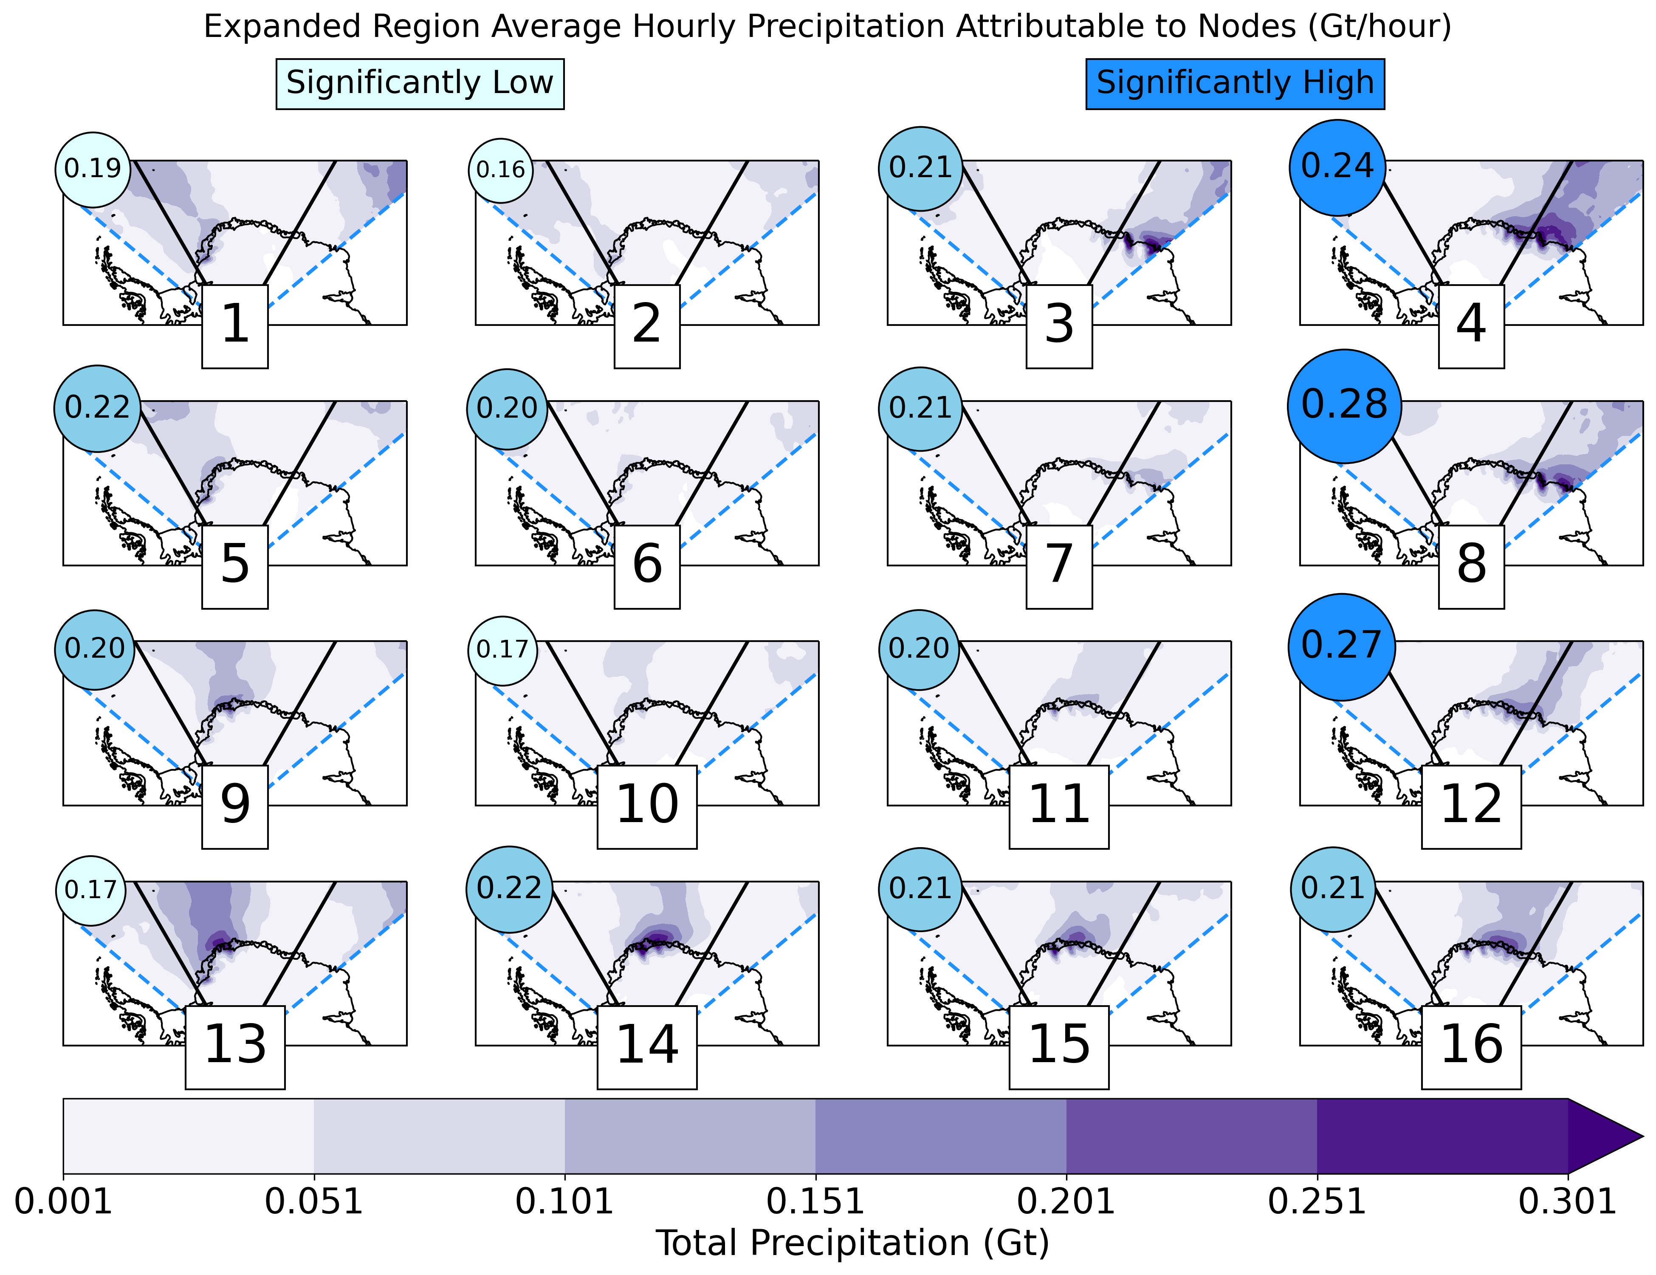
Synoptic Drivers of Atmospheric River Induced Precipitation Near Dronning Maud Land, Antarctica
Baiman, R., Winters, A. C., Lenaerts, J., & Shields, C. A. (2023). Synoptic Drivers of Atmospheric River Induced Precipitation Near Dronning Maud Land, Antarctica. Journal of Geophysical Research: Atmospheres, 128, e2022JD037859. https://doi-org.cuucar.idm.oclc.org/10.1029/2022JD037859.
OBJECTIVE
Identify synoptic of precipitation associated with ARs reaching Dronning Maud Land, Antarctic.
Cumulative precipitation for timesteps mapped to nodes from 50°W to 50°E (shading). Average landfalling precipitation intensity over extended focus region (blue dotted lines) for landfalling AR timesteps associated with nodes (blue circles). Average precipitation intensities that are statistically significantly high (low) are shown in dark (light) blue.
APPROACH
We employ a 16-node self-organizing map (SOM) trained with MERRA-2 sea-level pressure anomalies to identify synoptic-scale environments associated with landfalling ARs in and around DML.
IMPACT
Atmospheric Rivers (ARs) that reach Dronning Maud Land (DML) control the interannual variability of precipitation in the region. AR environments near DML feature an anomalous surface pressure couplet, anomalously high moisture, and sometimes a coastal barrier jet. The occlusion process dominates the quasi-geostrophic forcing for lift in DML ARs, which modulates the intensity of AR precipitation.

