Slide 1
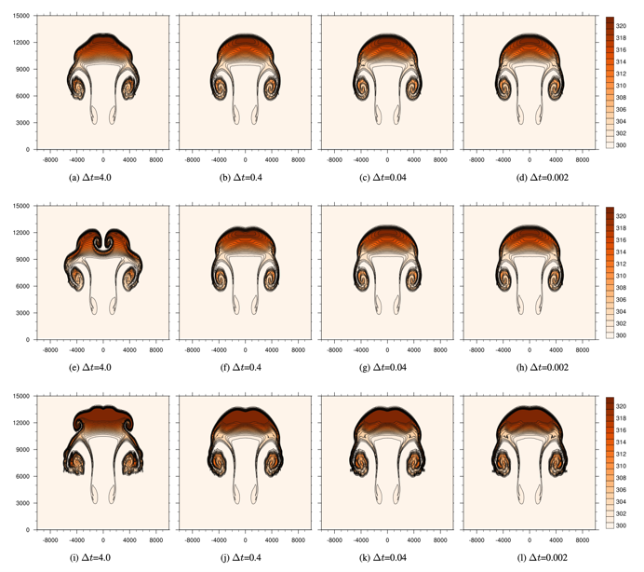
Energy-conserving physics for nonhydrostatic dynamics
in mass coordinate models
Scientific Challenge
Moist thermodynamic processes in atmospheric models are currently implemented with crude assumptions
Moist processes are represented by parameterization packages that do not take into consideration analytical and numerical formulations of the global atmospheric component
As numerical climate models advance to represent higher spatial and temporal scales, it is crucial to improve representation of moist thermodynamic processes
Approach and Results
We analyzed the most common approaches to physics-dynamics coupling as viewed from a time-split mechanism between physics and dynamics
We derived a new coupling mechanism for a nonhydrostatic atmospheric dynamical core
Analysis and performance of coupling mechanisms was evaluated in a test with rising thermal bubble and simplified moist physics package (as in the figure)
A test for a thermal raising bubble with simplified physics for three different coupling mechanisms that are most common in the current atmospheric models.
Impact
It is shown that to properly model energy fluxes of water forms in the atmosphere is it required to implement unapproximated thermodynamics in moist parameterizations
A consistent approach to physics-dynamics coupling mechanisms and its application to nonhydrostatic dynamics is provided
Citation: O. Guba, M. A. Taylor, P. A. Bosler, C. Eldred, P. H. Lauritzen: Energy-conserving physics for nonhydrostatic dynamics in mass coordinate models, Geosci. Model Dev., 17, 1429–1442 (2024).

