Slide 1
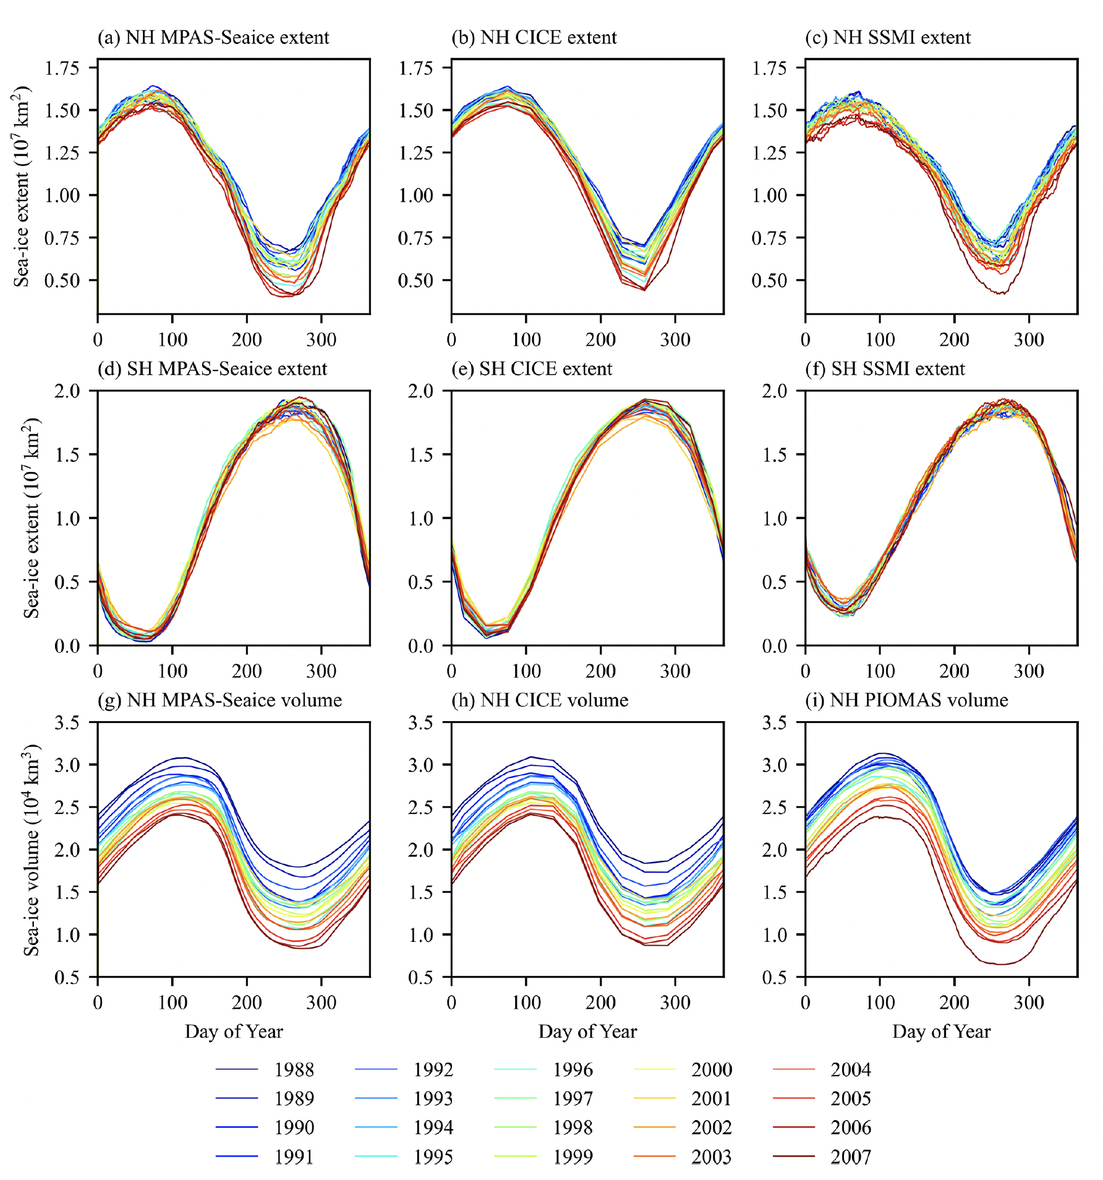
Sea-ice dynamics on unstructured Voronoi meshes in MPAS-Seaice
Scientific Challenge
Develop a sea ice dynamical core for the unstructured Voronoi meshes used in the Modeling for Prediction Across Scales (MPAS) framework
Develop and validate a sea ice component for E3SM
Approach and Results
Adapt variational operators used by CICE for the Voronoi meshes used by MPAS
Use two basis function options: Wachspress and piecewise linear
Additional finite volume formulation for comparison
Compare simulation results in idealized test cases, and against existing sea ice models on a quadrilateral mesh (CICE), and against observations
New spatial operators for strain and stress divergence show good error convergence properties for increasing model resolution
Model results compare favorably against CICE results and observations
Impact
MPAS-Seaice developed and used as sea ice component for E3SM
E3SM sea ice component can now use variable resolution meshes with model resources concentrated in regions of interest
Possibility of removing equatorial cells from model domain to increase computational efficiency
Comparison of sea ice extent and volume for results from MPAS-Seaice and CICE and observations showing good agreement
Citation: Turner, A. K., Lipscomb, W. H., Hunke, E. C., Jacobsen​​​​​​​, D. W., Jeffery, N., Engwirda, D., Ringler, T. D., and Wolfe, J. D.: MPAS-Seaice (v1.0.0): sea-ice dynamics on unstructured Voronoi meshes, Geosci. Model Dev., 15, 3721–3751, https://doi.org/10.5194/gmd-15-3721-2022, 2022.

