Slide 1
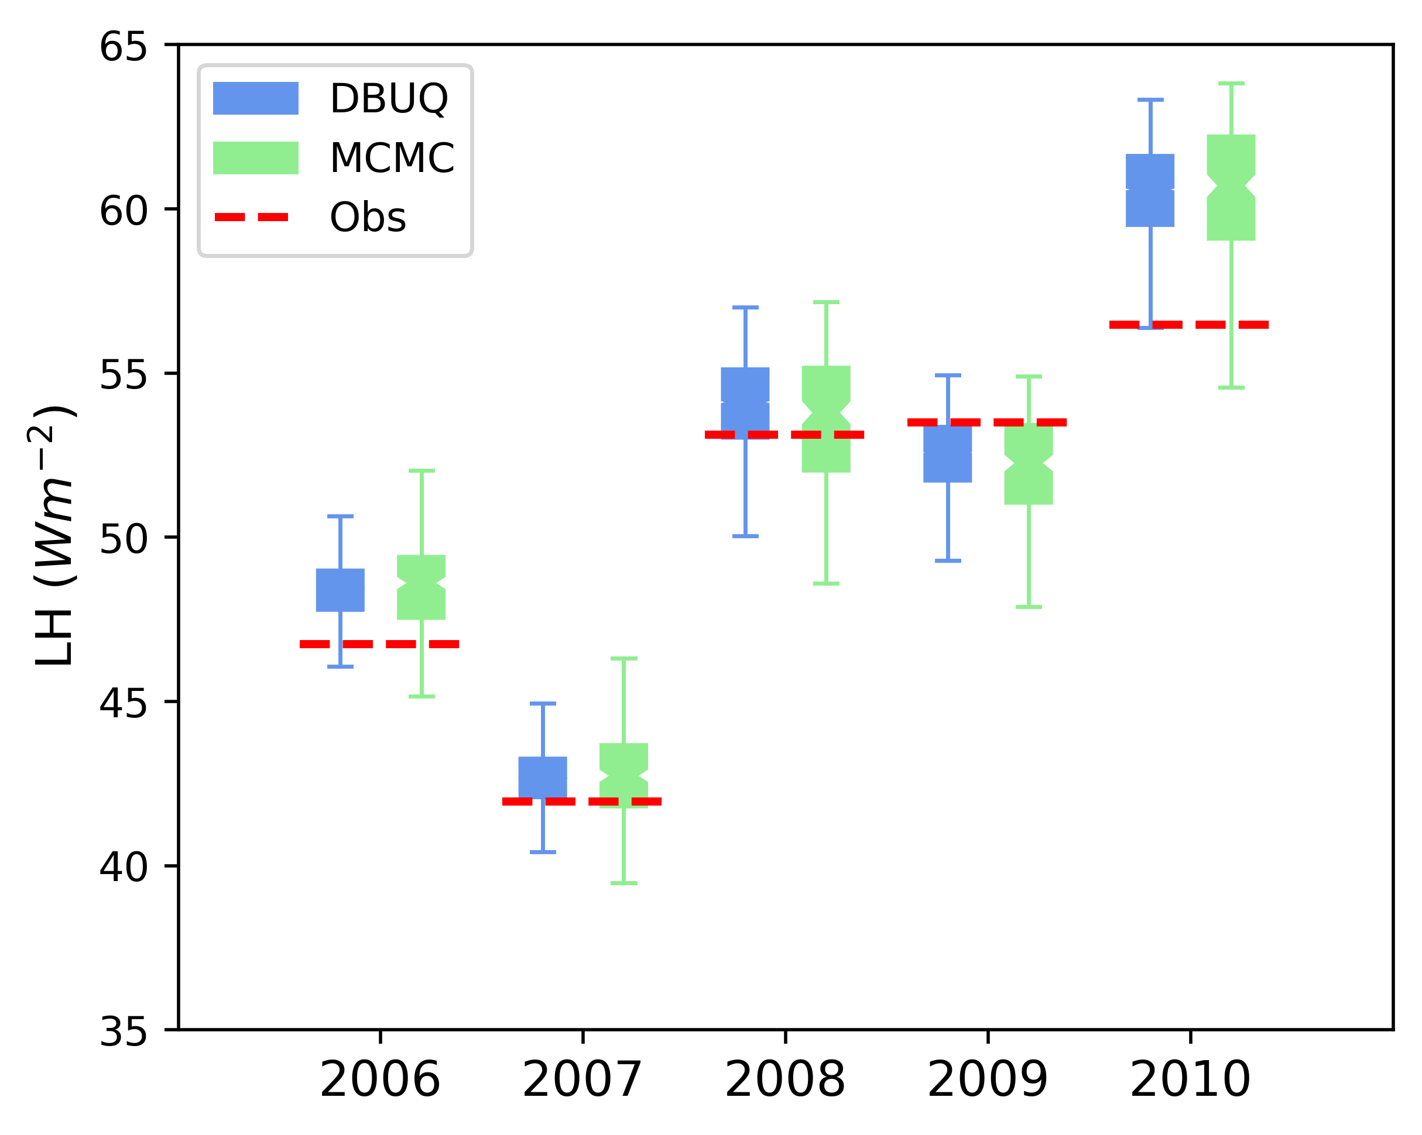
Advancing E3SM Land Model Calibration using AI-based UQ
Scientific Challenge
Calibration and uncertainty quantification (UQ) of E3SM land model (ELM) is critical to advance predictive understanding of ecosystems’ response to climate change. However, current UQ methods are typically computationally expensive, which limits their applicability for site-level model calibration.
Approach and Findings
This study developed a computationally efficient UQ method, called DBUQ, based on generative artificial intelligence (AI).
Applying DBUQ to calibrate the ELM at the Missouri Ozark AmeriFlux forest site showed that it accurately quantifies parameter uncertainty with a 30X speedup compared to Markov Chain Monte Carlo (MCMC) sampling.
DBUQ yields a posterior distribution for quantifying parameter uncertainty in the ELM that is comparable to that produced by MCMC sampling yet requires 30X less computing time.
Significance and Impact
The efficiency of DBUQ marks a significant advancement in model calibration and UQ, enabling precise, site-specific parameter estimation on a global scale.
The calibrated ELM with UQ can improve understanding of climate impact on ecosystem and inform climate-resilient decision-making.
Prediction uncertainty on latent heat flux (LH) produced by DBUQ and MCMC closely mirror each other and effectively encapsulate the observed data.
Lu, D., Liu, Y., Zhang, Z., Bao, F., & Zhang, G. (2024). A diffusion-based uncertainty quantification method to advance E3SM land model calibration. Journal of Geophysical Research: Machine Learning and Computation, https://doi.org/10.1029/2024JH000234
Notes:
Title: Advancing E3SM Land Model Calibration using AI-based Uncertainty Quantification
Subtitle: AI-Enabled Uncertainty Quantification for Rapid Calibration of Earth System Models
The Science
Calibration and uncertainty quantification (UQ) of the E3SM Land Model (ELM) at each site are essential for advancing our predictive understanding of ecosystem responses to climate change. However, traditional UQ methods are often computationally intensive, limiting their practical use for site-specific model calibration. Our research tackles this challenge by introducing a novel UQ method that utilizes generative artificial intelligence (AI) techniques. This approach has successfully quantified parameter posterior uncertainty, achieving a 30-fold improvement in computational efficiency compared to traditional Markov Chain Monte Carlo (MCMC) sampling.
The Impact
Our innovative method significantly lowers the computational costs associated with model calibration and UQ, thereby making site-specific parameter estimation globally feasible. This advancement enhances our ability to accurately calibrate the ELM to align with observational data, enabling more precise simulations of ecosystems and consequently improving our predictive understanding of the impacts of climate change on the ecosystem.
Summary
Land surface models are essential for simulating environmental processes and aiding climate-resilient decision-making. Traditionally, calibrating these models has been costly and time-consuming. To address this, we developed a new method called diffusion-based uncertainty quantification (DBUQ), which is faster and less memory-intensive than previous methods. Using supervised learning, DBUQ quickly generates samples to accurately approximate parameter posterior distributions. We tested this method on the Energy Exascale Earth System Model land model at the Missouri Ozark AmeriFlux forest site, finding that it can produce results similar to traditional methods but 30 times faster. This efficiency suggests that DBUQ could revolutionize the calibration of land surface models globally, enhancing our predictive understanding of climate impacts on ecosystems.
Contact
Dan Lu Oak Ridge National Laboratory lud1@ornl.gov
Program Manager
Renu Joseph, Xujing Davis U.S. Department of Energy, Biological and Environmental Research (SC-33)
Funding
The work was supported by the ECA project within the U.S. Department of Energy’s (DOE) Biological and Environmental Research (BER) Program.

