Slide 1
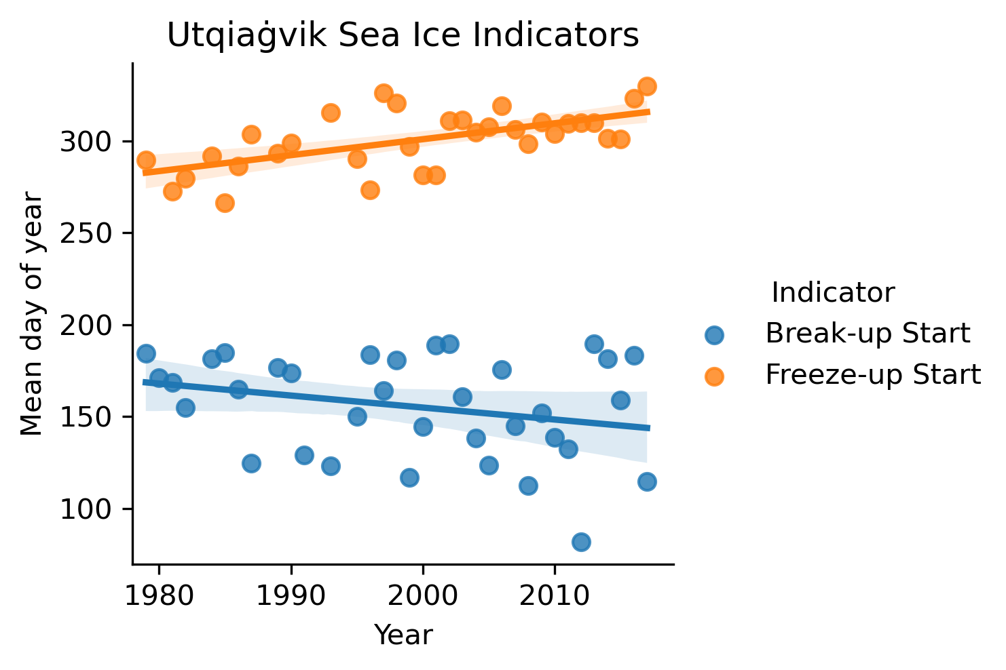
Sea ice breakup and freeze-up indicators
for users of the Arctic coastal environment
Why did we do this research?
Example of indicator trends (Utqiaġvik, AK)
The seasonal sea ice cycle governs uses of Arctic coastal and offshore environments. Key indicators derived from such uses of the environment can help link large-scale drivers and trends to changes at the local and regional scale.
How did we conduct the science?
What did we find and why does it matter?
Why do these findings matter?
Refined and implemented an algorithm to extract start and end dates for sea-ice freeze-up and break-up from passive microwave satellite data drawing on community-based observations
Analyzed and compared trends of these indicators at the local and regional scale for the pan-Arctic
Locally defined indicators can link pan-Arctic or global indicators (e.g., sea ice extent or volume) and local uses and may inform community-scale adaptation
Derived indicator fields support model validation and help identify key processes not represented well in models
Reference: Walsh, J.E., Eicken, H., Redilla, K. and Johnson, M., 2022. Sea ice breakup and freeze-up indicators for users of the Arctic coastal environment. The Cryosphere, 16(11), pp.4617-4635, https://doi.org/10.5194/tc-16-4617-2022

