Slide 1
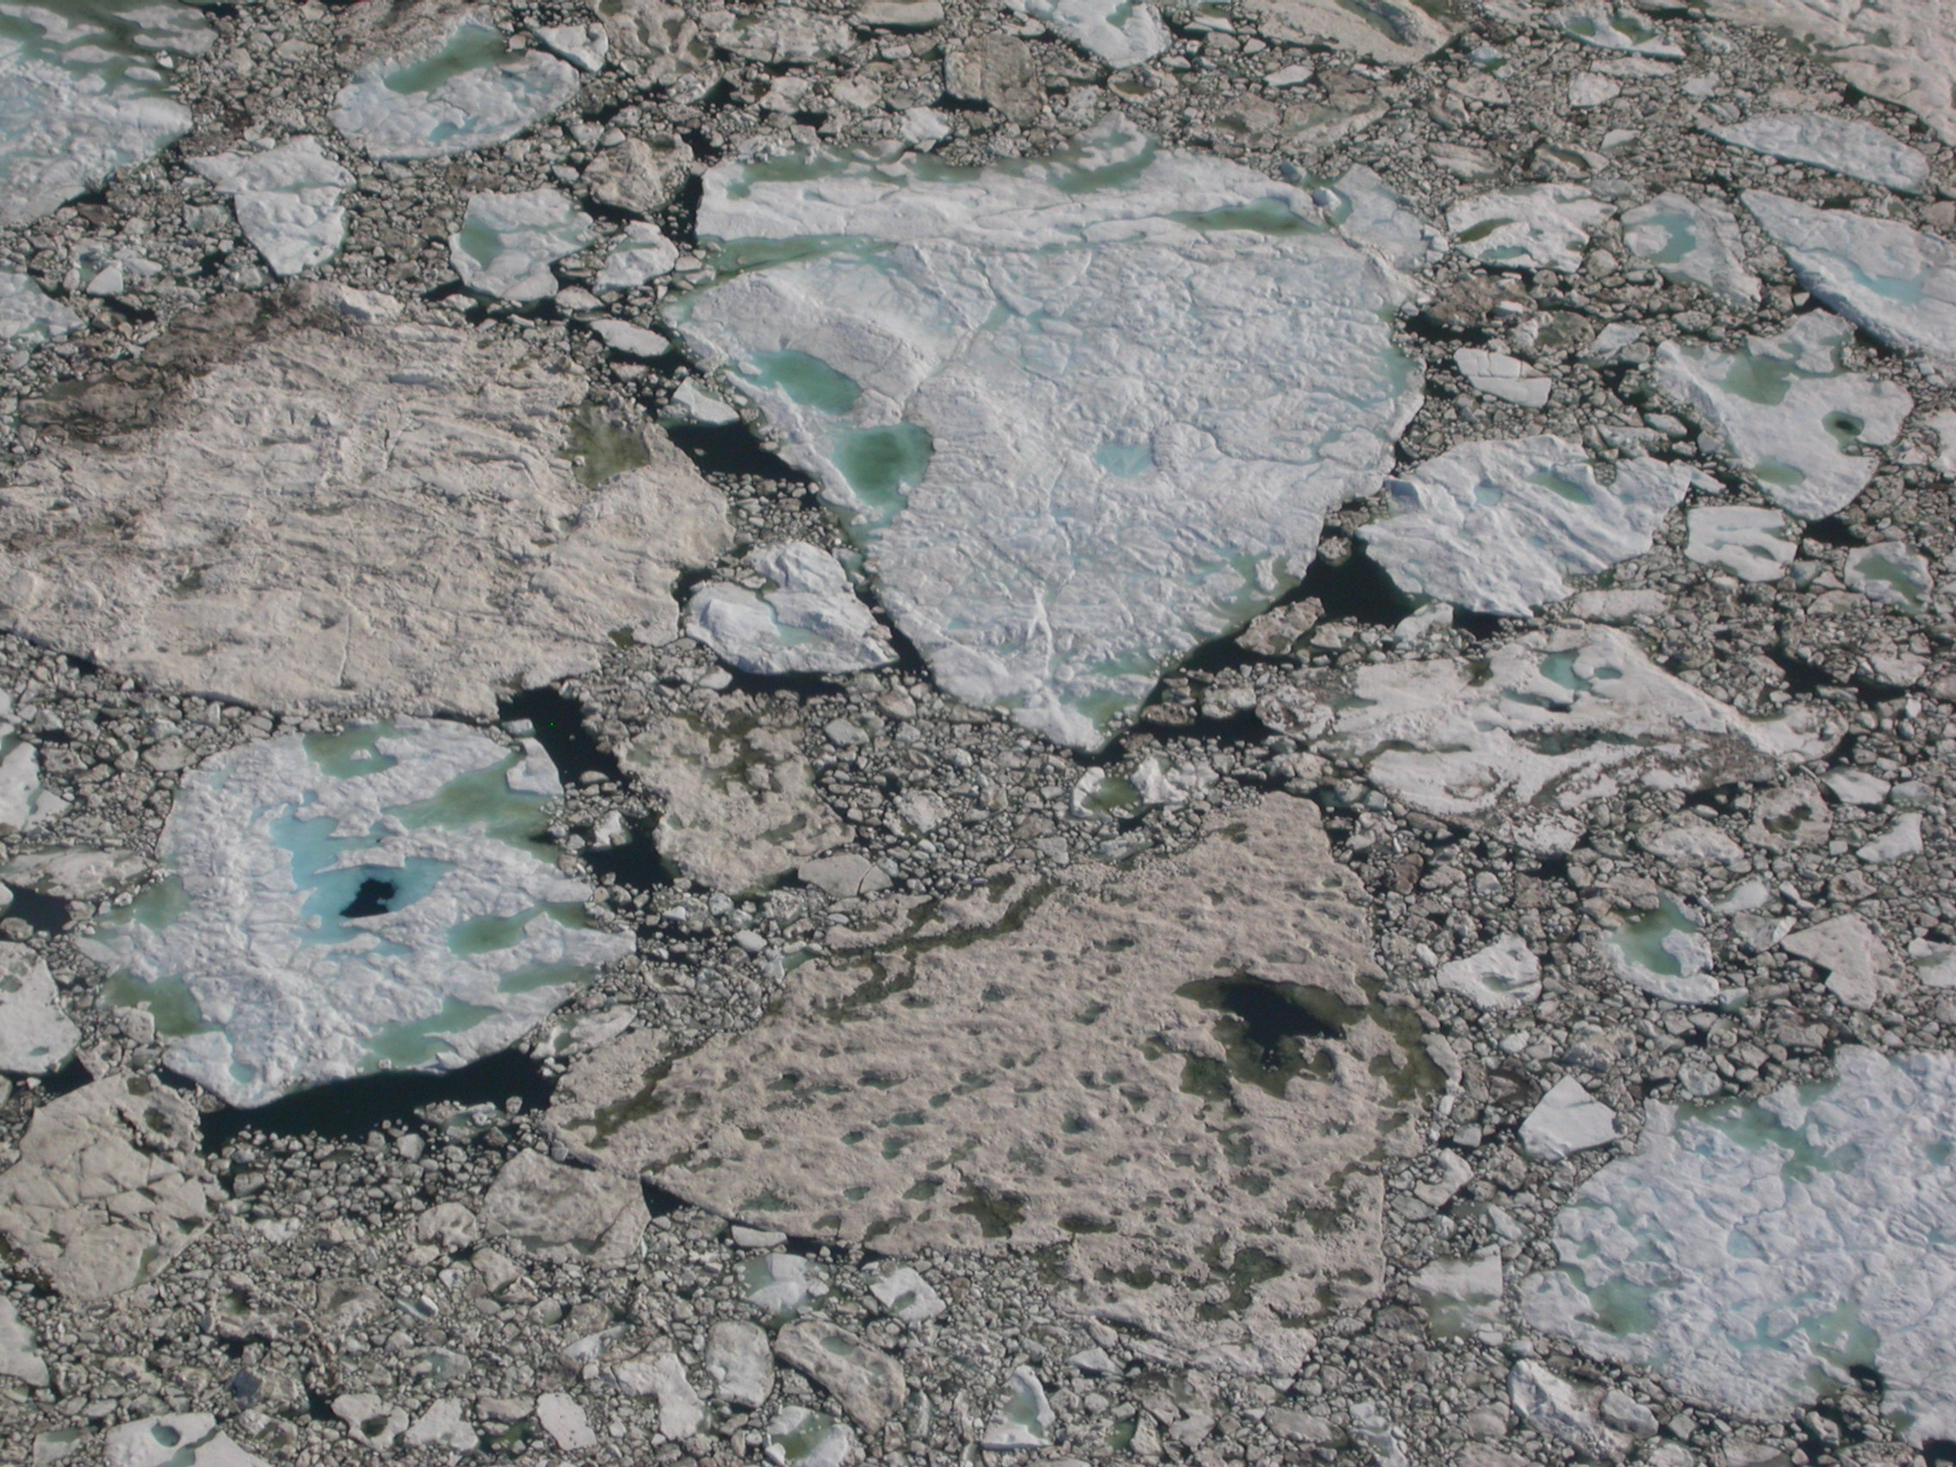
A neural network-based method for satellite-based mapping of sediment-laden sea ice in the Arctic
Why did we do this research?
Sediment-laden sea ice is a ubiquitous phenomenon in the Arctic Ocean and its marginal seas. Considering recent shifts in Arctic ice regimes that have likely increased the amount of sediment-laden ice, we developed and tested a method to monitor large-scale variations in sediment-laden ice by satellite.
Sediment-laden sea ice near Point Barrow, AK
How did we conduct the science?
What did we find and why does it matter?
Why do these findings matter?
Develop a satellite-based approach to quantify the distribution of sediment-laden ice, employing a neural network
Estimate fractions of sediment-laden ice from remotely-sensed surface reflectances based on a spectral unmixing algorithm
The satellite-based approach developed here opens up remote-sensing data archives for extensive studies of sea-ice sediment entrainment and transport, including impacts on biogeochemistry and surface albedo. The study also creates a foundation for validation of large-scale models of these important processes.
Reference: Waga, H., Eicken, H., Light, B., Fukamachi, Y., 2022. A neural network-based method for satellite-based mapping of sediment-laden sea ice in the Arctic. Remote Sens Environ 270, 112861. https://doi.org/10.1016/j.rse.2021.112861

