Slide 1
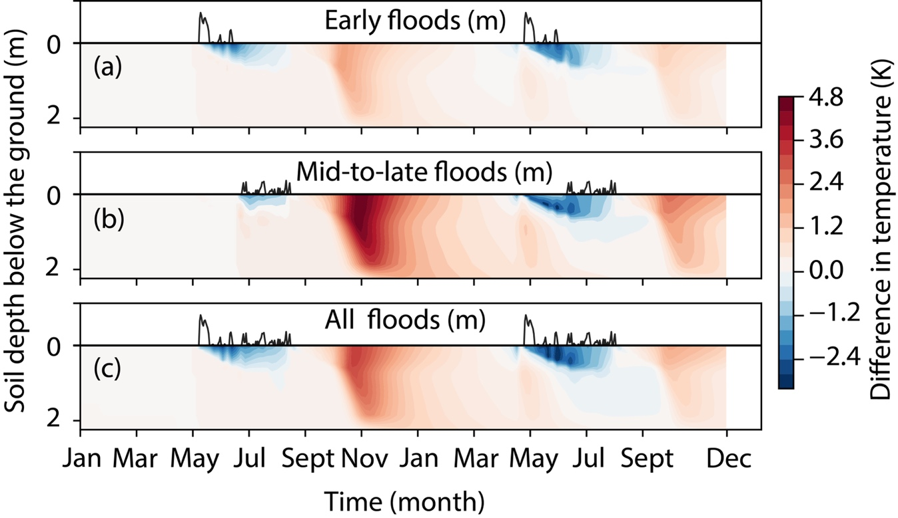
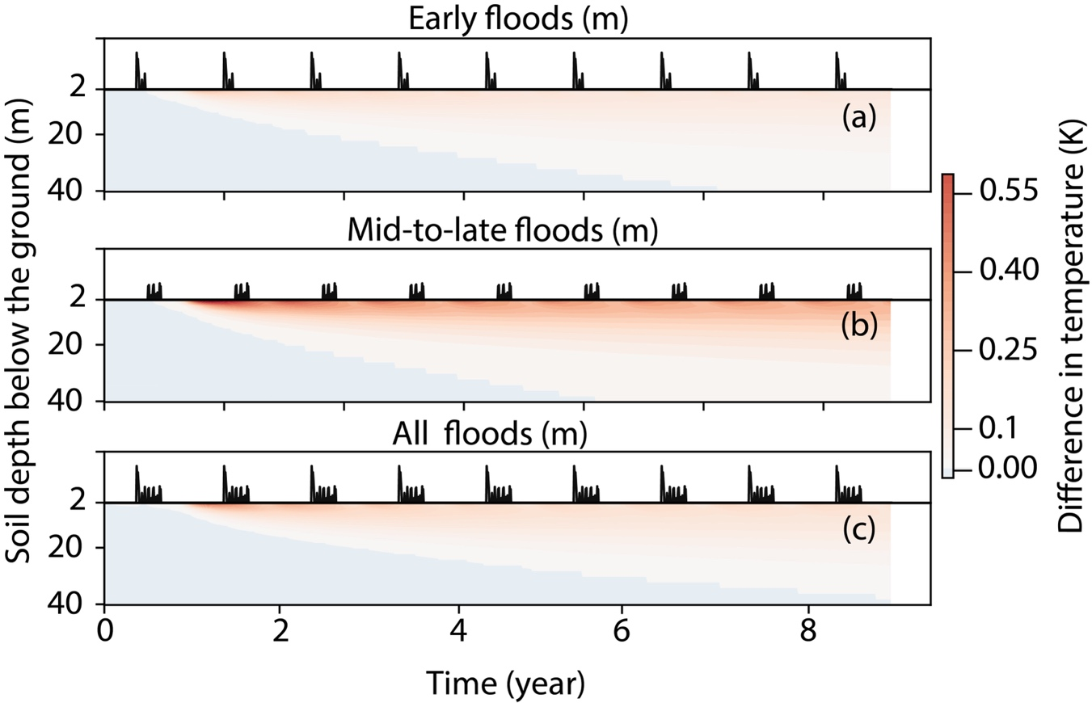
The thermal response of permafrost to coastal floodplain flooding
Objective
Impact
Model the thermal response of coastal permafrost to inundation by floods
First investigation of the impact of floods on low-lying coastal permafrost hydro-thermal dynamics
Improved our understanding of the coastal permafrost thaw mechanism.
The change in active layer thickness and subsurface temperature due to floods will have important biogeochemical implication and can potentially affect the biogeochemical cycle of permafrost.
Research
Modeled hydro-thermal responses of permafrost due to flooding using Advanced Terrestrial Simulator model
Quantified the effect of flooding on soil thermal conductivity, water saturation, and temperature.
Differences in subsurface temperature in the top 2 m soil zone (left most Fig) and deeper soil (left Fig) between the cases with and without floods. Floods result in a cooler surficial soil zone (blue color) and warmer deep soil (red color)
Reference: Zhang Y, Jafarov E, Piliouras A, Jones B, Rowland J, Moulton J. The thermal response of permafrost to coastal floodplain flooding. Environmental Research Letters. 2023 February 24; 18(3):035004. DOI: 10.1088/1748-9326/acba32

