Slide 1
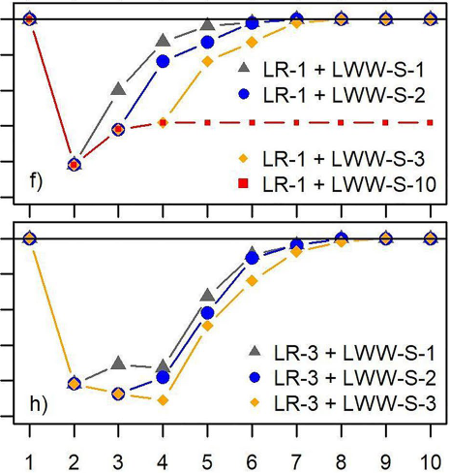
Lake Water Withdrawals and Seasonal Hydrologic Extremes (Droughts and Floods) Significantly Impact Connectivity of Lakes and Streams on the North Slope of Alaska
Why did we do this research?
Decrease in MQ7
(%) depending on scenarios applied: LR-xx - low rain for xx consecutive summers
LWW-S-xx - LWWs for xx consecutive years
The Arctic Coastal Plain of the North Slope of Alaska experienced extreme climate events and increased lake water withdrawal (LWW) for infrastructure construction,primarily ice roads and industrial operations. However, their potential combined effects on streamflow remained underexplored.
How did we conduct the science?
Scenario year
A spatially distributed hydrological model (at 10 m spatial resolution) was applied to Crea Creek watershed. The impacts of seasonal climate extremes and LWW were evaluated on seasonal runoff, minimum 7-day mean flow (MQ7), the recovery time of MQ7 to pre- perturbation conditions, and the duration of conditions that prevent fish passage.
Why do these findings matter?
Under current average climatic conditions, LWWs are not offset by same-year snowmelt as currently assumed in land management
regulations. Effective land management would benefit from considering the combined impact of climate change and industrial LWWs.
Reference: Gädeke, A., Arp, C.D., Liljedahl, A.K., Daanen, R.P., Cai, L., Alexeev, V.A., et al. (2022). Modeled streamflow response to scenarios of tundra lake water withdrawal and seasonal climate extremes, Arctic Coastal Plain, Alaska. Water Resources Research, 58, e2022WR032119. https://doi.org/10.1029/2022WR032119

