Slide 1
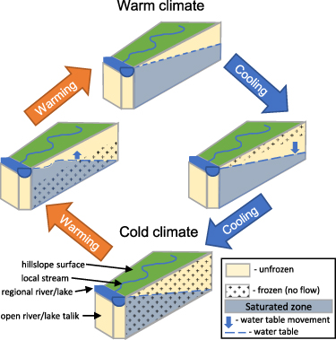
Permafrost-affected rivers can see an increase in runoff in a warmer climate,
even with the same amount of precipitation
Conceptualized evolution of frozen/unfrozen and unsaturated/saturated soil in response to the transitions between the warm and cold steady climates.
Why did we do this research?
Observations show increases in river discharge to the Arctic Ocean especially in winter over the last decades but the physical mechanisms driving these changes are not yet fully understood. We hypothesize that even in the absence of a precipitation increase, permafrost degradation alone can lead to increased annual river runoff.
How did we conduct the science?
Why do these findings matter?
We perform millennium-long simulations over an idealized watershed using a distributed, physically based water balance model forced by both a hypothetical warming defined by an air temperature increase of 7.5 ∘C over 100 years, and a corresponding cooling scenario.
Under the warming scenario, changes in subsurface water transport due to ground temperature changes result in a 7%–14% increase in annual runoff accompanied by a 6%–20% decrease in evapotranspiration with potentially important consequences for droughts and forest fires.
Reference: M.V Debolskiy, V.A Alexeev, R. Hock, R.B Lammers, A. Shiklomanov, J. Schulla, D. Nicolsky, V.E Romanovsky and A. Prusevich, "Water balance response of permafrost-affected watersheds to changes in air temperatures", ERL, Vol. 16, 084054, https://doi.org/10.1088/1748-9326/ac12f3

