Slide 1
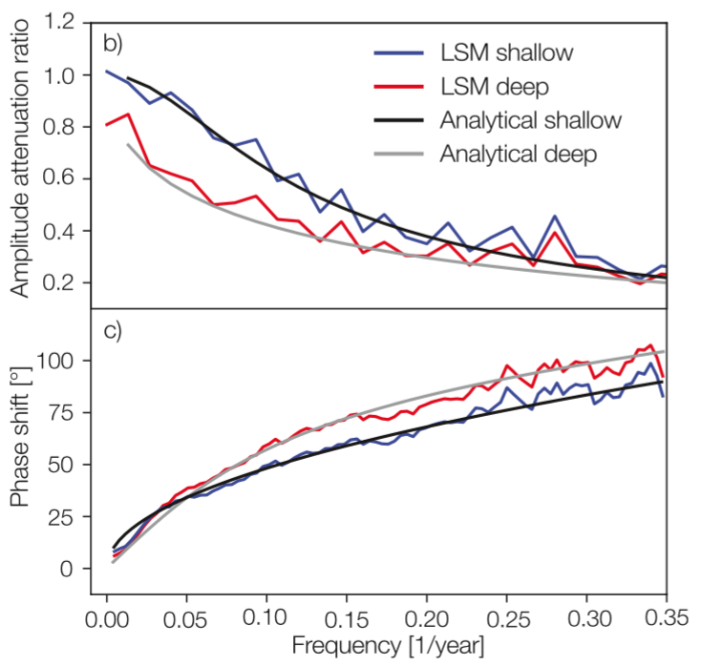
What is the best configuration for a soil model to properly simulate permafrost?
Why did we do this research?
Many current-generation climate models have land components that are too shallow (3–10 m). Shallow models alter the terrestrial heat storage and distribution of temperatures in the subsurface and therefore are inaccurate because do not properly reproduce the timescales and amplitudes of the simulated warming trend.
Amplitude and phase discrepancy at different frequencies for analytical and numerical solutions with different depths.
How did we conduct the science?
Why do these findings matter?
This study bridges the gap between analytical and simulation-based estimates of the subsurface thermodynamic state by adapting the classic analytical framework to mimic long-term anthropogenic warming.
Compared to previous studies, this study provides an accurate estimate of the required land model depth for long-term climate-change simulations and indicates the relative bias in insufficiently deep land models.
Reference: N.J.Steinert, J.F.González-Rouco, E.García-Bustamante , P. de Vrese, V .Alexeev, C.A. Melo Aguilar, F. García Pereira, J.H.Jungclaus, S.J.Lorenz, S. Hagemann, “Agreement of Analytical and Simulation-Based Estimates of the Required Land Depth in Climate Models”, GRL, 48, e2021GL094273. https://doi. org/10.1029/2021GL094273

