Slide 1
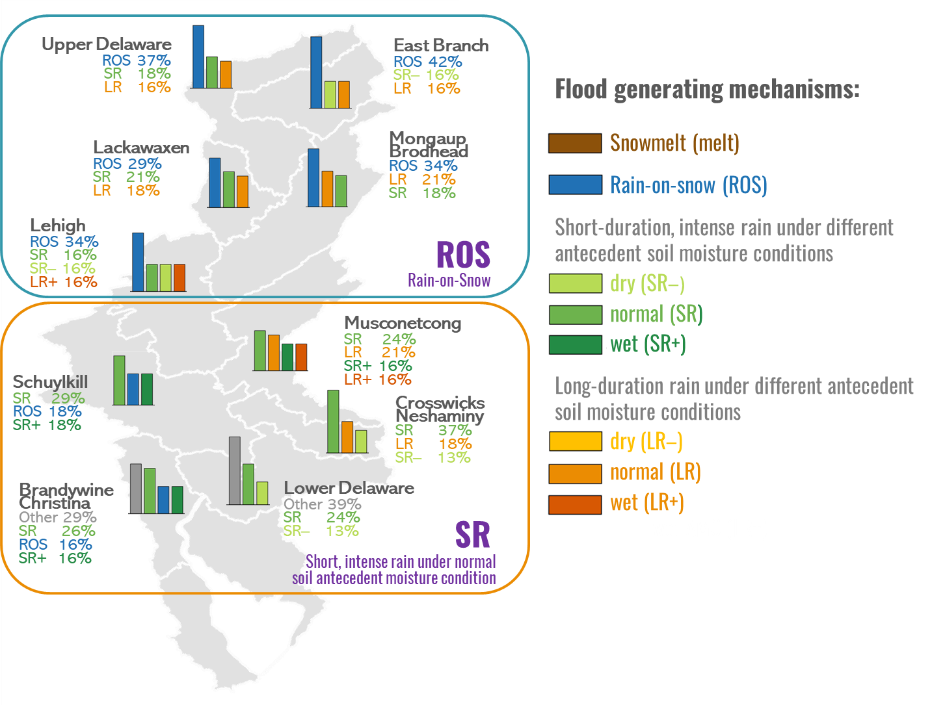
Future Climate to Intensify Extreme Floods and Shift Flood Generating Mechanisms in the Delaware River Basin
Objective
Predict future flood hazards and analyze the underlying drivers of changes across the Delaware River Basin, considering the uncertainties in climate projections.
Approach
Use a process-based hydrological model for analyzing the hydrometeorological condition of past and future flood events at the subbasin level.
Identify dominant generating mechanisms for each flood event, including snowmelt, rain-on-snow, and short-duration and long-duration rainfall under dry, wet, and normal antecedent soil moisture conditions.
Analyze future flood projections under 20 General Circulation Model (GCM) scenarios, highlighting both agreement and discrepancies in projected floods and dominant flood mechanism.
Impact
Future flood projections based on ensemble GCM scenarios indicate a regional intensification of flooding. In the high-elevation Upper Basin, a shift in the timing of floods is anticipated, from historical spring events caused by rain-on-snow to sporadic events driven by short, intense rain throughout the year. These changes collectively present greater challenges for future flood management efforts.
Simulations of 40-year historical flood events in the Delaware River Basin reveal that floods in the Upper Basin (blue box) are primarily caused by rain-on-snow (ROS) events, whereas the Lower Basin (orange box) is dominated by short, intense rainfalls (SR). Only the top three or four flood generating mechanisms are displayed for each subbasin, based on historical percentage contributions to flood occurrences.
Sun N., M.S. Wigmosta, H. Yan, H.A. Eldardiry, Z. Yang, M. Deb, and T. Wang, et al. Amplified Extreme Floods and Shifting Flood Mechanisms in the Delaware River Basin in Future Climates. Earths’ Future 12(3), e2023EF003868 (2024). [DOI: 10.1029/2023EF003868]
Notes:
http://www.pnnl.gov/science/highlights/highlights.asp?division=749

